Slide 1
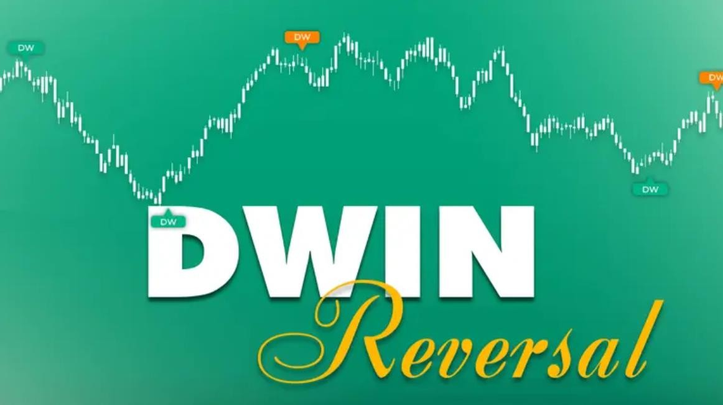
Why Free Indicators Are a Smart First Step for New Traders
Starting on your trading path can seem like embarking into a
stormy sea, thrilling but daunting. With platforms like NinjaTrader
8 providing an enormous selection of tools to work with, where do you start? Here are the free indicators for NinjaTrader that enable beginners to get their feet on the ground without breaking the bank. These free resources aren’t filler; they’re action-packed stepping stones that raise confidence, hone skills, and unlock the full potential of your trading environment.
Today, we’ll delve into the importance of beginning with free NinjaTrader 8 indicators, highlighting tools such as ninZaRenko, and provide practical advice on transitioning to premium alternatives.

Slide 2
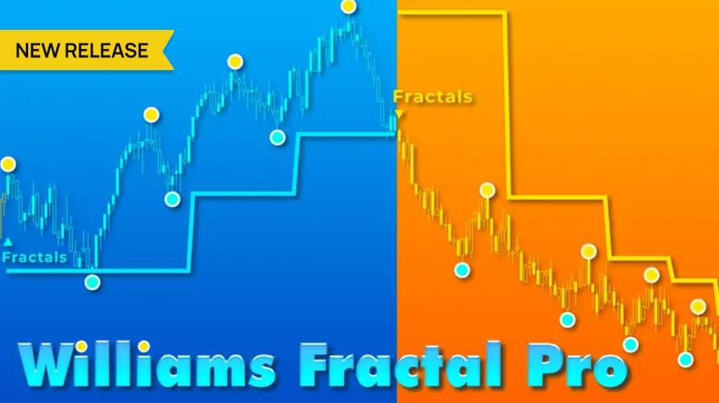
The Benefits of Starting Free
Free indicators for NinjaTrader offer an inexpensive gateway,
discarding the hurdle of initial costs. When you’re just starting as a trader, you’re probably dealing with learning curves: learning
market dynamics, learning chart analysis, and becoming familiar with software interfaces.
Spending money on advanced tools upfront could bring guilt if they don’t fit your style. Free options allow you to try out ideas freely, experimenting with strategies in real or virtual worlds without risking your pocket.
Discovering ninZaRenko: A Case Study
Consider ninZaRenko, a widely used free Renko bar indicator, as an exemplary case. Renko charts eliminate market chaos by emphasizing movement in price over time, and therefore, they are perfect for trend detection in unpredictable markets such as

Slide 3

futures or forex. You can immediately understand how ninZaRenko makes visualization easier by simply downloading and installing it on your NinjaTrader 8 platform.
This tool is not only simple, it’s also strong enough for serious testing, so you can use it with integrated features such as moving averages or RSI. By experimenting, you’ll discover the platform’s strengths, ability to customize workspaces, backtest on historical data, and combine with the Market Analyzer for multi-instrument scans.
Building Discipline and Community
Aside from discovery, indicators for NinjaTrader 8 also foster discipline and risk sensitivity. Novice traders typically are prone to over-reliance on signals, but beginning to trade on your own
makes you think for yourself. You’ll become skilled at cross- checking indicators with unfiltered price data, bypassing the
pitfalls of false breakouts in markets.

Slide 4

And most free tools have community forums or tutorials that link you to experienced users for advice. This social element makes solo learning a social journey, enhancing motivation and avoiding loneliness.
Moving to Paid Indicators
Naturally, free indicators have limitations; maybe they do not have advanced customization, multi-timeframe analysis, or real- time alerts. That’s where moving to paid choices becomes crucial. After perfecting your fundamentals with something like ninZaRenko, evaluate your requirements: Do you desire order flow depth or automated strategies?
Begin by determining the gap areas in your free setup, then look for paid indicators for NinjaTrader from established providers. Try paid demos if offered, and utilize exchange policies for flexibility. This step-by-step approach keeps costs low and growth high, transforming you from beginner to agile trader.

Slide 5
Conclusion: Start Smart, Scale Confidently
The free NinjaTrader 8 indicators are not just starters; they’re blueprints for developing a strong trading mindset. By experimenting with tools such as ninZaRenko, you trigger platform mastery and set the path for sophisticated features, at your own pace.
Ready to take it to the next level? Find best-of-breed indicators for NinjaTrader at ninZa.co, where 50,000+ users get lifetime perks, award-winning support, and innovative solutions designed for success. Join now and trade wiser!

