Slide 1

Coventry Clicks: Affordable, High-Quality Web Design
Coventry Clicks offers professional low-cost websites tailored to your needs. Perfect for small businesses and startups, our affordable solutions provide sleek designs, mobile optimization, and user-friendly functionality. Build your online presence without breaking the bank. Trust Coventry Clicks for quality websites that deliver results at budget-friendly prices.

Slide 2
Empowering Startups and Small Businesses
Affordable Web Design
High-Quality Sites
Cost-effective solutions tailored to your budget.
Sleek, user-friendly websites that drive results.

Slide 3
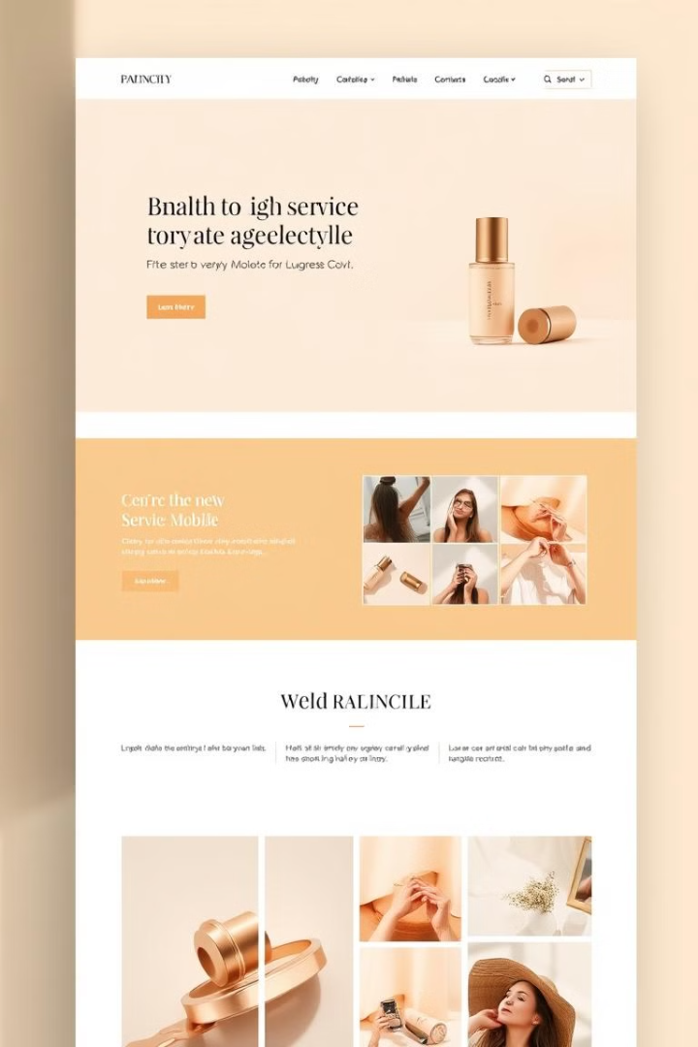


Sleek Designs, Seamless Navigation
Modern Aesthetics
Effortless User Flow
Visually appealing and engaging designs.
Easy navigation for a seamless user experience.

Slide 4



Mobile-Optimized for Today's Consumers
Responsive Design
Mobile First
Websites adapt to any screen size.
Optimized for optimal mobile browsing.

Slide 5
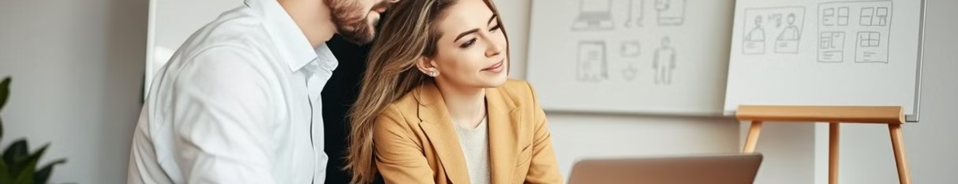
Tailored Solutions, Personalized Approach
Custom Design
Targeted Content
Unique websites that reflect your brand identity.
Content tailored to your specific audience.

Slide 6



Robust Functionalities, Exceptional User Experience
1
Seamless Navigation
2
Interactive Features
3
Strong Call to Action

Slide 7

Cost-Effective Pricing, Uncompromising Quality
1
2
Budget-Friendly
High-Quality Standards
Affordable plans for every business need.
Exceptional craftsmanship and attention to detail.

Slide 8
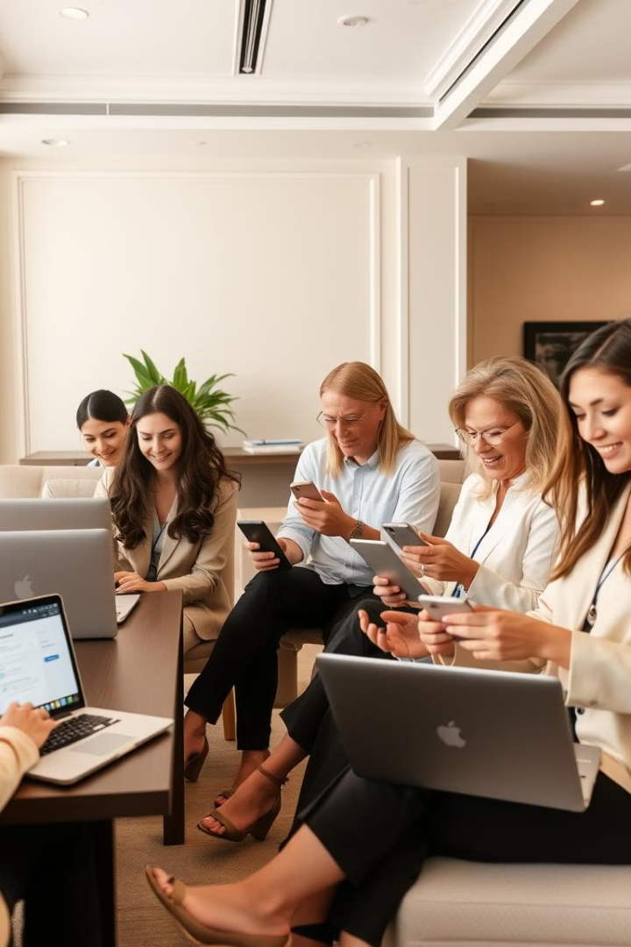
Elevate Your Online Presence with Coventry Clicks
Get a professional, mobile-optimized website for your business. Our services will help you grow and thrive online.

