Slide 1

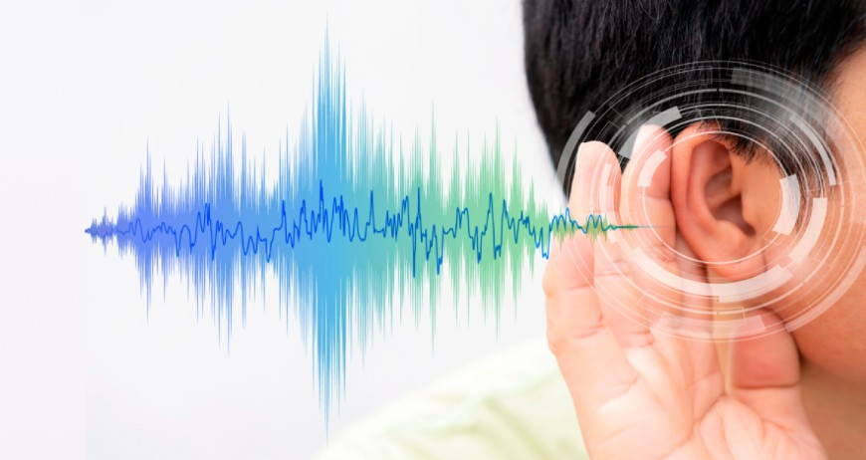
Education Near Punjabi Bagh: Hearing test near Punjabi Bagh
Hearing is among the most significant senses that help us to be attached to the world. Now be it talking with your loved ones, listening to music or just being conscious of what is going on around you, good hearing is an important part of life. You are already on the right track to hearing health as long as you are looking to take a hearing test near Punjabi Bagh.
In Kavya Speech and Hearing Clinic, you will find highly qualified audiologists that offer high-quality diagnostic services and individual treatment to restore normal hearing.
The reason why you should consider having a hearing test near Punjabi Bagh
Very little is done about the initial symptoms of hearing impairment when people believe it is a temporary condition. Nevertheless, hearing problems may impact communication and
self-confidence as well as the quality of life when untreated. If you often:
Ask individuals to repeat.
Increase TV volume frequently
Fight against noise conditions.
Hear ringing in your ears.
Then we need to reserve a hearing test near Punjabi Bagh.

Slide 2
Professional hearing test near Punjabi Bagh is helpful to identify the issues at the initial stage and guarantee the treatment in a timely manner to avoid further problems.
What occurs in a hearing test near Punjabi Bagh
It is easy, non-painful and fast when you visit a clinic to get a hearing test in the vicinity of Punjabi Bagh. At Kavya Speech and Hearing Clinic, there are trained audiologists who carry out the hearing assessment of you using advanced equipment.
Case History
Your audiologist will inquire about the symptoms, medical history and lifestyle.
Ear Examination
The ear canal is examined to determine the presence of wax, infection or obstruction.
Pure Tone Audiometry (PTA)
This test identifies your hearing level with various frequencies.
Impedance Audiometry
This tests the functioning of the middle ear, and identifies problems such as imbalance of fluid or pressure.
OAE & BERA Tests
Complex cases and children are tested with advanced tests such as OAE and BERA. These tests are all combined in a detailed hearing test in the vicinity of Punjabi Bagh so as to diagnose properly.
Advantages of having a Hearing Test near Punjabi Bagh
Having a trusted hearing test near Punjabi Bagh has a number of benefits:
✔ Early Detection
Early hearing test near Punjabi Bagh is a way of detecting hearing loss before it becomes severe.
✔ Better Communication
A hearing test in and around Punjabi Bagh is followed by appropriate treatment, which enhances speech clarity and comprehension.

Slide 3
✔ Customized Solutions
Clinics offer hearing aids and therapy that is personalized to your test results.
✔ Better Quality of Life.
Frequent hearing test near Punjabi Bagh can make sure you are not socially isolated or insecure.
Why Choose Kavya Speech & Hearing Clinic
In search of the most appropriate hearing test near Punjabi Bagh, it is important to select the appropriate clinic.
Experienced Audiologists
The clinic has experienced professionals in the field of hearing and speech care.
Advanced Technology
The contemporary diagnostic equipment can guarantee accurate findings in all hearing test near Punjabi Bagh.
Comprehensive Services
Everything is under one roof; Diagnosis to hearing aid fitting.
Patient-Centered Care
All hearing test near Punjabi Bagh are customized to suit the needs of the patient and make him/her feel comfortable and satisfied.
Hearing Tests available in the area of Punjabi Bagh
In case you are seeking a hearing test near Punjabi Bagh, the following are the frequent tests you can be subjected to:
Pure Tone Audiometry (PTA)
To measure the hearing levels, the most frequently used hearing test near Punjabi Bagh.
Tympanometry / Impedance Test
Used to test ear health of middle ear.
OAE (Otoacoustic Emissions)
Newborn and child friendly.
BERA (Brainstem Evoked Response Audiometry)
Higher level test of neurological hearing evaluation.

Slide 4

Kavya Speech and Hearing Clinic has these tests hence it is a reliable place to get a hearing test near Punjabi Bagh.
Indications You Have to have a Hearing Checkup around Punjabi Bagh
Not sure about the need of hearing test near Punjabi Bagh? Be aware of the following:
Hearing problems on telephone conversation.
Difficulty in comprehension in groups.
Feeling that others are mumbling
Debilitating or ringing in ears (tinnitus)
Lack of doorbells or alarms.
In case you observe any of these, do not postpone your hearing test near Punjabi Bagh.
Hearing Test Near Punjabi Bagh to Children
Children also may experience hearing problems that impact speech and learning. An early hearing test near Punjabi Bagh will help in early identification of problems.
At Kavya Speech and Hearing Clinic, children undergo special tests such as OAE and BERA.
Early identification by a hearing test near Punjabi Bagh will provide an appropriate development of speech and academic achievement.

Slide 5
Hearing Test Near Punjabi Bagh Senior Hearing Test
Hearing loss in old age is a common phenomenon. A routine hearing test near Punjabi Bagh frequently helps seniors.
Benefits include:
Improved communication with family.
Reduced social isolation
Improved mental health
Hearing test near Punjabi Bagh (routinely) is a way of making the seniors feel independent and confident.
Punjabi Bagh Near Hearing Test What to Expect
Your audiologist will discuss your hearing test results with you after your hearing test near Punjabi Bagh.
You can be recommended:
Hearing aids
Medical treatment
Speech therapy
Follow-up tests
Hearing aid trial and complete care such as hearing aid trial and fitting can also be obtained at clinics such as Kavya Speech & Hearing Clinic.
Hearing Test Before Booking tips Before Booking a Hearing Test Near Punjabi Bagh
To obtain good results with your hearing test around Punjabi Bagh, do the following tips:
No exposure to loud noises prior to the test.
Clean but do not use cotton buds deep in ears.
Bring past reports as possible.
Remain calm when taking the test.
Your hearing test near Punjabi Bagh will provide interesting results on the basis of a proper preparation.
What is the Frequency of Hearing Tests around Punjabi Bagh?
Experts recommend:
Adults: After every 1-2 years.
Seniors: Every year
Children: As advised by doctors
Hearing test routinely around Punjab bagh assists in monitoring hearing health and in identifying changes early.

Slide 6
Book Your Hearing Test near Punjabi Bagh
Do not wait in case you have any hearing problems. It is easy to book a hearing test in the neighbourhood of Punjabi Bagh and this will transform your life.
Turn to Kavya Speech and Hearing Clinic to receive professional assistance, hi-tech diagnosis, and individualized therapy.
It has one of the most reliable hearing test centers around Punjabi Bagh with professional audiologists, superior equipment, and customer-friendly services.
Conclusion
You should never neglect your hearing health. An early hearing test near Punjabi Bagh would make you be in touch, assured, and cheerful.
Regular hearing check-ups are needed whether you are a child, an adult or a senior. Select a reputable clinic such as Kavya Speech & Hearing Clinic and make the first move towards having a better hearing today.
Frequently Asked Questions - Hearing Test Near Punjabi Bagh.
What is the length of hearing test?
An audiometric examination in the vicinity of Punjabi Bagh lasts about 20-40 minutes.
Does a hearing test hurt?
No, a hearing test is totally safe and painless and it is close to Punjabi Bagh.
How much does it cost to have a hearing test?
The price of the hearing test will differ according to the type of hearing test in proximity of Punjabi Bagh.
Are children able to have a hearing test?
Well, there is a special hearing test available in Punjabi Bagh to children.
Does the test require hearing aid?
It may only be recommended by the audiologist when the hearing test in the area of Punjabi Bagh indicates hearing loss.

