Slide 1


Quora Web Solution
Website Design and
Development
Company
Web Design & Web Development
Company in Bangalore, India
www.quorawebsolution.com
+91 9986 056 909
info@quorawebsolutions.com
24A, 1st Main Rd, Chandra Reddy
Layout, Koramangala 4th Block,
Koramangala, Bengaluru,
Karnataka 560034

Slide 2
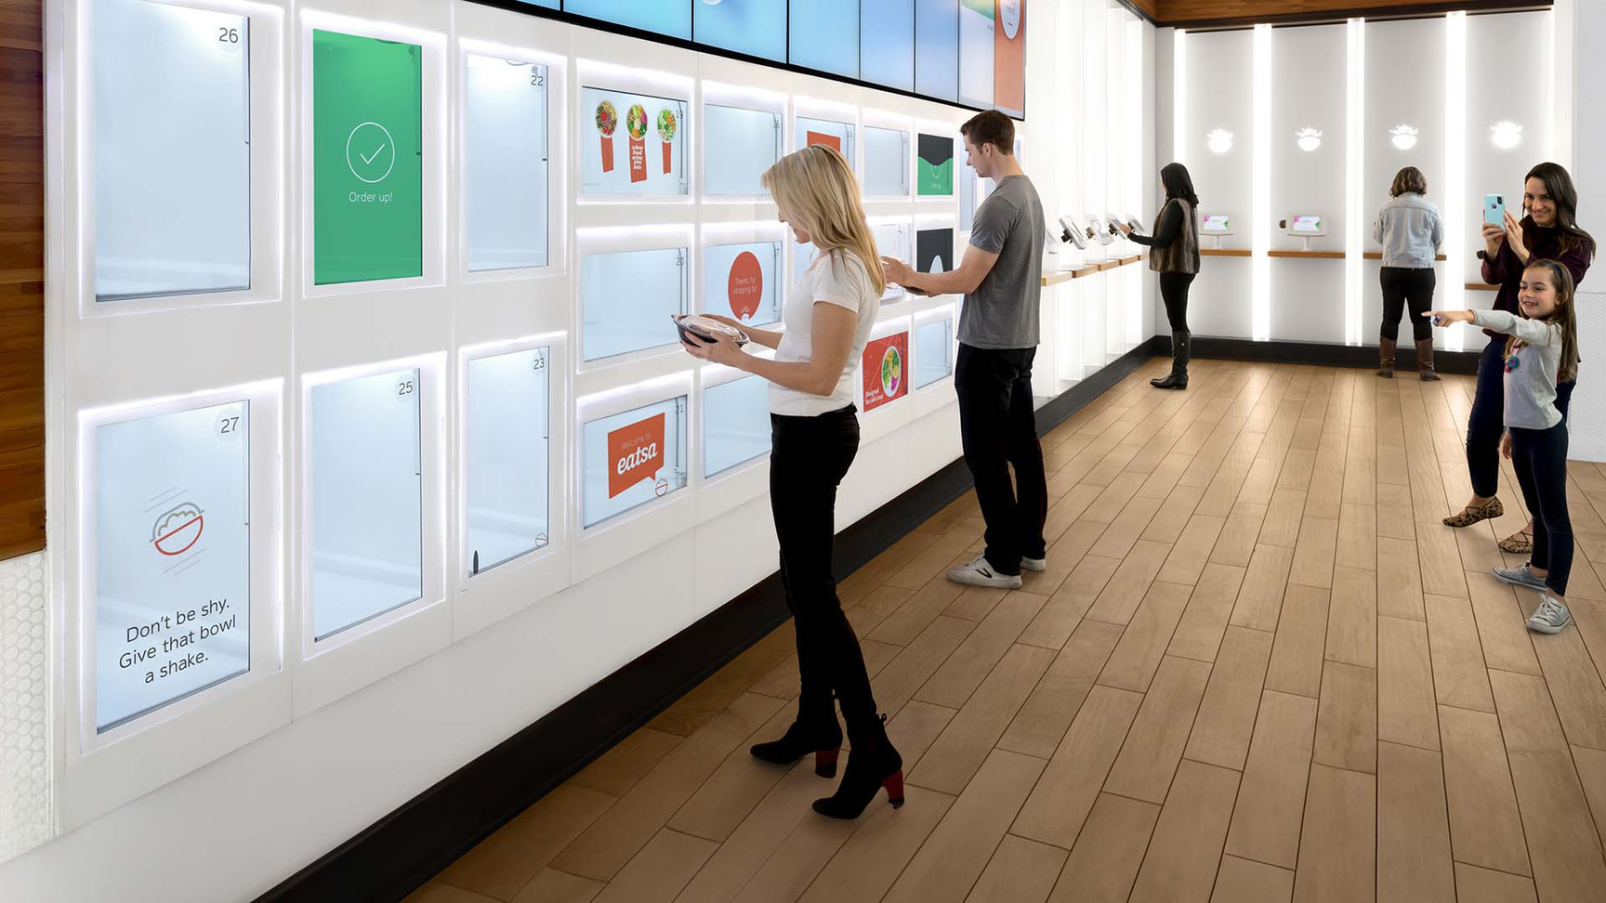
Crafting Captivating Digital Experiences: A Comprehensive Guide to Website Design and Development Companies
www.quorawebsolution.com

Slide 3

In today's digital age, a well-designed and functional website is no longer just a luxury but a necessity for businesses of all sizes.
www.quorawebsolution.com

Slide 4

A visually appealing and user-friendly website not only enhances your brand image but also improves customer engagement, drives conversions, and ultimately boosts your bottom line.
www.quorawebsolution.com

Slide 5

Whether you're building a website from scratch or using a website builder, a robust online presence can significantly impact brand visibility, customer engagement, and overall business success.
www.quorawebsolution.com

Slide 6
This is where website design and development companies come into play. These specialized firms possess the expertise to transform your digital vision into reality, creating stunning websites that leave a lasting impression and captivate your target audience.
A well-designed website can help you:
  Establish your brand identity: Your website is often the first impression potential customers have of your business. A visually appealing and well-organized website can help you establish a strong brand identity and differentiate yourself from your competitors.
  Improve customer engagement: A user-friendly website that is easy to navigate and provides a seamless user experience can help you keep visitors engaged and encourage them to return.
www.quorawebsolution.com

Slide 7
  Drive conversions: Whether you're selling products, services, or generating leads, a well-designed website can help you convert visitors into customers. By using persuasive calls to action, compelling content, and effective lead capture forms, you can increase your conversion rates.
  Boost your bottom line: A strong online presence can help you reach a wider audience, generate more leads, and increase your sales. By investing in a high-quality website, you can improve your return on investment (ROI) and grow your business.
What Do Website Design and Development Companies Do?
Website design and development companies offer a wide range of services to help businesses establish a strong online presence, including website building. Their core responsibilities typically include:
www.quorawebsolution.com

Slide 8
  Website Design: Creating visually appealing and user-friendly website layouts, incorporating branding elements, and ensuring a seamless user experience.
  Web Development: Building the technical infrastructure of the website, including coding, programming, and database integration.
  E-commerce Development: Designing and developing online stores, integrating payment gateways, and managing inventory.
  Content Management Systems (CMS):: Implementing CMS platforms like WordPress or Drupal to enable easy content updates and management.1
www.quorawebsolution.com

Slide 9
  Search Engine Optimization (SEO): Optimizing websites to improve search engine rankings and attract organic traffic.
  Digital Marketing: Leveraging digital marketing strategies to promote websites and generate leads.
  Web Hosting: Providing server space and domain name registration to keep websites online.
  Website Maintenance: Regularly updating, securing, and backing up websites to ensure optimal performance.
Why Choose a Website Design and Development Company?
  Expertise and Experience: These companies have skilled professionals who stay updated with the latest web technologies and design trends.
www.quorawebsolution.com

Slide 10
  Customized Solutions: They tailor their services to meet the unique needs and goals of each client.
  Time and Cost-Effective: Outsourcing website design and development can save time and resources for businesses.
  Professionalism and Quality: They deliver high-quality websites that are visually appealing, functional, and responsive.
  Scalability: They can adapt websites to accommodate future growth and evolving business requirements.
How to Choose the Right Website Design and Development Company
When selecting a website design and development company, consider the following factors:
  Portfolio: Review their past projects to assess their design aesthetic and technical capabilities.
  Experience: Look for companies with a proven track record and experience in your industry.
www.quorawebsolution.com

Slide 11
  Communication: Effective communication is crucial, so choose a company that listens to your needs and provides clear updates.
  Pricing: Get quotes from multiple companies and compare pricing models to find the best fit for your budget.
  SEO Expertise: If SEO is a priority, ensure the company has a strong understanding of SEO best practices.
  Responsive Design: A responsive website adapts to different screen sizes, ensuring a seamless user experience across devices.
By partnering with a reputable website design and development company, you can unlock the full potential of your online presence and drive business growth.
Elevate Your Digital Presence: The Power of Expert Website Design and Development
www.quorawebsolution.com

Slide 12
In today's digital age, a well-designed and functional website is no longer a luxury but a necessity.1 It serves as the digital face of your business, influencing how customers perceive your brand and engage with your products or services.2 A robust online presence can significantly impact brand visibility, customer engagement, and overall business success.3
The Role of Website Design and Development Companies
Website design and development companies specialize in creating and maintaining websites that are both aesthetically pleasing and highly functional.4 They possess the expertise to transform your digital vision into a reality, crafting stunning websites that leave a lasting impression.
Key Services Offered by Website Design and Development Companies:
  Website Design: Creating visually appealing and user-friendly website layouts, incorporating branding elements, and ensuring a seamless user experience.5
www.quorawebsolution.com

Slide 13
  Web Development: Building the technical infrastructure of the website, including coding, programming, and database integration.6
  E-commerce Development: Designing and developing online stores, integrating payment gateways, and managing inventory.7
  Content Management Systems (CMS): Implementing CMS platforms like WordPress or Drupal to enable easy content updates and management.8
  Search Engine Optimization (SEO): Optimizing websites to improve search engine rankings and attract organic traffic.9
  Digital Marketing: Leveraging digital marketing strategies to promote websites and generate leads.10
  Web Hosting: Providing server space and domain name registration to keep websites online.11
www.quorawebsolution.com

Slide 14
  Website Maintenance: Regularly updating, securing, and backing up websites to ensure optimal performance.12
Why Choose a Website Design and Development Company?
  Expertise and Experience: These companies have skilled professionals who stay updated with the latest web technologies and design trends.13
  Customized Solutions: They tailor their services to meet the unique needs and goals of each client.14
  Time and Cost-Effective: Outsourcing website design and development can save time and resources for businesses.15
  Professionalism and Quality: They deliver high-quality websites that are visually appealing, functional, and responsive.
  Scalability: They can adapt websites to accommodate future growth and evolving business requirements.
www.quorawebsolution.com

Slide 15
How to Choose the Right Website Design and Development Company
When selecting a website design and development company, consider the following factors:
  Portfolio: Review their past projects to assess their design aesthetic and technical capabilities.16
  Experience: Look for companies with a proven track record and experience in your industry.
  Communication: Effective communication is crucial, so choose a company that listens to your needs and provides clear updates.17
  Pricing: Get quotes from multiple companies and compare pricing models to find the best fit for your budget.
  SEO Expertise: If SEO is a priority, ensure the company has a strong understanding of SEO best practices.
www.quorawebsolution.com

Slide 16
  Responsive Design: A responsive website adapts to different screen sizes, ensuring a seamless user experience across devices.18
By partnering with a reputable website design and development company, you can unlock the full potential of your online presence and drive business growth.
Ready to Elevate Your Digital Presence?
Contact us today to discuss your project and learn how we can help you achieve your digital goals.
www.quorawebsolution.com

Slide 17
Quora Web Solution: Quora Web Solution is a trusted website development company based in Bangalore, India, offering a wide array of services to not only domestic but global clientele. Be it Website Design and Development, SEO services, Digital Marketing, Branding, App Development, Ecommerce Solution, and Logo Creation . Quora Web Solution has the best website developers offering top quality services and that is the reason why we are well known as one of the best Website Development Companies in Bangalore, India.
Visit Us - www.quorawebsolution.com
Call Us - +91 9986 056 909
Mail Us - info@quorawebsolutions.com
www.quorawebsolution.com

Slide 18

WORDPRESS DEVELOPMENT
ECOMMERCE DEVELOPMENT
PHP DEVELOPMENT
CMS DEVELOPMENT
DRUPAL DEVELOPMENT
WEBSITE SERVICES
WEBPORTAL DEVELOPMENT
MAGENTO DEVELOPMENT
WEBSITE DEVELOPMENT
JOOMLA DEVELOPMENT
SMALL BUSINESS DEVELOPMENT
CHEAP WEBSITE DEVELOPMENT
STATIC WEBSITE DEVELOPMENT
DYNAMIC WEBSITE DEVELOPMENT
WEBSITE DESIGN COMPANY
TOUR AND TRAVEL WEBSITE DEVELOPMENT
Services

