Slide 1

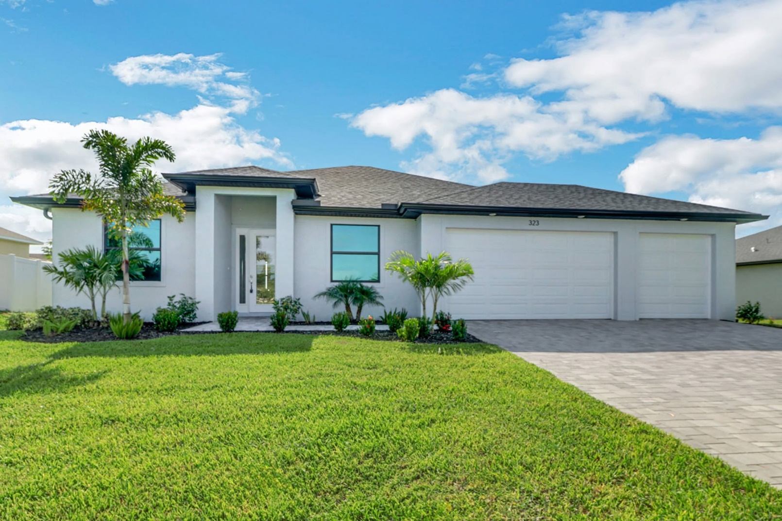
How Affordable Home Builders Cape Coral FL Help You Save More

Slide 2

Affordable home builders Cape Coral FL will build top-quality homes without spending a lot of cash. You might think that building a house can be expensive. In that case, you are wrong. These home builders know how to save money while building. Here, we have explained how they can help you save more.
1. Use Bulk Buying to Lower Prices
A custom home builder will purchase materials for only one house. It can be more expensive. On the other hand, affordable home builders will purchase in bulk. This is because they build many houses at the same time. Therefore, the cost of the purchase will not be more. For example, one can mention buying windows, nails, and so on. Consequently, you need not spend much on building the house. The cost of every item is less. One can compare it to buying food in a family pack.
2. You Get Energy-Efficient Features Included
Staying in modern, affordable homes provides certain advantages. One of these is saving money. This can be done with the help of energy-saving appliances. For example, you can mention special windows capable of blocking heat. You don’t need to pay a lot of money on energy bills. Affordable home builders Cape Coral FL, also install thermostats in modern houses. There is also no need for you to pay extra for upgrades. It is beneficial for you as well as the planet.
3. Do Not Spend Much on Ads
An affordable home builder will not spend much money on ads. For example, one can talk about big signs.

Slide 3
On the contrary, they convey information to their known people. Satisfied purchasers share the good news. No costly ads will be needed for this. They also do not have any fancy showrooms. Therefore, the price of homes will be low. It is essential for you to make payments only for the house. You need not pay for any big signs.
4. Build Homes Very Fast
On most occasions, home builders will consume plenty of time while building. They might even take one year to do so. You need to go on paying rent during this period. However, you can save money when the house is built quickly.
We hired an affordable builder to construct our building in Florida. The good thing is that they did the job within several months. Thus, we could stop paying rent after moving in fast. We could also spend the saved cash on other essential aspects.
Winding up
While building your house, you need the appropriate builder. Affordable home builders Cape Coral FL purchase many things at one go. They also help save energy while using proper plans. They do not waste any materials. You don’t need to pay any extra charges. Thus, you can expect these builders to provide you with a nice home at an affordable rate.

Slide 4

For More Details Contact Us :
Name: Sposen Signature Homes
Address: 2311 Santa Barbara Blvd, Suite 112, 33991 Cape Coral, Florida, USA
Telephone: 239-244-8886
Email id: hello@sposenhomes.com
Website: https://sposenhomes.com

