Slide 1







KNOW ALLEGIANT CARRY-ON SIZE RULES BEFORE YOU FLY
Essential Information on Allegiant Air Carry On Bag Size and Baggage Policies
+1-888-212-0809

Slide 2


OVERVIEW OF ALLEGIANT AIRLINES BAGGAGE POLICY
Allegiant Air maintains specific carry-on and checked baggage policies that every traveler should review before booking. Understanding the allegiant carry on size requirements and allegiant airlines baggage weight limits is essential to avoid unexpected fees or boarding complications at the gate.
Baggage policies can vary by route, fare type, and booking date, making it crucial to verify the latest rules before you fly. Checking Allegiant's official guidelines in advance ensures a smooth travel experience and helps you pack with confidence — avoiding costly surprises at the airport.

Slide 3

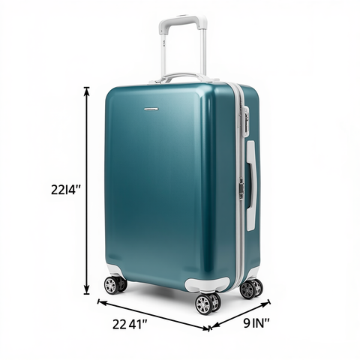
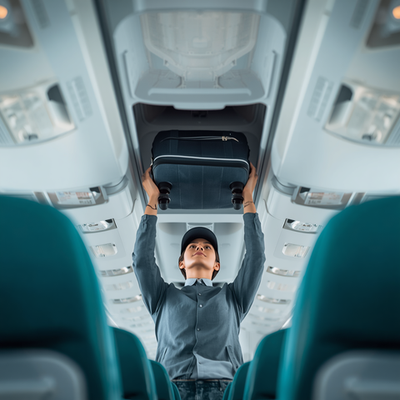
ALLEGIANT CARRY-ON SIZE RESTRICTIONS
Allegiant Air carry-on bag size must not exceed 22 x 14 x 9 inches, including handles and wheels. This applies to bags placed in the overhead bin. Any item exceeding these dimensions may be required to be checked at the gate, incurring additional fees.
What counts toward carry-on dimensions: the total exterior measurement including all pockets, handles, and wheels. Personal items such as purses or laptop bags must fit under the seat. Always measure your bag before arriving at the airport to ensure full compliance with Allegiant carry-on size rules.

Slide 4
WEIGHT LIMITS & BAGGAGE FEES
✈ Carry-On Weight: No explicit weight limit is enforced for carry-on bags. However, your bag must be manageable enough to lift and stow in the overhead bin or fit under the seat in front of you without assistance.
⚖ Checked Baggage Max Weight: 40 lbs (18 kg) per bag. Allegiant Airlines enforces a strict 40-pound limit on all checked luggage. Bags exceeding this limit will be subject to overweight baggage fees at the airport.
💲 Overweight Bag Fees: Fees for overweight checked bags start at $50 and increase based on the amount of excess weight. Always use a luggage scale before heading to the airport to avoid unexpected charges and travel delays.

Slide 5







IMPORTANT RULES & TIPS BEFORE YOU FLY WITH ALLEGIANT
Pack according to Allegiant Air carry-on bag size rules (22 x 14 x 9 inches) to avoid delays at the gate. Ensure your bag fits in the overhead bin or under the seat before arriving at the airport.
Use a luggage scale to check your Allegiant suitcase weight before heading to the airport. Checked bags must not exceed 40 lbs (18 kg) — overweight fees start at $50 and increase with excess weight.
Always check the latest Allegiant Airlines baggage weight and size policies on their official website before travel. Policies may change, and staying informed helps ensure a smooth, fee-free flying experience.

Slide 6


THANK YOU!
Safe travels! Visit Allegiant Airlines' official baggage policy page for the latest updates before you fly.

