Slide 1
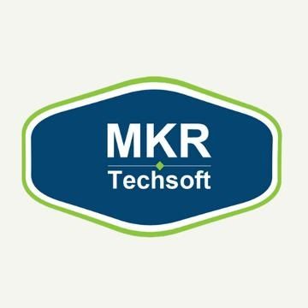

SEO Service Packages Salt Lake City
Transform your website’s success by using our SEO service packages in Salt Lake City, combining expert SEO strategies for more traffic & better search rankings.

Slide 2

Professional SEO Company in Salt Lake City
Discover the change with our professional SEO company in Salt Lake City that helps your website rank higher & brings more traffic to care your business growth.

Slide 3

Website SEO Package Salt Lake City
Unlock your site’s latent with our website SEO package in Salt Lake City crafted to rally rankings, increase organic traffic, & help your business grow locally.

Slide 4
At MKR Techsoft Private Limited, we help businesses grow online with affordable SEO in Salt Lake City. Our tailored strategies deliver real results for startups, small businesses, and enterprises.
Contact No - (213) 396-7034
Website - https://www.mkrtechsoft.com/salt-lake-city-seo-packages/
Address:- 10730, White Oak Avenue Suite 115 Granada Hills, CA 91344

