Slide 1
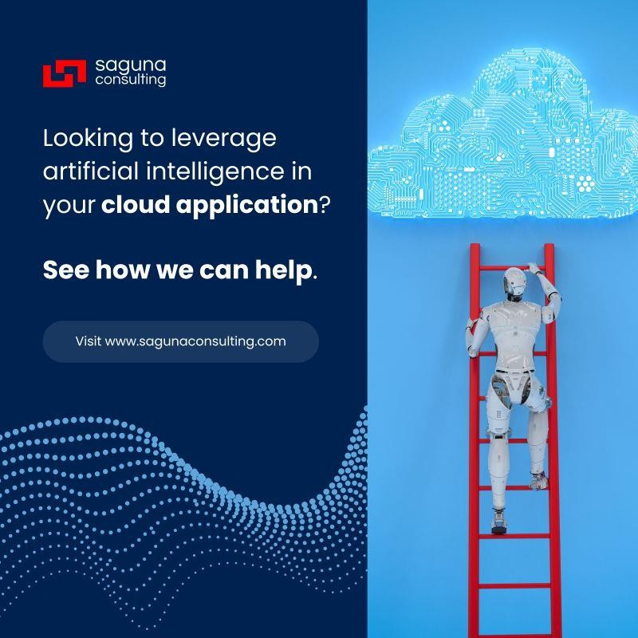
The cloud is no longer just about storage and scalability—it's becoming the foundation for intelligent applications that transform businesses.
At Saguna Consulting, we're helping organizations harness the full potential of cloud-native applications enhanced with artificial intelligence capabilities. Our development approach combines cloud architecture expertise with practical AI implementation to deliver solutions that:
Process and analyze data at scale to uncover actionable insights
Automate complex workflows to increase operational efficiency
Deliver personalized experiences that adapt to user behavior
Scale intelligently based on real-time demands
Whether you're modernizing legacy systems or building new cloud-native applications, our team brings the technical depth and strategic vision needed to implement AI effectively within your cloud environment.
From initial architecture design through deployment and ongoing optimization, we ensure your cloud applications leverage the right AI capabilities to address your specific business challenges.
Ready to explore how intelligent cloud applications can drive innovation for your organization? Visit
https://lnkd.in/gQFTSafj

