Slide 1

Leave Counseling Resources
Explore leave counseling resources to navigate mental health leave with expert guidance, forms support, and stress-free planning. Gain more insights with us!

Slide 2
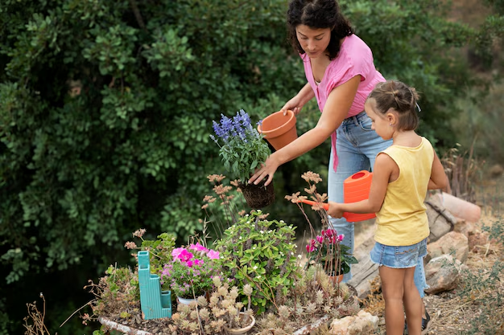
Impact Garden Donations
Support meaningful Impact Garden donations that turn small acts of care into lasting change via community support, healing initiatives & compassionate giving.

Slide 3
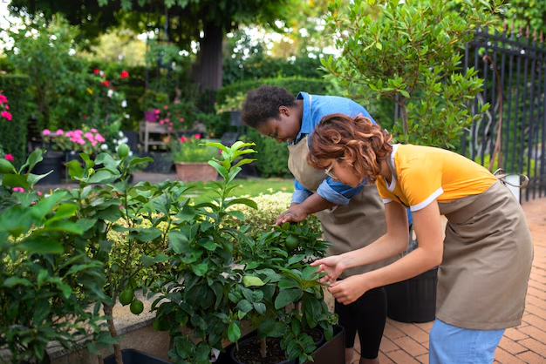
Small Acts Big Change
Inspired by the belief that small acts big change, this initiative highlights how everyday kindness and intentional giving can transform lives and communities.

Slide 4

Contact Us
Bio: Heal Before Work supports Californians facing burnout & stress with therapy, SDI leave counseling, psychological tests, & telehealth services, helping individuals access mental health leave with care.
Phone Number : 5104395706
Address: 1990 N. California Blvd., 8th Floor, Walnut Creek, CA 94596, United States
Website: https://healbeforework.com/

