Slide 1


How Much You'll Pay for Vegas Cash Vaults

Slide 2

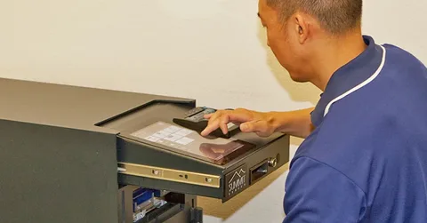
Why vault pricing shifts so much across Vegas
Volume leads pricing talks. Higher counts raise labor needs. More eyes and checks raise time spent per drop. Route planning also adds weight. Short routes cost less. Wide service areas raise fuel and crew time. Timing matters too. Late night or early morning service adds a premium due to risk and staffing needs.

Slide 3
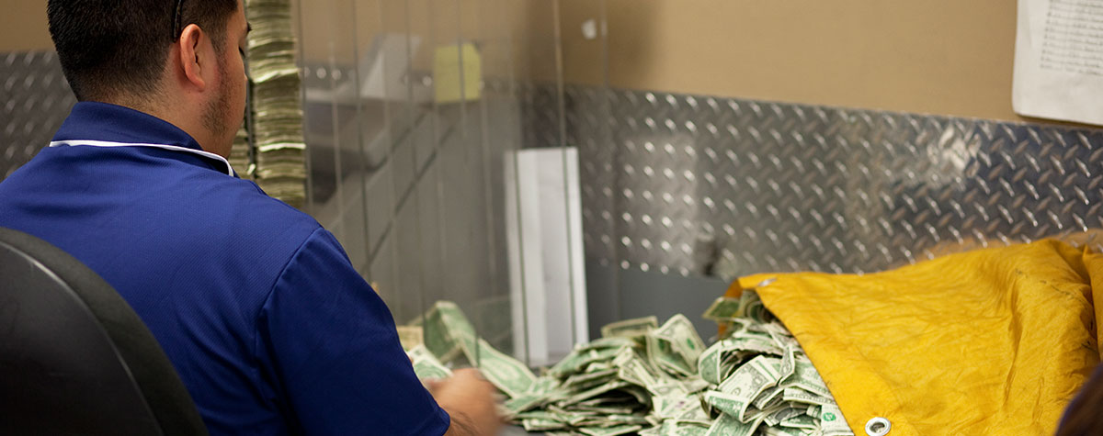
Vault services go beyond storage alone
Some owners expect a vault fee to cover a locked room and little else. Real vault service offers far more. Secure receipt. Verified counts. Dispute logs. Digital reports. Change prep. Deposit prep. Each add on shapes total cost. Count accuracy drives value. Dual count systems cut loss risk. That adds staff hours. Tech also shifts pricing. Smart safes reduce staff time and lower loss exposure. Vault firms that pair tech with manual checks often price higher yet save money across longer use.

Slide 4
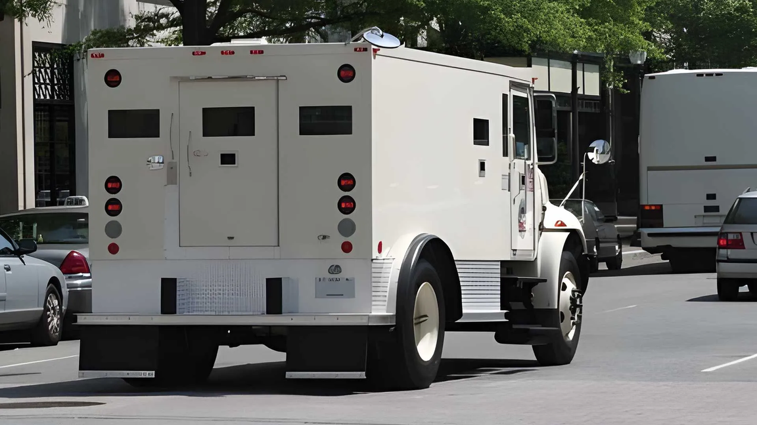
How Vegas risk levels affect vault fees
Vegas carries a unique risk profile. Tourist flow stays high. Cash draw stays visible. That raises security needs. Vault providers factor local crime data, pickup timing, and route exposure. Higher risk zones raise fees due to extra safeguards. Armored support often pairs with vault use. That bundle affects pricing too. One vendor handling both vault and transport often offers better value than split contracts.

Slide 5
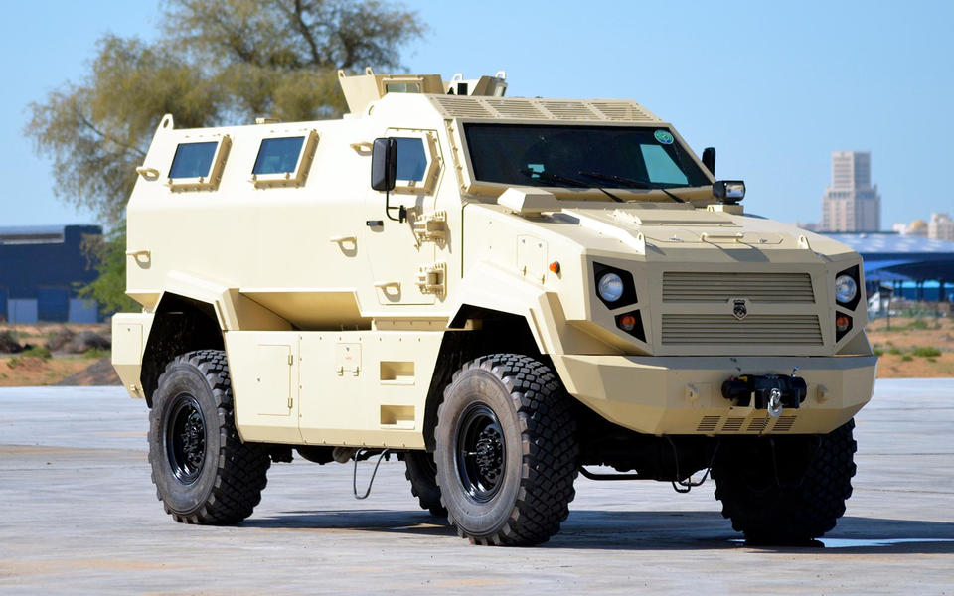
Hidden costs many firms miss early
Some fees hide until later. Rush change orders cost more. Extra pickups raise bills. Failed access attempts add charges. Schedule changes close to service time also add cost. Another common cost sits with poor prep. Unsorted bills slow counts. Loose bags delay checks. That extra time shows up on invoices. Staff training helps reduce those fees over time.

Slide 6



CONTACT US
www.sectransecurity.com
P.O.Box 227267 Los Angeles, CA 90022
(562)-(948)-(1446)
info@sectransecurity.com

