Slide 1

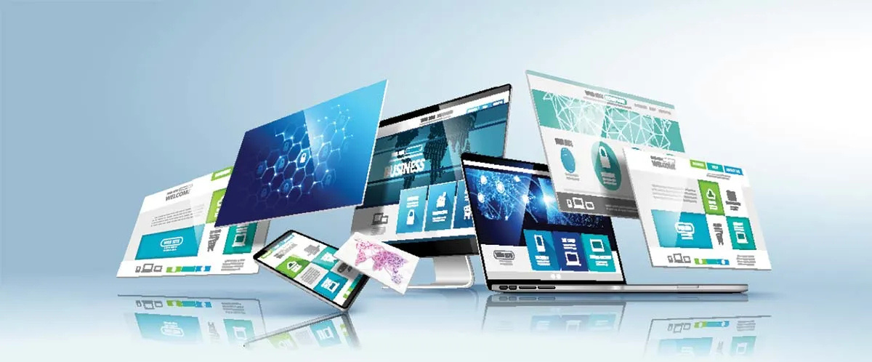
Quora Web Solution
Website Design and
Development
Company
Web Design & Web Development
Company in Bangalore, India
www.quorawebsolution.com
+91 9986 056 909
info@quorawebsolutions.com
24A, 1st Main Rd, Chandra Reddy
Layout, Koramangala 4th Block,
Koramangala, Bengaluru,
Karnataka 560034

Slide 2
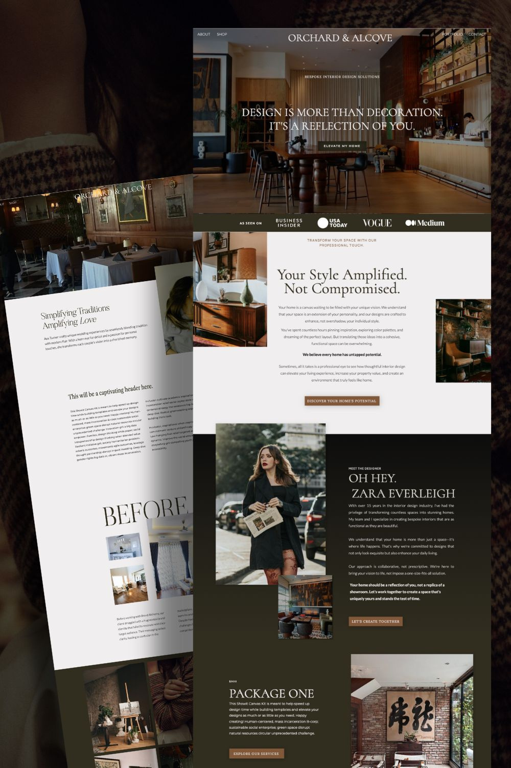
Why Professional Website Design Matters More Than Ever for Law Firms, Doctors, and Consultants
In today’s digital-first world, your website is often the first impression potential clients have of your business. Whether you're a lawyer, doctor, or consultant, a professionally designed website isn’t just a luxury — it’s a necessity.
1. Builds Trust Instantly
Clients seeking legal, medical, or professional advice are looking for someone credible.
www.quorawebsolution.com

Slide 3
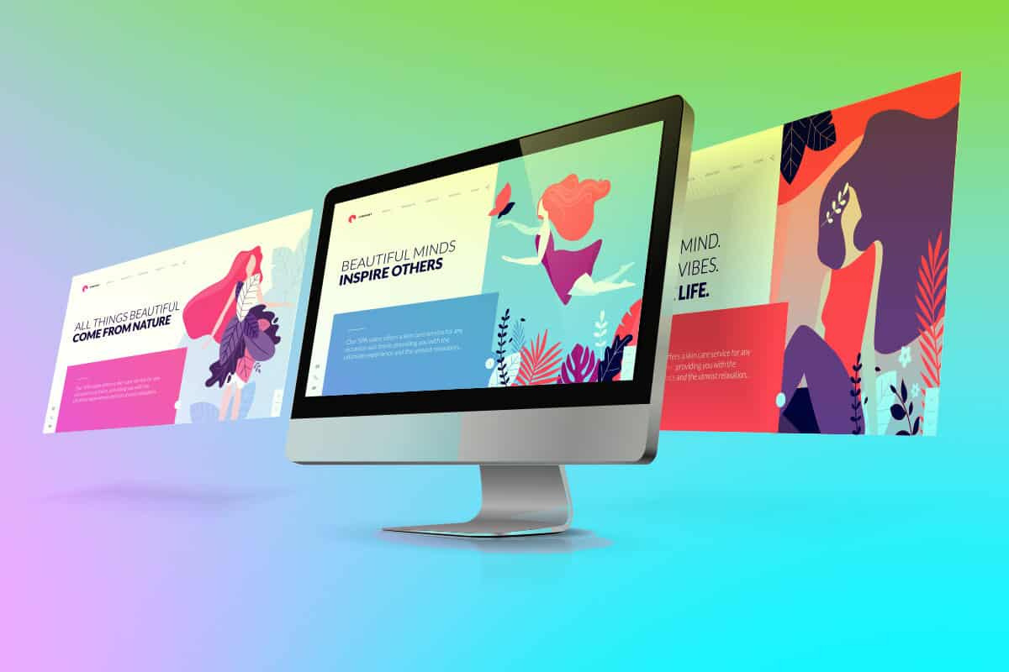
A clean, modern, and well-structured website conveys professionalism and builds trust. An outdated or poorly designed site, on the other hand, can instantly drive visitors away.
2. Improves Client Conversion
A well-designed website guides visitors toward action — whether it’s booking an appointment, calling your office, or filling out a consultation form.
www.quorawebsolution.com

Slide 4

Clear navigation, strategic call-to-actions, and mobile-friendly design make it easier for users to take that next step.
3. Showcases Expertise
A good website allows professionals to highlight their services, credentials, client testimonials, and case studies.
www.quorawebsolution.com

Slide 5
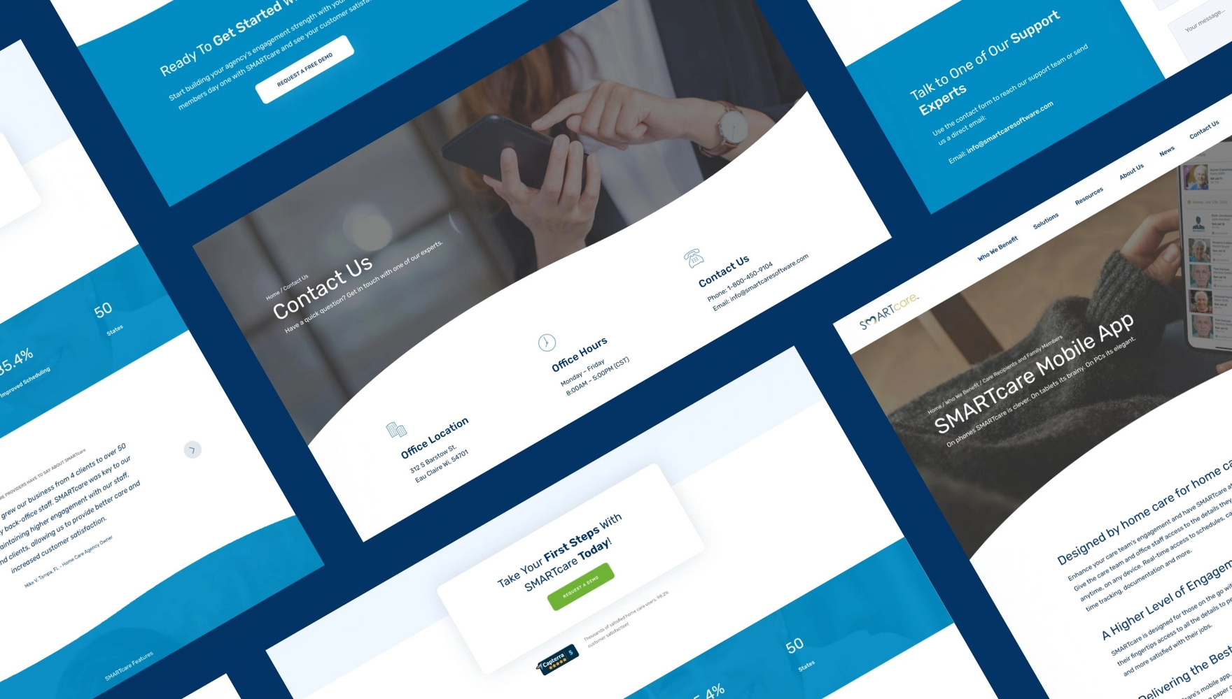
For consultants, this means building authority. For doctors and lawyers, it reinforces reliability and knowledge in their fields.
4. Optimized for Local SEO
www.quorawebsolution.com

Slide 6
Professional web developers also ensure your site is optimized for search engines, especially for local searches. When someone Googles “divorce lawyer near me” or “dermatologist in New Delhi,” your website needs to show up — and make an impression.
5. Enhances Credibility in a Competitive Market
Whether you're a solo consultant or part of a large firm, competition is fierce. A sleek website helps you stand out. It's your 24/7 online representative, ready to answer questions, book appointments, and promote your brand around the clock.
www.quorawebsolution.com

Slide 7
Final Thoughts
Your website is more than just an online brochure — it’s a powerful marketing tool. For professionals like lawyers, doctors, and consultants, investing in professional website design is no longer optional. It’s the smartest move you can make for your practice or consultancy in 2025.
How We Helped a Local Business Increase Online Leads by 300% with a Custom-Built Website
www.quorawebsolution.com

Slide 8
In today’s competitive digital landscape, having a website isn’t enough — you need a website that performs. Here’s how we helped a small local business transform its online presence and triple its leads within just a few months.
The Challenge
The client — a service-based business operating locally — was struggling with an outdated website that didn’t reflect their brand, wasn’t mobile-friendly, and lacked clear calls-to-action. Their online inquiries had dropped significantly, and most visitors were bouncing off the site within seconds.
Our Strategy
We started with a full website audit, market research, and a deep dive into their customer behavior.
www.quorawebsolution.com

Slide 9
Based on our findings, we implemented the following:
Custom Design: We created a clean, modern design that aligned with the brand’s identity and appealed to the local target audience.
Conversion-Focused Layout: We restructured the site to highlight key services, integrated clear CTAs (like “Get a Free Quote” and “Book a Call”), and added trust elements such as testimonials and certifications.
SEO Optimization: We optimized all on-page content for local search terms, ensuring the business appeared in relevant Google searches.
Mobile & Speed Optimization: We ensured the site loaded fast and worked seamlessly across all devices.
The Results
www.quorawebsolution.com

Slide 10
Within just 90 days of launching the new custom-built website, the business saw:
A 300% increase in online inquiries and quote requests
A 45% decrease in bounce rate
Higher Google search rankings for targeted local keywords
Final Thoughts
A website can either work for your business — or against it. By focusing on strategy, design, and user experience, we helped this local business turn their website into a lead-generating machine. And we can do the same for you.
www.quorawebsolution.com

Slide 11
Quora Web Solution: Quora Web Solution is a trusted website development company based in Bangalore, India, offering a wide array of services to not only domestic but global clientele. Be it Website Design and Development, SEO services, Digital Marketing, Branding, App Development, Ecommerce Solution, and Logo Creation . Quora Web Solution has the best website developers offering top quality services and that is the reason why we are well known as one of the best Website Development Companies in Bangalore, India.
Visit Us - www.quorawebsolution.com
Call Us - +91 9986 056 909
Mail Us - info@quorawebsolutions.com
www.quorawebsolution.com

Slide 12

WORDPRESS DEVELOPMENT
ECOMMERCE DEVELOPMENT
PHP DEVELOPMENT
CMS DEVELOPMENT
DRUPAL DEVELOPMENT
WEBSITE SERVICES
WEBPORTAL DEVELOPMENT
MAGENTO DEVELOPMENT
WEBSITE DEVELOPMENT
JOOMLA DEVELOPMENT
SMALL BUSINESS DEVELOPMENT
CHEAP WEBSITE DEVELOPMENT
STATIC WEBSITE DEVELOPMENT
DYNAMIC WEBSITE DEVELOPMENT
WEBSITE DESIGN COMPANY
TOUR AND TRAVEL WEBSITE DEVELOPMENT
Services

