Slide 1


Quora Web Solution
Website Design and
Development
Company
Web Design & Web Development
Company in Bangalore, India
www.quorawebsolution.com
+91 9986 056 909
info@quorawebsolutions.com
24A, 1st Main Rd, Chandra Reddy
Layout, Koramangala 4th Block,
Koramangala, Bengaluru,
Karnataka 560034

Slide 2
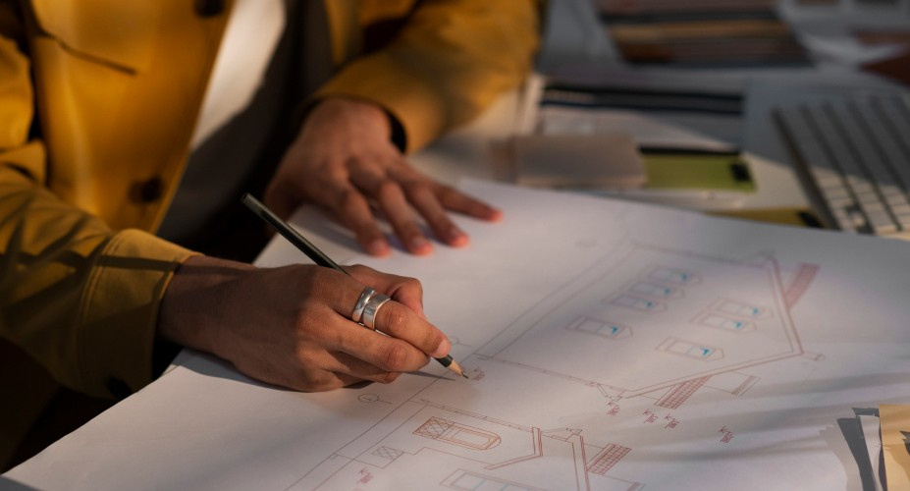
Crafting Digital Experiences that Captivate: A Look at Top-Tier Design and Development Companies
www.quorawebsolution.com

Slide 3
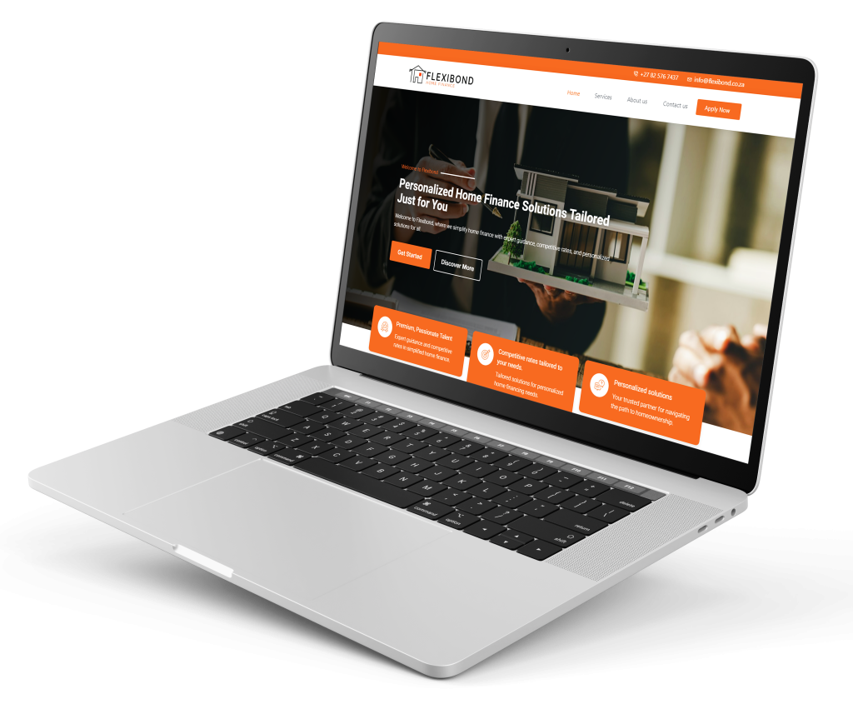
In today's digital age, a captivating online presence is no longer a luxury but a necessity.
www.quorawebsolution.com

Slide 4

To stand out in a crowded marketplace, businesses must invest in top-tier design and development companies that can craft digital experiences that resonate with their target audience.
www.quorawebsolution.com

Slide 5

What Makes a Top-Tier Design and Development Company?
www.quorawebsolution.com

Slide 6
A top-tier company is more than just a team of skilled designers and developers. It’s a strategic partner that understands the nuances of digital transformation. Key characteristics of such companies include:
  User-Centric Approach: They prioritize user experience (UX) and user interface (UI) design to create intuitive and engaging digital products.1
  Cutting-Edge Technology: They stay abreast of the latest technological trends to deliver innovative solutions.
  Cross-Functional Expertise: They have a diverse team of experts, including designers, developers, content strategists, and digital marketers.
  Data-Driven Insights: They leverage data analytics to make informed decisions and optimize performance.
  Agile Methodology: They adopt agile development practices to ensure flexibility and adaptability.
www.quorawebsolution.com

Slide 7
Key Factors to Consider When Choosing a Design and Development Company
  Portfolio: Evaluate the company's past projects to assess their design aesthetic, technical capabilities, and industry experience.2
  Team Expertise: A strong team with diverse skills and a passion for innovation is crucial.
  Communication: Effective communication is essential for a successful partnership.
  Project Management: A robust project management process ensures timely delivery and quality.
  Pricing and Contracts: Clearly defined pricing models and contracts protect both parties.
Top-Tier Design and Development Companies Shaping the Digital Landscape
While specific companies may vary in reputation and expertise, here are some qualities to look for in a top-tier firm:
www.quorawebsolution.com

Slide 8
  Innovative Design Thinking: They push the boundaries of creativity and challenge the status quo.
  Seamless User Experiences: They prioritize intuitive interactions and minimal friction.
  Scalable Solutions: They build digital products that can grow with your business.
  Strong Security Measures: They protect sensitive data and ensure compliance with industry standards.
  Exceptional Customer Support: They provide ongoing maintenance and support to keep your digital assets running smoothly.
By partnering with a top-tier design and development company, businesses can unlock the full potential of the digital world. A well-crafted digital experience can drive brand awareness, increase engagement, and ultimately boost revenue.
www.quorawebsolution.com

Slide 9
3
By following these guidelines and considering the factors mentioned above, you can select a design and development company that will help you achieve your digital goals.
## **Best Web Design and Development Companies: Boost Your Online Visibility**
A strong online presence is crucial for businesses of all sizes to thrive in today's digital age. A well-designed and developed website can significantly impact your brand's visibility, credibility, and ultimately, your bottom line. To achieve these goals, partnering with a top-tier web design and development company is crucial.
www.quorawebsolution.com

Slide 10
When choosing a web design and development company, prioritize expertise, design aesthetics, technical proficiency, SEO understanding, responsive design, e-commerce capabilities, CMS user-friendliness, and reliable customer support.
When selecting a company to bring your digital vision to life, consider the following factors:
* **Expertise and Experience:** Look for a company with a proven track record of delivering high-quality websites.
* **Design Capabilities:** A strong design team can create visually appealing and user-friendly websites that leave a lasting impression.
www.quorawebsolution.com

Slide 11
* **Development Skills:** A skilled development team ensures that your website is technically sound, fast, and secure.
* **SEO Expertise:** Understanding search engine optimization (SEO) is crucial for improving your website's visibility in search engine results.
* **Responsive Design:** A responsive website adapts to different screen sizes, providing a seamless user experience across devices.
* **E-commerce Functionality:** If you're an online retailer, consider a company with experience in building and maintaining e-commerce websites.
www.quorawebsolution.com

Slide 12
* **Content Management Systems (CMS):** A user-friendly CMS empowers you to manage your website's content easily.
Reliable customer support ensures timely resolution of issues and queries.
**Top Web Design and Development Companies to Consider**
While specific recommendations may vary based on your individual needs and budget, here are some qualities to look for in a top-tier web design and development company:
www.quorawebsolution.com

Slide 13
* **Innovative Design Thinking:** They should be able to push the boundaries of creativity and deliver unique, visually stunning designs.
* **Seamless User Experience:** User experience (UX) should be a top priority, ensuring that your website is easy to navigate and use.
* **Scalable Solutions:** Your website should be able to grow with your business, accommodating future expansion and increased traffic.
* **Strong Security Measures:** Protecting your website and your customers' data is paramount.
* **Exceptional Customer Support:** A responsive and helpful support team can make a significant difference.
www.quorawebsolution.com

Slide 14
A reputable web design and development company can maximize your online presence. Invest in a high-quality website that drives traffic, generates leads, and ultimately contributes to your business success.
www.quorawebsolution.com

Slide 15
Quora Web Solution: Quora Web Solution is a trusted website development company based in Bangalore, India, offering a wide array of services to not only domestic but global clientele. Be it Website Design and Development, SEO services, Digital Marketing, Branding, App Development, Ecommerce Solution, and Logo Creation . Quora Web Solution has the best website developers offering top quality services and that is the reason why we are well known as one of the best Website Development Companies in Bangalore, India.
Visit Us - www.quorawebsolution.com
Call Us - +91 9986 056 909
Mail Us - info@quorawebsolutions.com
www.quorawebsolution.com

Slide 16

WORDPRESS DEVELOPMENT
ECOMMERCE DEVELOPMENT
PHP DEVELOPMENT
CMS DEVELOPMENT
DRUPAL DEVELOPMENT
WEBSITE SERVICES
WEBPORTAL DEVELOPMENT
MAGENTO DEVELOPMENT
WEBSITE DEVELOPMENT
JOOMLA DEVELOPMENT
SMALL BUSINESS DEVELOPMENT
CHEAP WEBSITE DEVELOPMENT
STATIC WEBSITE DEVELOPMENT
DYNAMIC WEBSITE DEVELOPMENT
WEBSITE DESIGN COMPANY
TOUR AND TRAVEL WEBSITE DEVELOPMENT
Services

