Slide 1

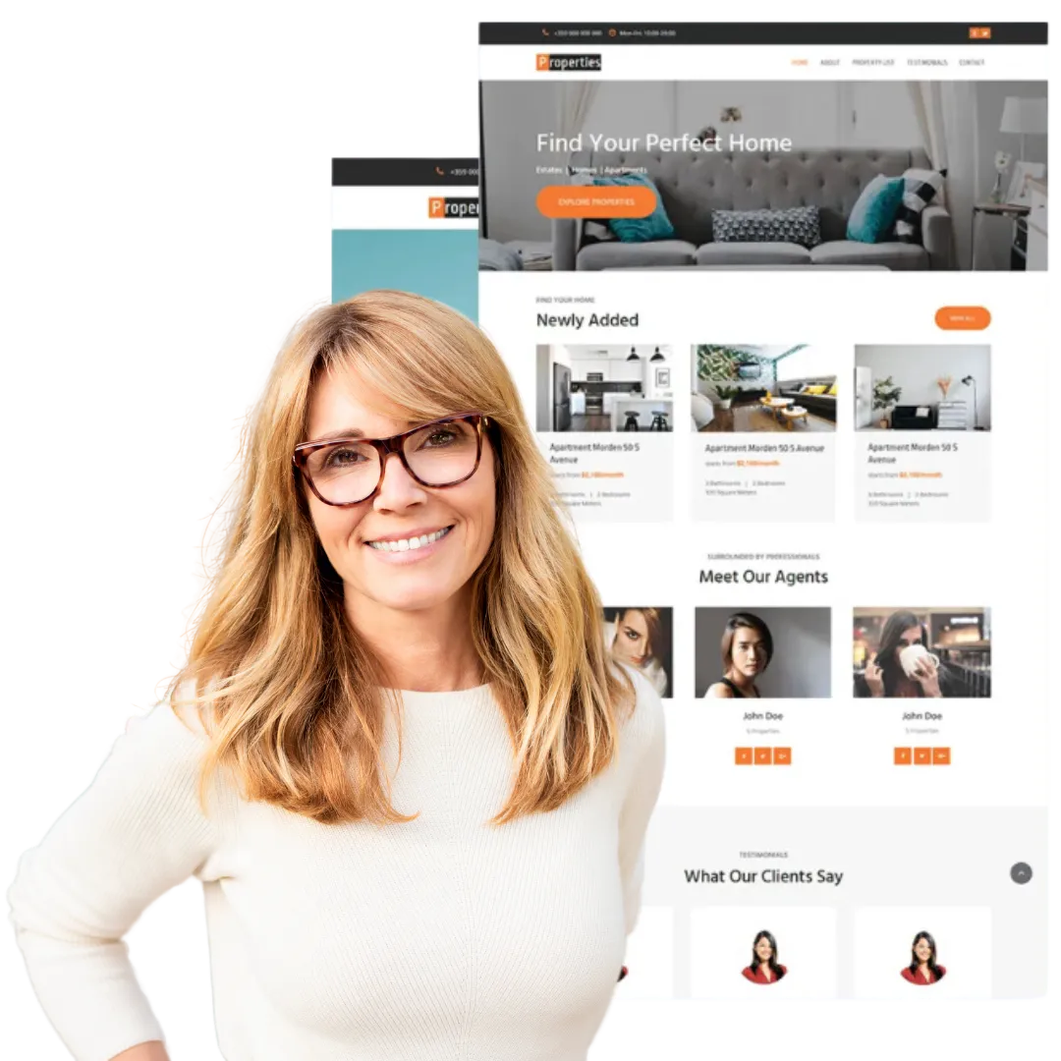
Quora Web Solution
Website Design and
Development
Company
Web Design & Web Development
Company in Bangalore, India
www.quorawebsolution.com
+91 9986 056 909
info@quorawebsolutions.com
24A, 1st Main Rd, Chandra Reddy
Layout, Koramangala 4th Block,
Koramangala, Bengaluru,
Karnataka 560034

Slide 2

Building Websites for Success: Exploring the Intersection of Creative Design, Robust Development, and Effective User Experience
www.quorawebsolution.com

Slide 3
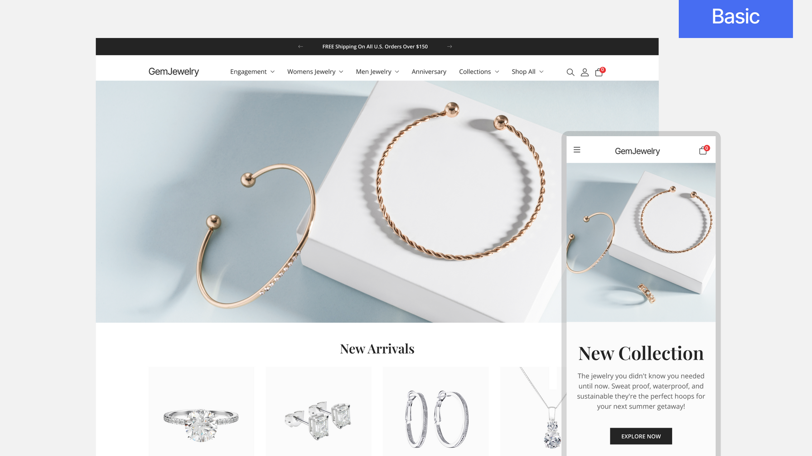
In today’s digital-first world, having a strong online presence is no longer a luxury—it’s a necessity.
www.quorawebsolution.com

Slide 4
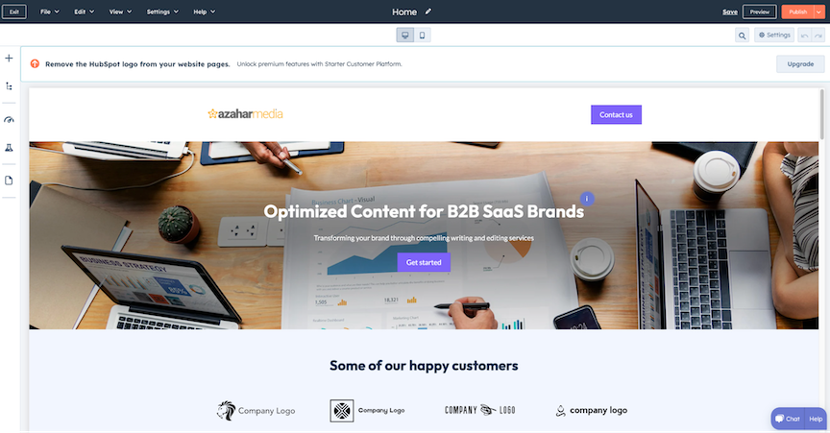
Whether you're a startup, a small business, or an established enterprise, your website often serves as the first point of contact between you and your customers.
www.quorawebsolution.com

Slide 5
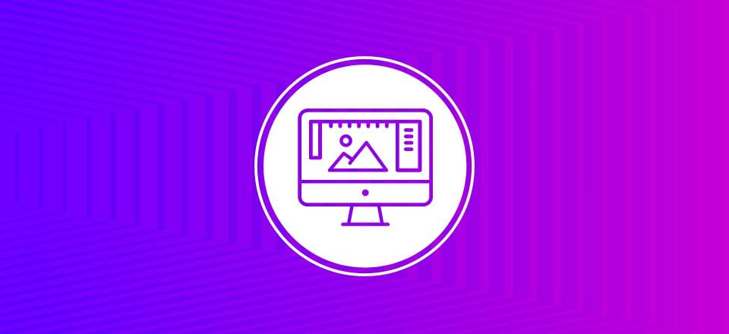
Building a website that not only looks great but also functions seamlessly is the key to standing out in a crowded market.
www.quorawebsolution.com

Slide 6
To achieve this, web design, development, and user experience (UX) must work hand-in-hand to create an effective, engaging, and high-performing website. Here’s how these three elements come together for a truly successful site.
Creative Design: The Visual Hook
A website’s design is the first thing users notice when they land on a page. It’s what grabs their attention and sets the tone for their entire visit. Good design should reflect your brand’s identity while providing an aesthetically pleasing and intuitive layout. This includes a well-organized structure, clean typography, a cohesive color palette, and responsive imagery that adapts to different screen sizes.
Creative design goes beyond just looking nice; it serves a functional purpose too.
www.quorawebsolution.com

Slide 7
For example, a simple, well-placed call-to-action (CTA) button can drive conversions, and a clear navigation menu makes it easy for users to find what they’re looking for quickly. The goal is to ensure that every visual element serves a purpose, making the site both beautiful and functional.
Robust Development: The Backbone of Functionality
While design gets the attention, development is what brings the site to life. The development process involves writing the code that powers the website—whether it’s front-end (what users see) or back-end (what makes everything work). A website needs to be both fast and secure, which is why robust development is crucial.
Speed is essential in today’s internet culture. Slow-loading websites frustrate users, leading to higher bounce rates and poor SEO rankings.
www.quorawebsolution.com

Slide 8
Developers must optimize images, streamline code, and make sure the website runs efficiently across different devices and browsers. Security is another critical aspect. With increasing cyber threats, ensuring that your website is protected from data breaches and malware attacks is non-negotiable.
A well-developed website also enables scalability. As your business grows, your website should be able to handle increased traffic, new features, and evolving technologies without breaking down or requiring a complete redesign. A solid development foundation allows for flexibility and future-proofing.
Effective User Experience: Putting the Visitor First
User experience (UX) is all about understanding and anticipating what visitors want and ensuring that they can accomplish their goals seamlessly.
www.quorawebsolution.com

Slide 9
The best websites don’t just look good—they make it easy for users to find information, navigate smoothly, and perform actions, whether it’s making a purchase, signing up for a newsletter, or contacting customer support.
A key element of UX is usability, which involves intuitive design elements, such as clear labels, simple navigation, and minimal friction in the user journey. Additionally, a responsive design is essential—users should have an equally great experience whether they’re on a desktop, tablet, or smartphone. The simpler and more intuitive the user experience, the more likely visitors will stay on the site, engage with the content, and return again.
The Power of the Intersection
www.quorawebsolution.com

Slide 10
When creative design, robust development, and effective UX come together, the result is a website that not only looks amazing but functions flawlessly and provides a seamless user experience. It's a trifecta that not only attracts visitors but keeps them engaged and encourages them to convert.
In today’s competitive digital landscape, businesses must recognize the importance of this intersection. A website is a critical touchpoint for both customer acquisition and retention, so investing in all three elements is essential for long-term success.
Conclusion
Building websites for success is a balance between aesthetics, functionality, and user satisfaction.
www.quorawebsolution.com

Slide 11
By focusing on creative design, robust development, and a seamless user experience, you create a site that stands out, works efficiently, and serves the needs of your audience. In the end, a well-rounded approach to web design and development is not just about making a pretty site—it’s about building a digital experience that delivers real value and drives business growth.
How to Choose the Right Website Design and Development Company: Tips for Ensuring a Seamless, Scalable, and Secure Digital Presence
www.quorawebsolution.com

Slide 12
Choosing the right website design and development company can be a game-changer for your business. Your website is often the first interaction potential customers have with your brand, so it needs to be more than just visually appealing. It must be functional, scalable, secure, and able to grow alongside your business. The process of finding a development partner that aligns with your vision can be overwhelming, but with the right guidance, you can ensure that your website not only looks great but works even better. Here are some tips to help you make the best choice.
1. Assess Your Needs and Objectives
Before you start browsing potential companies, take a step back and clearly define your website goals. Are you building a simple informational site, an e-commerce platform, or a more complex web application? Do you need custom features, integrations, or a mobile-first design?
www.quorawebsolution.com

Slide 13
Understanding your specific needs will help you identify companies with the right skill set and experience. For instance, if you need an online store, a company with e-commerce expertise and experience with platforms like Shopify or WooCommerce will be essential. If scalability is important, ensure that the company has experience building flexible sites that can grow with your business.
2. Look for a Strong Portfolio and Proven Experience
A reputable design and development company should have a solid portfolio showcasing their past projects. Take the time to browse through their previous work to assess the quality of their design, user experience, and functionality. Ask for case studies or examples of work similar to your project to gauge their expertise in your industry or the type of site you need.
www.quorawebsolution.com

Slide 14
Additionally, check for client testimonials or reviews. Past clients’ experiences can provide valuable insight into the company's reliability, communication, and ability to deliver on time and within budget.
3. Ensure They Focus on User Experience (UX)
While attractive design is important, a website’s usability and user experience (UX) are even more crucial. Your website needs to be easy to navigate, fast-loading, and intuitive. Poor UX can result in higher bounce rates and lower conversion rates, even if the design is visually stunning.
Make sure the company prioritizes UX in their design process.
www.quorawebsolution.com

Slide 15
They should conduct user research, create wireframes, and continuously test and refine the website to ensure a smooth and engaging user experience across all devices.
4. Scalability and Flexibility
Your business will evolve, and your website needs to grow with it. When choosing a development company, ensure they design with scalability in mind. A scalable website can handle increased traffic, new features, and changing business needs without requiring a major overhaul.
Ask the company how they build websites to accommodate future growth. Do they use flexible CMS platforms? Are their solutions modular, allowing you to easily add new features?
www.quorawebsolution.com

Slide 16
These are key factors to consider for long-term success.
5. Security is Non-Negotiable
Cybersecurity is a critical aspect of any website. With data breaches and online threats becoming more common, it's essential to ensure your website is secure from day one. A trustworthy design and development company should implement best practices for website security, including SSL certificates, secure payment gateways, and regular security updates.
Discuss security measures with potential companies and ask about their experience in building secure websites.
www.quorawebsolution.com

Slide 17
Also, inquire about their ongoing support for security updates and maintenance after the site goes live.
6. Check for Post-Launch Support and Maintenance
A successful website doesn’t end at launch. Websites require ongoing maintenance, updates, and support to remain functional and secure. Be sure to choose a company that offers post-launch support, whether it’s for troubleshooting, regular updates, or adding new features as your business grows.
Clear communication about ongoing support should be part of your agreement. Make sure you know how the company handles issues after the site is live and what kind of maintenance packages they offer.
7. Consider Their Communication and Collaboration Style
www.quorawebsolution.com

Slide 18
A smooth collaboration process is essential for a successful partnership. The best design and development companies are responsive, transparent, and easy to work with. They should be willing to listen to your needs, explain technical terms in a way you can understand, and involve you throughout the design and development process.
Make sure the company is open to feedback and willing to make adjustments as needed. The more collaborative the relationship, the more likely you’ll end up with a website that aligns with your vision and meets your business goals.
8. Evaluate Their Technical Expertise
www.quorawebsolution.com

Slide 19
Ensure the company you choose has the technical skills necessary to bring your website vision to life. From front-end design to back-end development, make sure they are proficient in the technologies you need, whether it's HTML, CSS, JavaScript, PHP, or more advanced tools like React or Node.js.
You should also ask about their knowledge of SEO best practices. A website that’s beautifully designed but not optimized for search engines won’t help you attract traffic. Ask how they incorporate SEO into their design and development process.
www.quorawebsolution.com

Slide 20
Conclusion
Choosing the right website design and development company is a critical step toward establishing a successful online presence. By evaluating your needs, reviewing portfolios, ensuring strong UX and security measures, and considering scalability, you can make an informed decision. Remember that your website should not only reflect your brand’s identity but also serve as a powerful tool that drives growth, engages users, and adapts to future needs. Take the time to choose a company that aligns with your vision, and you’ll be well on your way to a digital presence that’s seamless, scalable, and secure.
www.quorawebsolution.com

Slide 21
Quora Web Solution: Quora Web Solution is a trusted website development company based in Bangalore, India, offering a wide array of services to not only domestic but global clientele. Be it Website Design and Development, SEO services, Digital Marketing, Branding, App Development, Ecommerce Solution, and Logo Creation . Quora Web Solution has the best website developers offering top quality services and that is the reason why we are well known as one of the best Website Development Companies in Bangalore, India.
Visit Us - www.quorawebsolution.com
Call Us - +91 9986 056 909
Mail Us - info@quorawebsolutions.com
www.quorawebsolution.com

Slide 22

WORDPRESS DEVELOPMENT
ECOMMERCE DEVELOPMENT
PHP DEVELOPMENT
CMS DEVELOPMENT
DRUPAL DEVELOPMENT
WEBSITE SERVICES
WEBPORTAL DEVELOPMENT
MAGENTO DEVELOPMENT
WEBSITE DEVELOPMENT
JOOMLA DEVELOPMENT
SMALL BUSINESS DEVELOPMENT
CHEAP WEBSITE DEVELOPMENT
STATIC WEBSITE DEVELOPMENT
DYNAMIC WEBSITE DEVELOPMENT
WEBSITE DESIGN COMPANY
TOUR AND TRAVEL WEBSITE DEVELOPMENT
Services

