Slide 1


Quora Web Solution
Website Design and
Development
Company
Web Design & Web Development
Company in Bangalore, India
www.quorawebsolution.com
+91 9986 056 909
info@quorawebsolutions.com
24A, 1st Main Rd, Chandra Reddy
Layout, Koramangala 4th Block,
Koramangala, Bengaluru,
Karnataka 560034

Slide 2

How SEO-Optimized Web Design Can Improve Your Search Rankings and Drive Organic Traffic
Introduction
www.quorawebsolution.com

Slide 3

In today's competitive digital landscape, a visually appealing website alone is not sufficient to ensure success. If your website is not optimized for search engines, you may struggle to attract visitors, no matter how visually appealing it is.
www.quorawebsolution.com

Slide 4
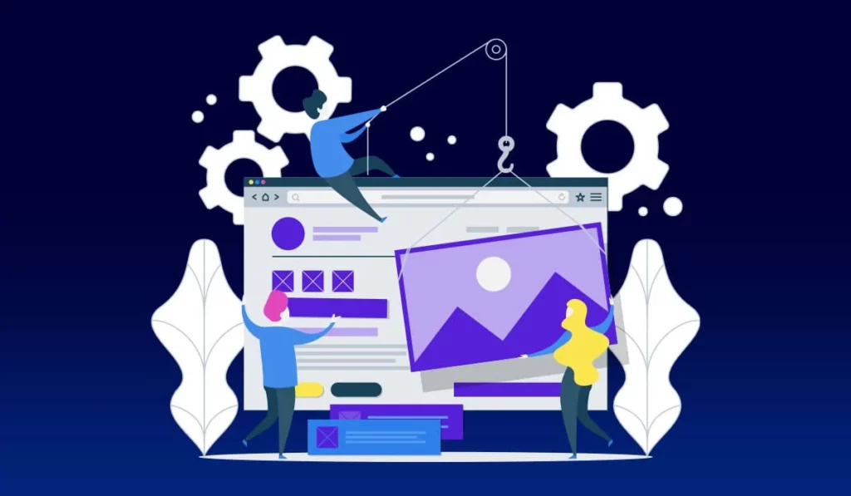
SEO-optimized web design ensures that your site is not only aesthetically pleasing but also structured in a way that enhances visibility on search engines like Google.
www.quorawebsolution.com

Slide 5

This article explores how SEO-focused design can improve your search rankings and drive organic traffic.
1. Mobile Responsiveness
www.quorawebsolution.com

Slide 6
Google prioritizes mobile-friendly websites in its search rankings. A responsive design ensures your website adapts to different screen sizes, providing a seamless experience across all devices. This reduces bounce rates and improves engagement, signaling to search engines that your site offers value.
Best Practices:
Use a mobile-first design approach.
Ensure text, images, and buttons are properly scaled for smaller screens.
Evaluate your website's mobile-friendliness with Google's Mobile-Friendly Test tool to identify areas for improvement and ensure optimal performance on all devices.
2. Fast Loading Speed
Page speed is a crucial ranking factor. A slow website frustrates users and leads to higher bounce rates, which negatively impact SEO.
www.quorawebsolution.com

Slide 7
Best Practices:
Reduce image file sizes through advanced compression techniques while maintaining high visual quality to enhance page load speed.
Use a Content Delivery Network (CDN) to distribute website data more efficiently.
Minimize HTTP requests and enable browser caching.
Optimize code by reducing unnecessary JavaScript, CSS, and HTML.
3. SEO-Friendly URL Structure
A well-structured URL helps both users and search engines understand the page content.
Best Practices:
Use short, descriptive URLs with relevant keywords.
Avoid complex URLs with numbers and special characters.
www.quorawebsolution.com

Slide 8
Use hyphens (-) to separate words in URLs rather than underscores (_), as search engines interpret hyphens as space separators, improving readability and ranking.
Example:
Good: www.example.com/seo-web-design
Bad: www.example.com/page?id=12345
4. Optimized Site Navigation
Easy-to-use navigation helps search engines crawl your site efficiently and enhances user experience.
Best Practices:
Use a clear and logical menu structure.
Implement internal linking to connect relevant pages.
www.quorawebsolution.com

Slide 9
Create a well-structured XML sitemap and submit it to Google Search Console.
5. High-Quality Content and On-Page SEO
Content plays a vital role in SEO-optimized web design. Engaging, informative, and keyword-rich content enhances visibility and user engagement.
Best Practices:
Perform thorough keyword research and seamlessly integrate relevant terms into your content to enhance discoverability and engagement.
Use heading tags (H1, H2, H3) to structure content clearly.
Optimize meta titles and descriptions with primary keywords.
www.quorawebsolution.com

Slide 10
Utilize schema markup to provide structured data that helps search engines interpret and display your content more effectively in search results.
6. Image Optimization
Search engines rely on alt text and file names to understand images, which can boost SEO rankings.
Best Practices:
Choose meaningful and keyword-rich file names for images (e.g., "seo-optimized-web-design.jpg" instead of "image123.jpg") to improve search engine recognition and ranking.
Add alt text with keywords to describe the image.
Compress images to improve loading speed.
7. Secure Website with HTTPS
www.quorawebsolution.com

Slide 11
Google favors secure websites that use HTTPS. SSL certificates encrypt user data and enhance credibility, boosting SEO rankings.
Best Practices:
Install an SSL certificate to enable HTTPS.
Regularly update and monitor security settings.
Avoid mixed content issues (secure and non-secure elements on the same page).
8. User Experience (UX) and Engagement Signals
Google considers user behavior metrics such as dwell time, click-through rates, and bounce rates when ranking websites.
Best Practices:
www.quorawebsolution.com

Slide 12
Design intuitive navigation and clear CTAs (Call-to-Action).
Improve readability with proper font sizes and spacing.
Include engaging multimedia elements (videos, infographics, interactive content).
Conclusion
SEO-optimized web design is essential for improving search rankings and driving organic traffic. By implementing mobile responsiveness, fast loading speeds, structured URLs, user-friendly navigation, high-quality content, and security measures, businesses can create a website that not only ranks higher on search engines but also provides a great user experience. Investing in SEO-friendly design ensures long-term success in the competitive digital landscape.
How Custom Website Development Can Transform Your Business and Boost Sales
www.quorawebsolution.com

Slide 13
Introduction
In today’s digital-first world, having a strong online presence is crucial for business success. A custom website tailored to your brand, goals, and audience can provide a competitive edge, enhance customer engagement, and drive sales. Unlike template-based websites, custom development offers flexibility, scalability, and advanced functionalities designed to meet unique business needs. This article explores how custom website development can transform your business and increase sales.
1. Unique Brand Identity
A custom website allows you to build a unique brand identity that stands out from competitors. Instead of relying on generic templates, you can create a visually appealing and distinctive online presence that reflects your business values and personality.
www.quorawebsolution.com

Slide 14
Benefits:
A cohesive and professional brand image
Custom design elements that align with your brand’s style
A unique user experience that sets you apart
2. Enhanced User Experience (UX)
User experience plays a significant role in customer retention and conversion rates. Custom website development ensures that your site is designed with user needs in mind, offering smooth navigation, fast loading times, and mobile responsiveness.
Best Practices:
Optimize for mobile and desktop users
Improve page load speed with efficient coding
www.quorawebsolution.com

Slide 15
Use intuitive navigation to enhance usability
3. SEO and Performance Optimization
A custom website is built with search engine optimization (SEO) in mind, making it easier for potential customers to find you online. Unlike generic templates, custom websites allow for better control over site architecture, meta tags, and on-page SEO elements.
Advantages:
Better search rankings due to optimized coding
Faster page speed for improved user experience and lower bounce rates
Structured data implementation for enhanced search visibility
4. Scalability and Future Growth
A template-based website may be limiting as your business grows.
www.quorawebsolution.com

Slide 16
Custom website development ensures your site is scalable and adaptable to new business needs, allowing for future enhancements and integrations.
Features:
Ability to add new features and functionalities as needed
Flexible architecture that grows with your business
Integration with third-party tools like CRM, payment gateways, and analytics
5. Improved Security and Data Protection
Custom websites provide better security features than off-the-shelf solutions.
www.quorawebsolution.com

Slide 17
With tailored security measures, you can protect customer data, prevent cyber threats, and ensure compliance with industry standards.
Security Enhancements:
SSL certificates for secure transactions
Data encryption to safeguard sensitive information
Regular security updates and monitoring
6. Increased Conversion Rates
A custom website is designed with your sales funnel in mind.
www.quorawebsolution.com

Slide 18
By incorporating tailored CTAs, personalized content, and user-friendly checkout processes, you can maximize conversions and increase revenue.
Strategies:
Custom landing pages optimized for lead generation
A/B testing for improving conversion performance
Streamlined checkout process for seamless transactions
www.quorawebsolution.com

Slide 19
Conclusion
Investing in custom website development is a strategic move that can significantly enhance your business’s online presence, improve user engagement, and boost sales. By focusing on brand identity, user experience, SEO, security, and scalability, businesses can create a powerful digital platform that supports long-term success. If you want to take your business to the next level, a custom-built website is the way to go.
www.quorawebsolution.com

Slide 20
Quora Web Solution: Quora Web Solution is a trusted website development company based in Bangalore, India, offering a wide array of services to not only domestic but global clientele. Be it Website Design and Development, SEO services, Digital Marketing, Branding, App Development, Ecommerce Solution, and Logo Creation . Quora Web Solution has the best website developers offering top quality services and that is the reason why we are well known as one of the best Website Development Companies in Bangalore, India.
Visit Us - www.quorawebsolution.com
Call Us - +91 9986 056 909
Mail Us - info@quorawebsolutions.com
www.quorawebsolution.com

Slide 21

WORDPRESS DEVELOPMENT
ECOMMERCE DEVELOPMENT
PHP DEVELOPMENT
CMS DEVELOPMENT
DRUPAL DEVELOPMENT
WEBSITE SERVICES
WEBPORTAL DEVELOPMENT
MAGENTO DEVELOPMENT
WEBSITE DEVELOPMENT
JOOMLA DEVELOPMENT
SMALL BUSINESS DEVELOPMENT
CHEAP WEBSITE DEVELOPMENT
STATIC WEBSITE DEVELOPMENT
DYNAMIC WEBSITE DEVELOPMENT
WEBSITE DESIGN COMPANY
TOUR AND TRAVEL WEBSITE DEVELOPMENT
Services

