Slide 1



Frontier Airlines
Carry On Baggage for Frontier
Essential Guide to Frontier Airlines Carry-On Policies
Presented By:
Daisy Parker
+1-888-212-0809
https://www.airflypolicy.com/

Slide 2

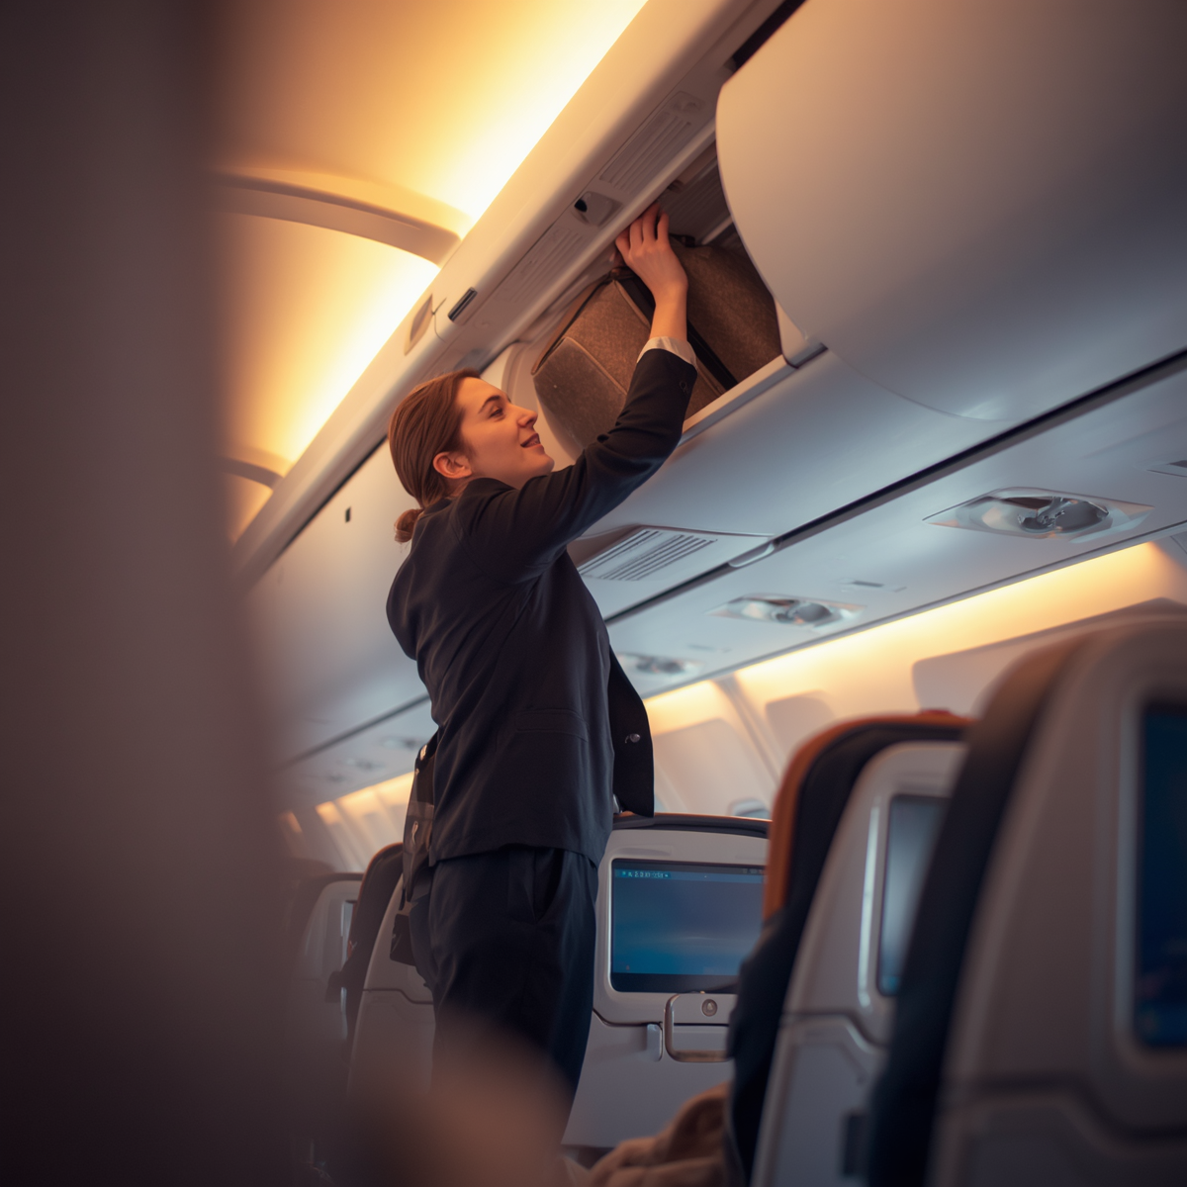
Understanding carry on baggage for frontier
Frontier Airlines allows one personal item (like a small backpack or purse) free of charge on every flight.
Carry-on bags require an additional fee unless your fare bundle already includes carry-on baggage allowance.
Following carry on baggage for frontier rules is essential to avoid unexpected fees and delays at the gate.

Slide 3
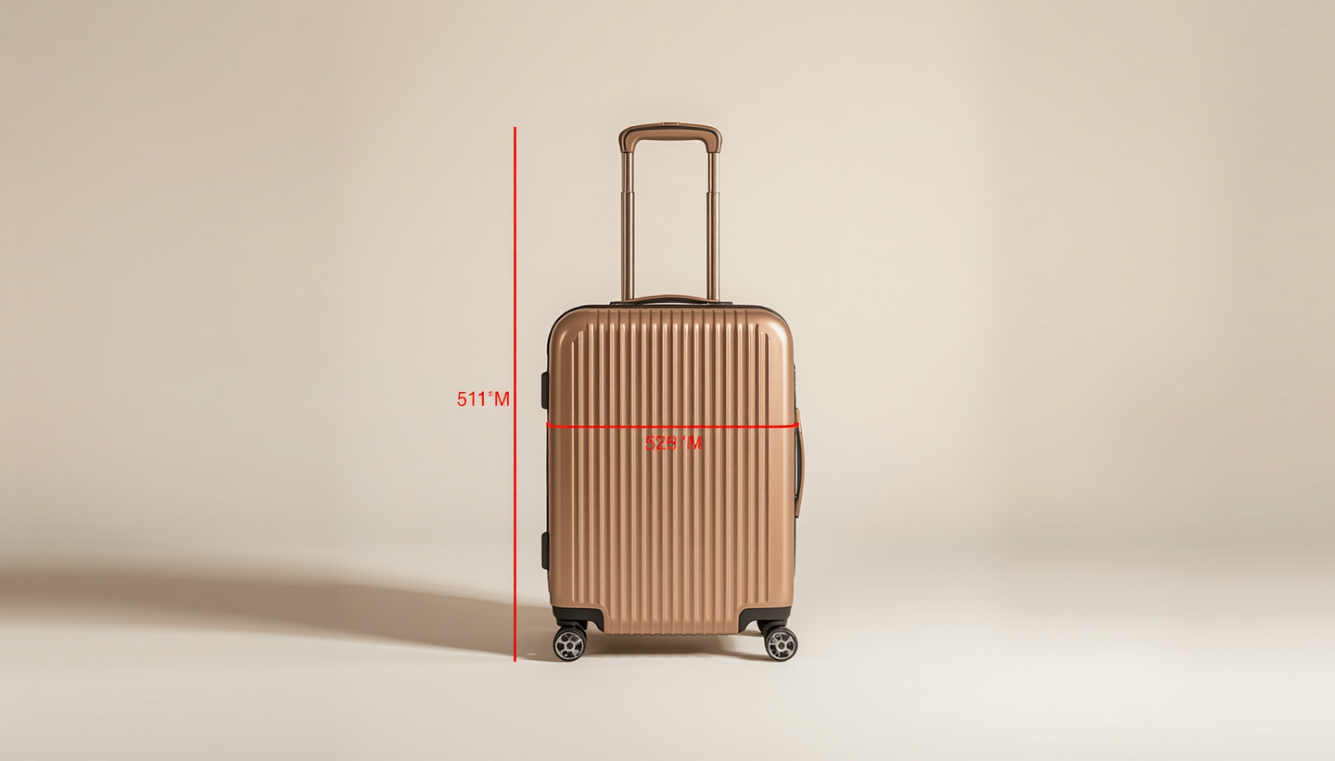
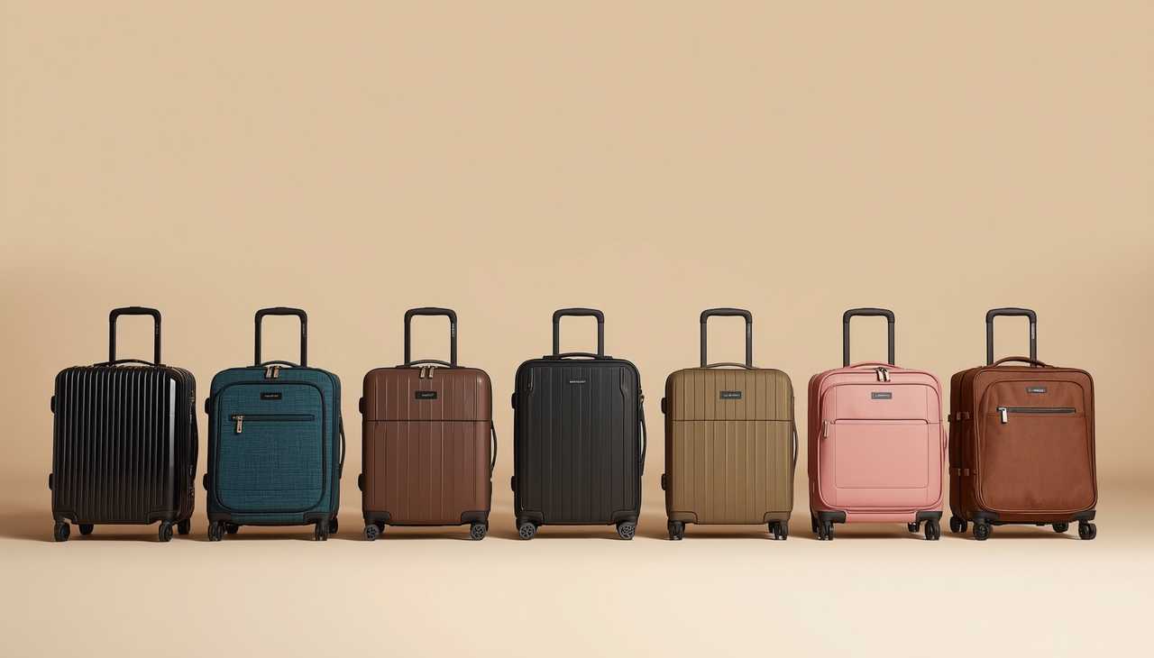
Size &
Weight
Limits
Frontier Airlines: Max 10x16x24 in. Carry-on fee required unless bundled in fare. Weight limit: 35 lbs. Personal item must fit under seat (14x18x8 in.) — free of charge.
Industry Standard: Most carriers allow 22x14x9 in. carry-on. Average weight limit: 40–50 lbs. One carry-on + one personal item typically included in base fare.

Slide 4


Measure your carry-on bag before travel to ensure it meets Frontier's size requirements and avoid gate surprises.
Pack efficiently and light to stay within weight limits and make the most of your carry-on allowance.
Smart Tips for Carry-On Baggage
Use your personal item allowance wisely — a well-packed backpack or purse can carry essentials for free.
Check Frontier's carry-on baggage policy updates before your flight to stay informed of any rule changes.

Slide 5

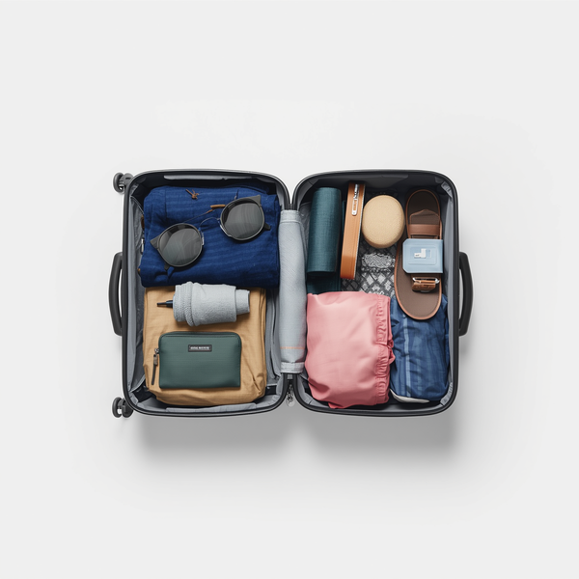



Key Takeaways on Carry On Baggage for Frontier
Know Frontier's carry-on baggage rules before your trip to avoid surprises at the gate.
Avoid unexpected fees by adhering to size and weight limits for carry-on bags.
Pack smart and use your personal item allowance wisely for a stress-free experience.
Visit Frontier's official website at flyfrontier.com for the latest carry on baggage for frontier policies and updates before every flight.

