Slide 1
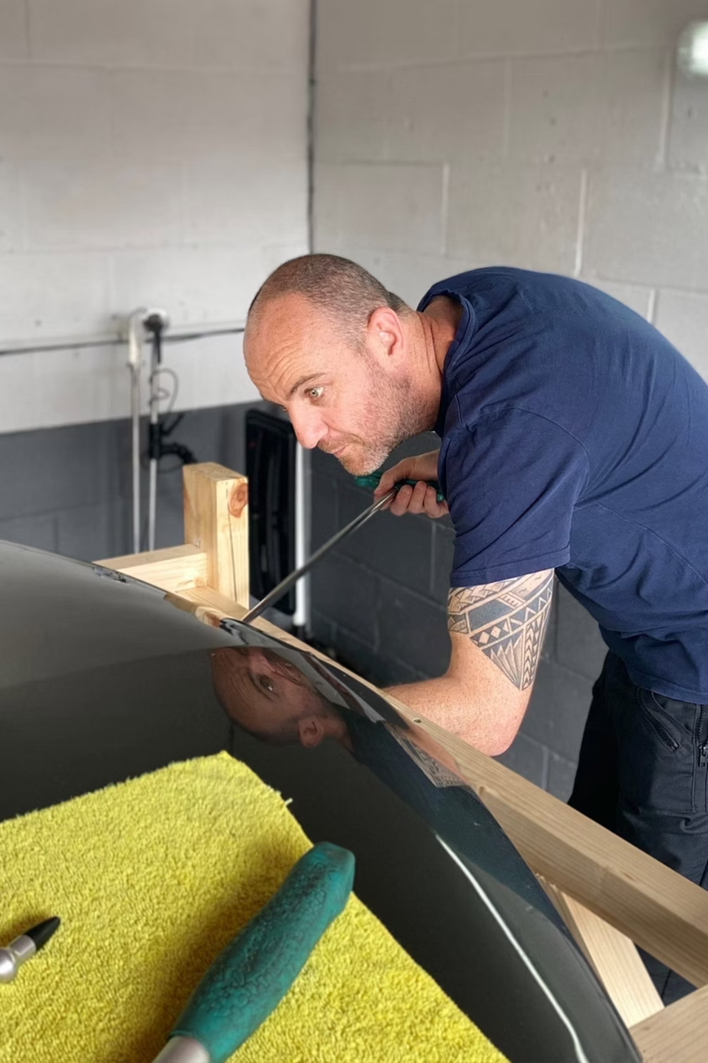

Paintless Dent Repair Training
Develop Specialist Automotive Repair Skills
The demand for skilled technicians continues to grow as vehicle owners seek cost-effective repair solutions that preserve original paintwork. Paintless dent repair training provides a practical pathway into this specialist area of the automotive industry. At Dent Finish, our training programme is designed to help students gain hands-on experience, technical knowledge, and the confidence needed to perform professional dent repairs.

Slide 2
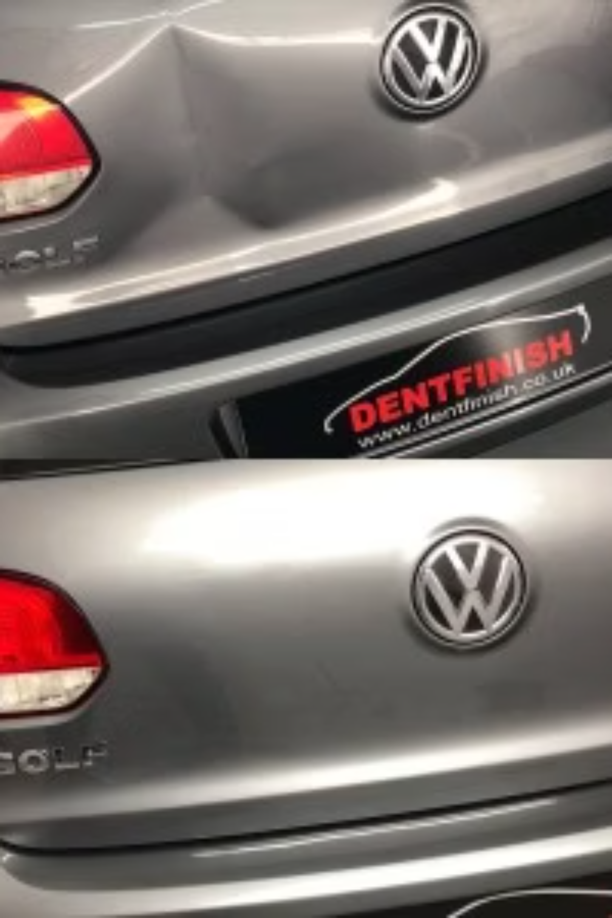

Learn the Principles of Metal Restoration
Paintless dent repair focuses on restoring damaged panels without using fillers, sanding, or repainting. During paintless dent repair training, students learn how metal behaves under pressure and how dents can be carefully manipulated back to their original shape. Understanding these principles is essential for achieving smooth, high-quality repairs while maintaining the factory finish.
This knowledge forms the foundation of successful paintless dent repair techniques.

Slide 3
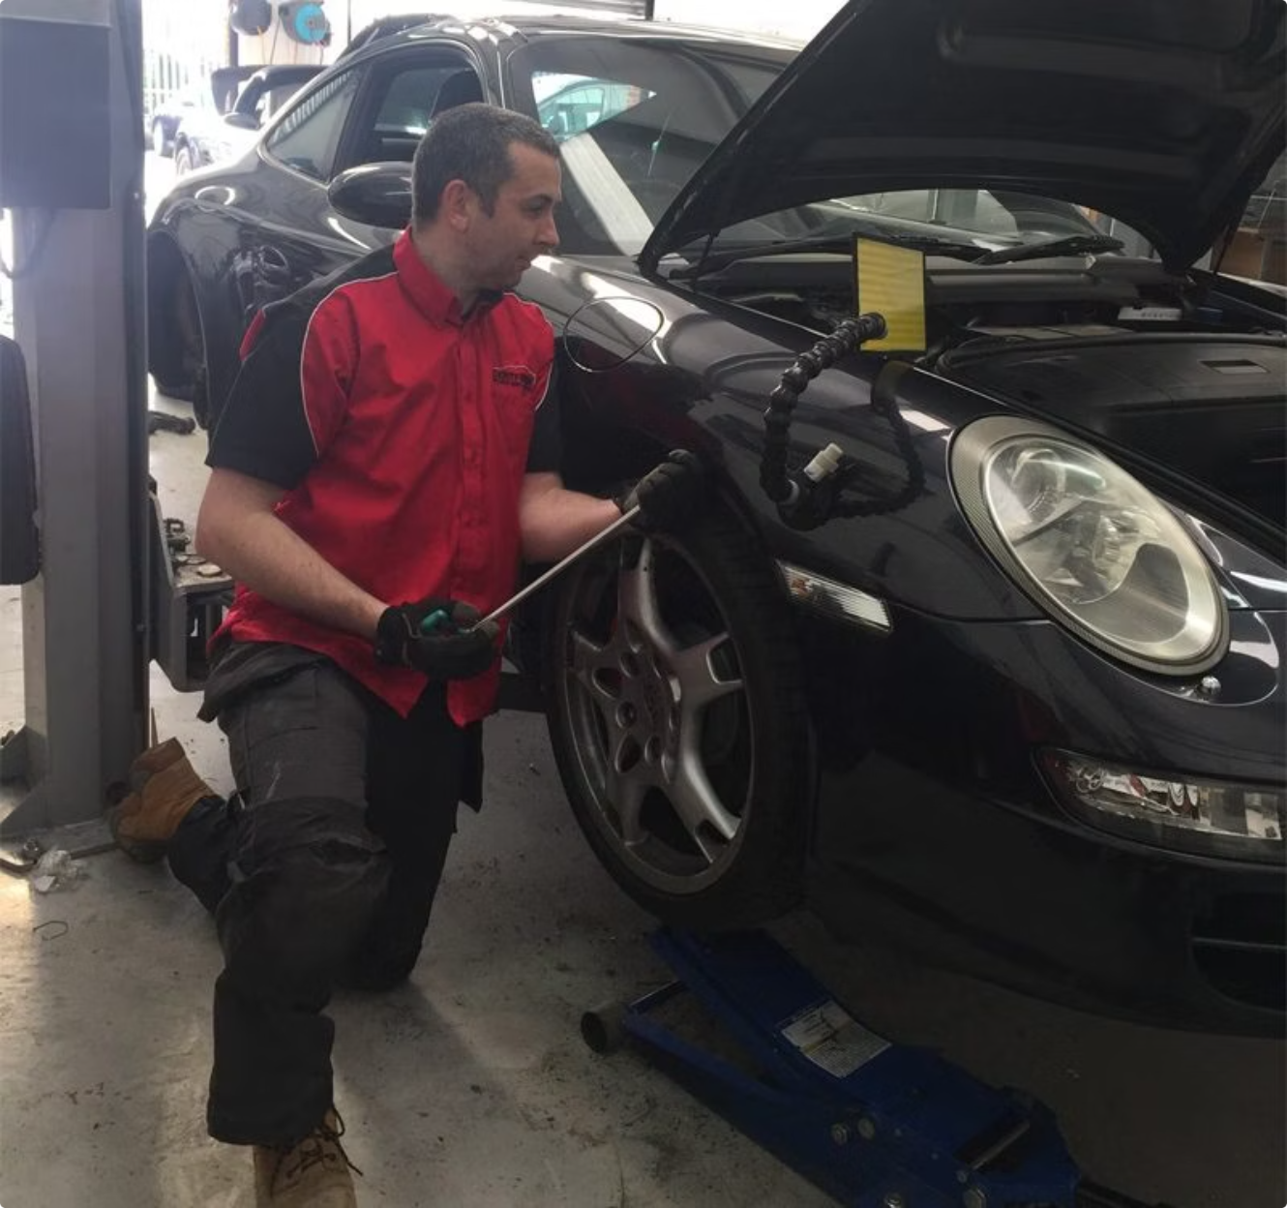

Gain Practical Tool Handling Experience
Professional dent repair requires precision and control. Trainees are introduced to specialist tools used throughout the repair process and learn how to access damaged areas safely and effectively. Practical exercises help students understand the correct use of equipment while improving accuracy and consistency.
Specialist Tools
Accuracy & Consistency
Real-World Readiness
Hands-on introduction to professional PDR equipment
Practical exercises to build precision and control
Confidence to handle actual repair situations

Slide 4

Build Confidence Through Structured Learning
A well-designed training programme provides a step-by-step approach to skill development. Students progress from basic repair techniques to more advanced dent removal methods under professional guidance. This structured learning process helps reinforce good habits and improve repair quality over time.
Basics
Advanced
Foundational skills and panel awareness
Complex repairs under supervision
Intermediate
Various dent types and panel shapes
Through supervised practice, trainees gain valuable experience working on different panel shapes and dent types.

Slide 5
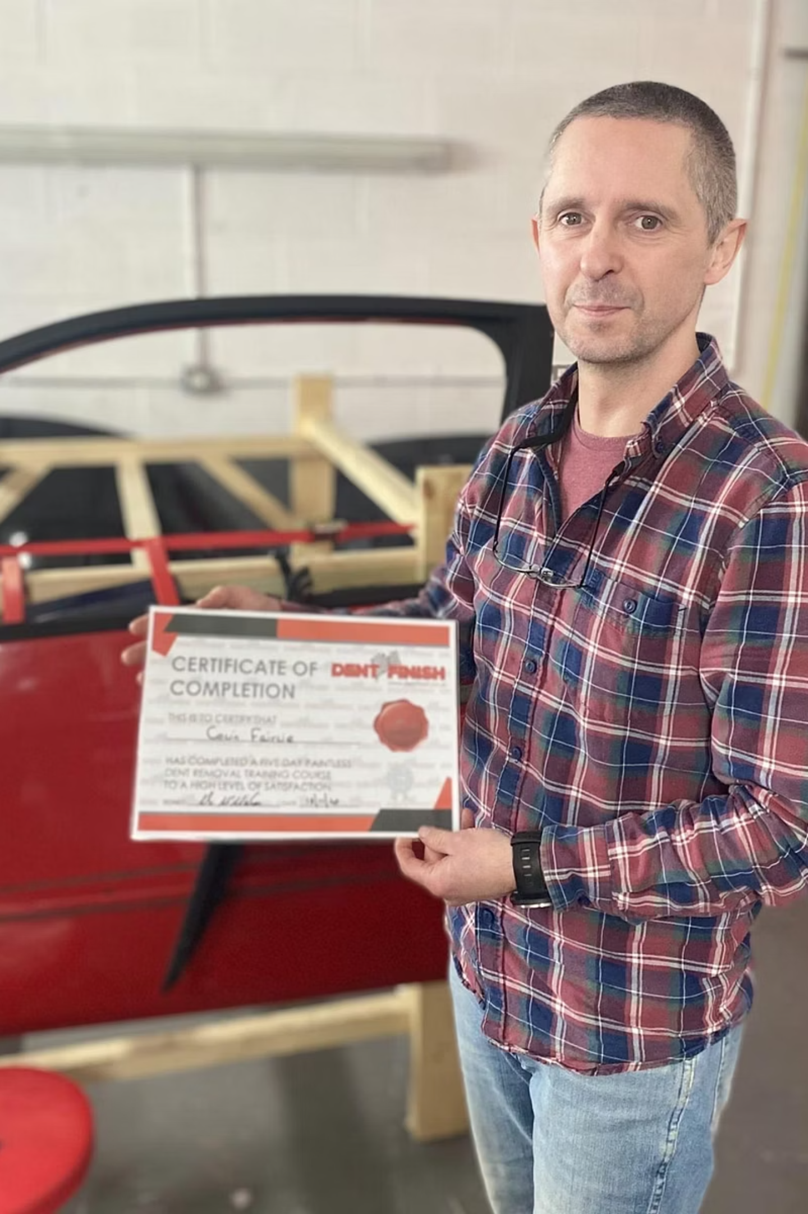
Create New Career Opportunities
Completing paintless dent repair training can open doors to a variety of roles within the automotive sector. Skilled technicians are sought after by body shops, vehicle repair centres, dealerships, and mobile repair businesses. The specialised nature of paintless dent repair also makes it an attractive option for individuals interested in self-employment.
Body Shops
Join established repair facilities
Dealerships
Work within manufacturer networks
Mobile Repair
Flexible, on-the-go service options
Self-Employment
Build your own specialist business
As demand for non-invasive vehicle repairs continues to increase, qualified technicians can benefit from long-term career prospects.

Slide 6
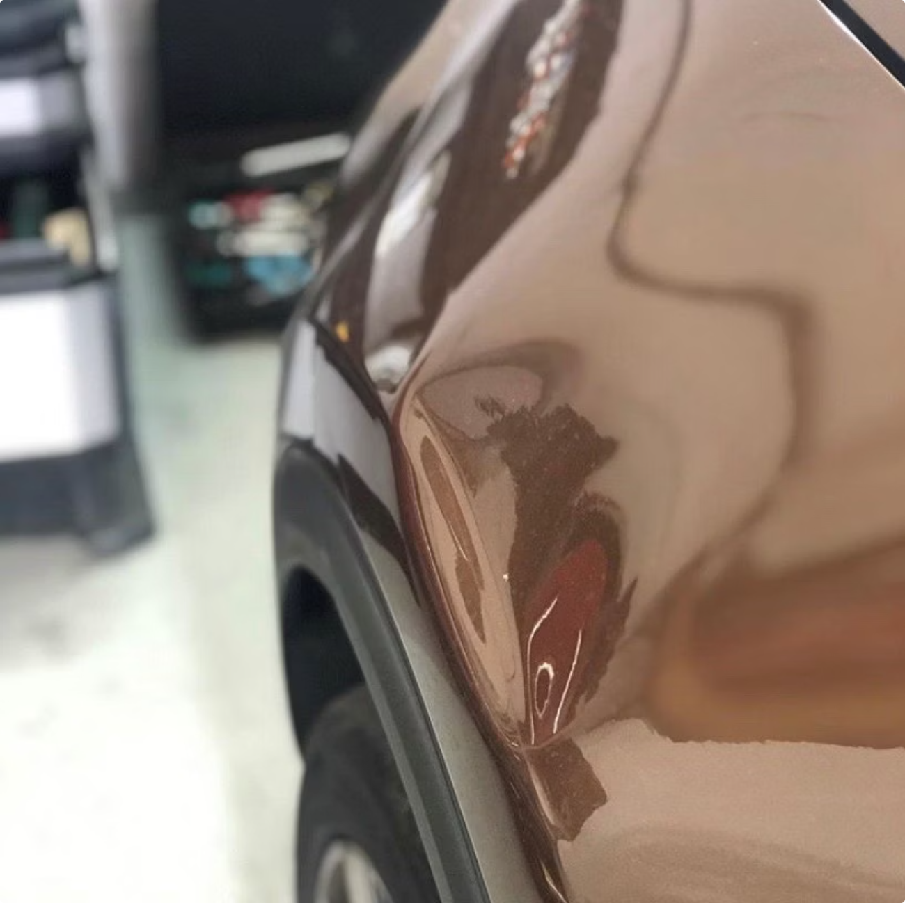

Train with Dent Finish
At Dent Finish, our paintless dent repair training combines practical instruction with industry-focused techniques to help students build valuable expertise. Whether you are starting a new career or expanding your existing automotive skills, our course provides the knowledge and hands-on experience needed to succeed in the growing paintless dent repair industry.
Practical Instruction
Industry-Focused Techniques
Career-Ready Expertise
Hands-on learning in a real workshop environment
Up-to-date methods used by professionals
Skills designed for immediate employment

Slide 7

Contact Dent Finish
Get in Touch
Our Location
📞 0151 345 5575
📱 07737731119
✉️ info@dentfinish.co.uk
Unit 1 Westminster Ind Park
Rossfield Rd
Ellesmere Port
Cheshire, North West England
CH65 3DU
United Kingdom
Follow Us
Instagram · Facebook · Twitter
Ready to start your paintless dent repair career? Contact Dent Finish today to find out more about our training programme.

