Slide 1


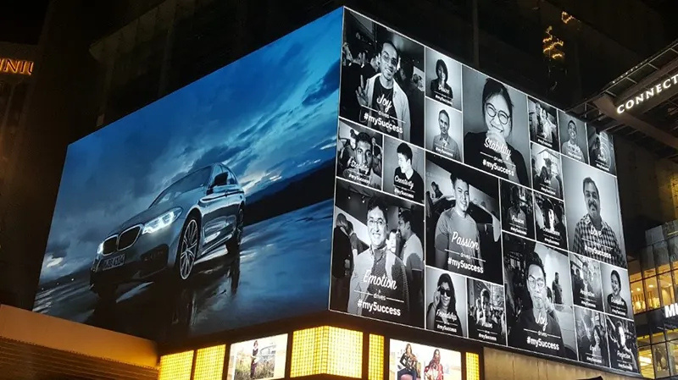
CINSTAR LED
LEADING OUTDOOR LED SCREEN MANUFACTURER IN THE USA
Visit us: www.cinstar-led.com

Slide 2
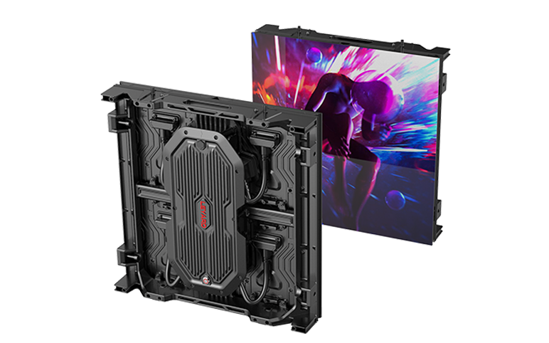
INTRODUCTION
In today’s fast-paced world, outdoor advertising has undergone significant evolution with the advent of dynamic visual technology. From massive digital billboards on highways to LED walls at stadiums and event venues, outdoor LED screens have become an essential tool for businesses aiming to capture attention in high-traffic environments. Among the industry leaders, one name continues to stand out as the No.1 outdoor LED screen manufacturer in the USA a brand known for innovation, reliability, and premium-quality display solutions.

Slide 3
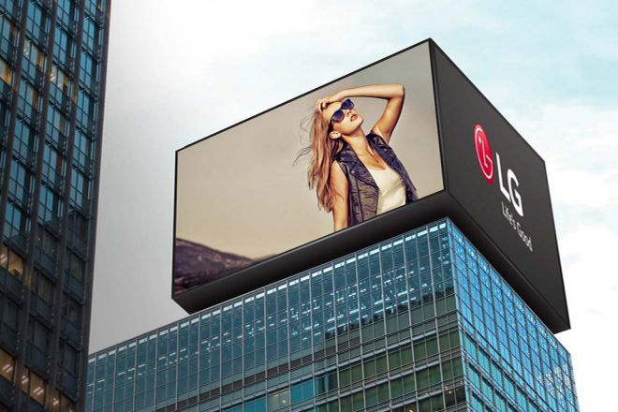
KEY BENEFITS OF OUTDOOR LED DISPLAY SCREENS
High Brightness & Visibility:
Weatherproof Design:
Outdoor LED screens are engineered to perform under bright daylight. With thousands of nits of brightness, your content remains sharp and noticeable in any lighting condition.
Durability is critical. Outdoor LED screens come with IP65 or higher protection ratings, making them resistant to rain, dust, heat, and cold. This ensures consistent performance year-round.

Slide 4
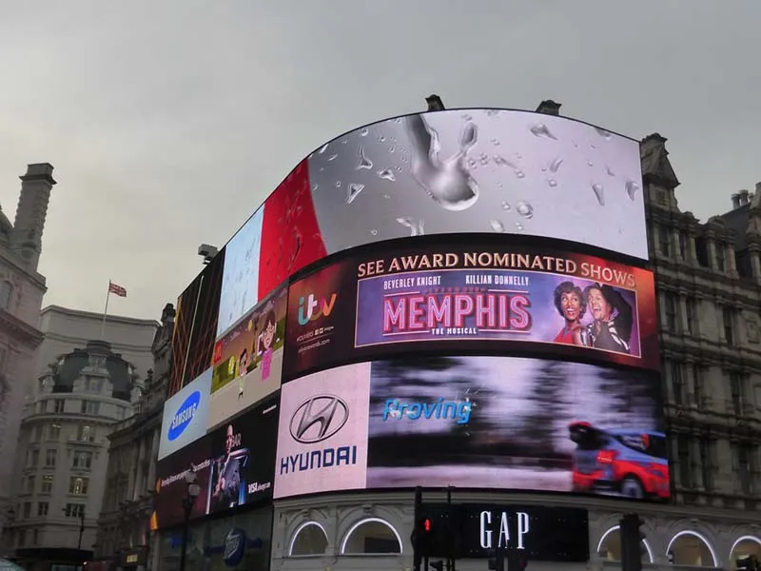
Energy-Efficient & Cost-Effective:
Modern LED technology consumes significantly less energy while delivering brighter visuals. The long lifespan of LED panels also reduces replacement and maintenance costs over time.
Modular Flexibility:
From large billboards to custom-shaped installations, outdoor LED display boards are available in various sizes and configurations. They can be easily scaled and maintained due to their modular nature.

Slide 5
OUTDOOR LED VIDEO WALLS – THE NEXT BIG THING
A growing trend in urban advertising and live event production is the use of outdoor LED video walls. These large-scale, seamless displays captivate audiences with high-resolution images and video, ideal for sports arenas, concerts, retail centers, and city squares.
Video walls allow for the blending of creativity and technology. Their vibrant visuals ensure maximum engagement, while their scalability enables installation in any outdoor space. Whether it’s a small corner in a shopping district or a central position on Times Square, outdoor LED video walls offer unmatched exposure and visual impact.

Slide 6
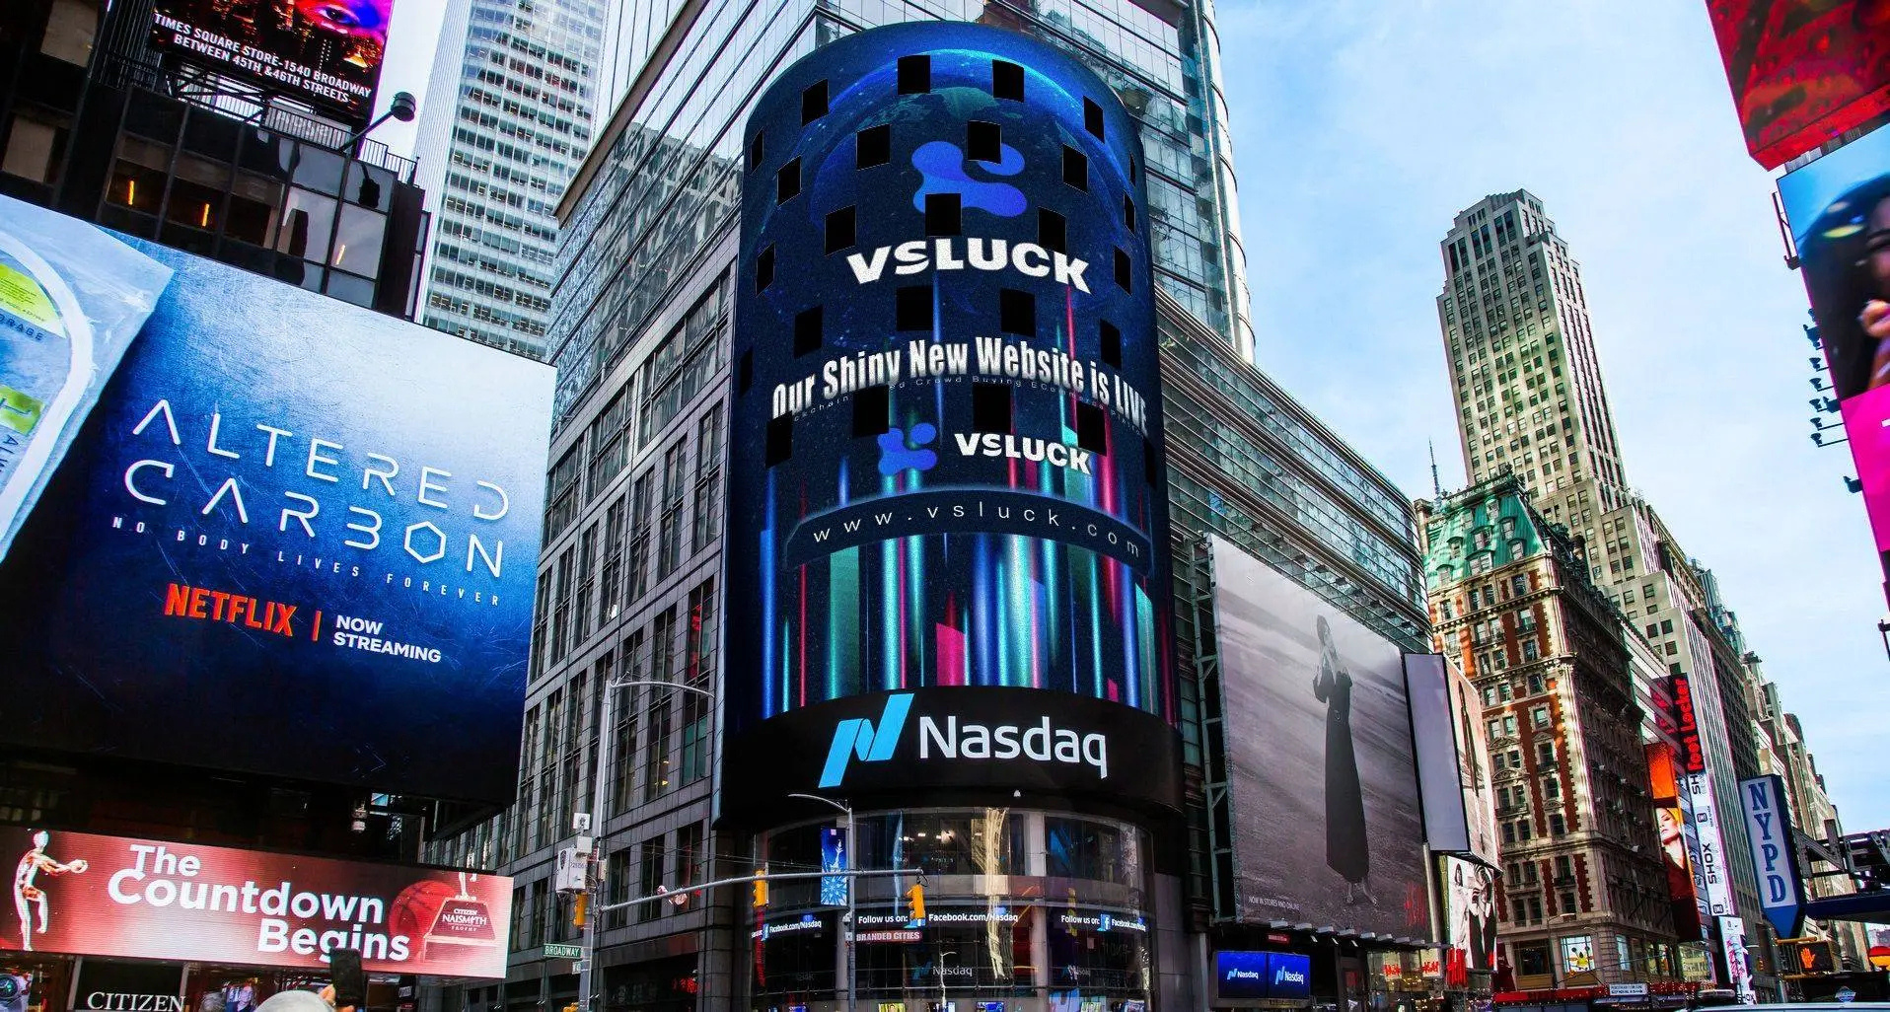
THANK YOU
www.cinstar-led.com

