Slide 1
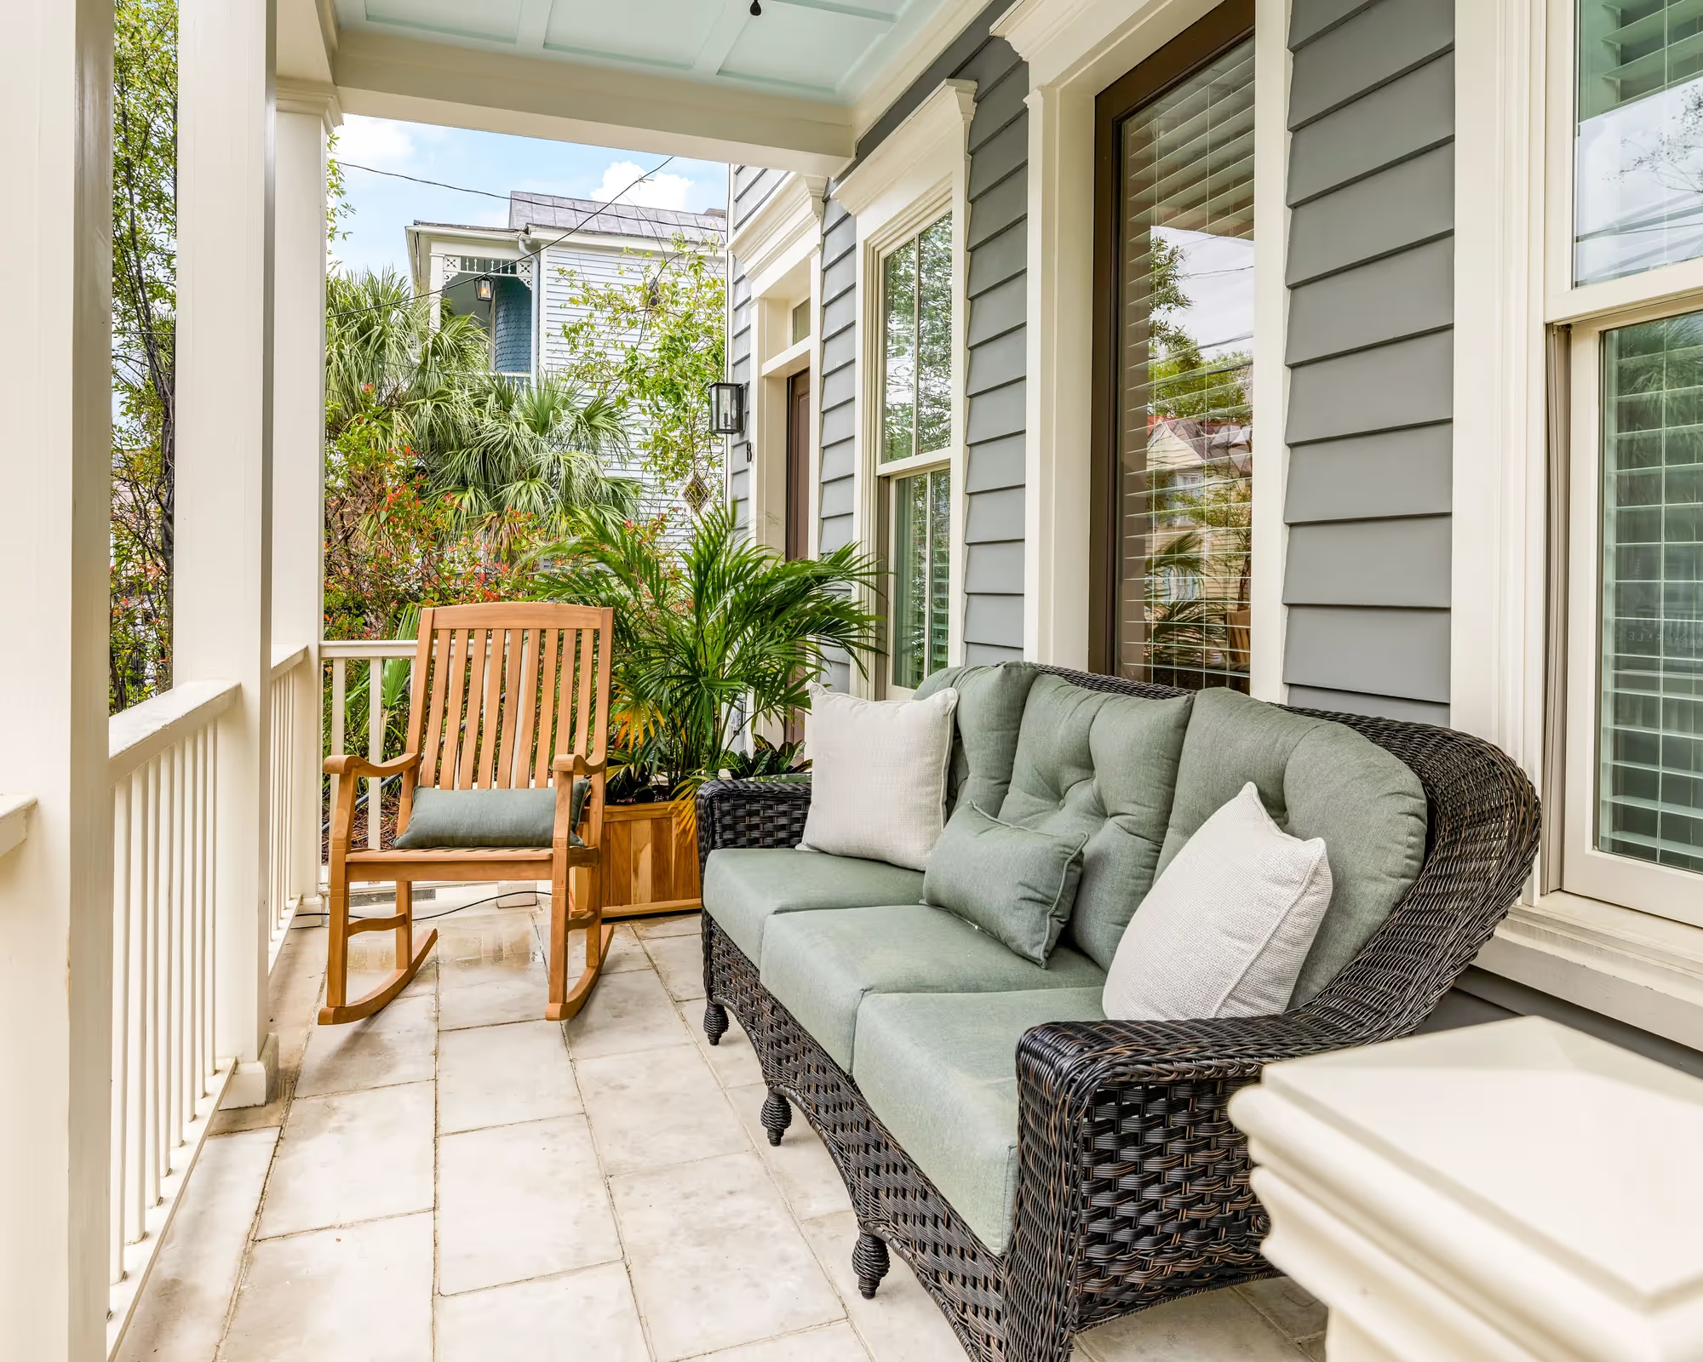
Luxury Boutique Hotels South Carolina
Discover the perfect mix of style and comfort at luxury boutique hotels in South Carolina, offering tailored experiences, elegant interiors & special service.

Slide 2
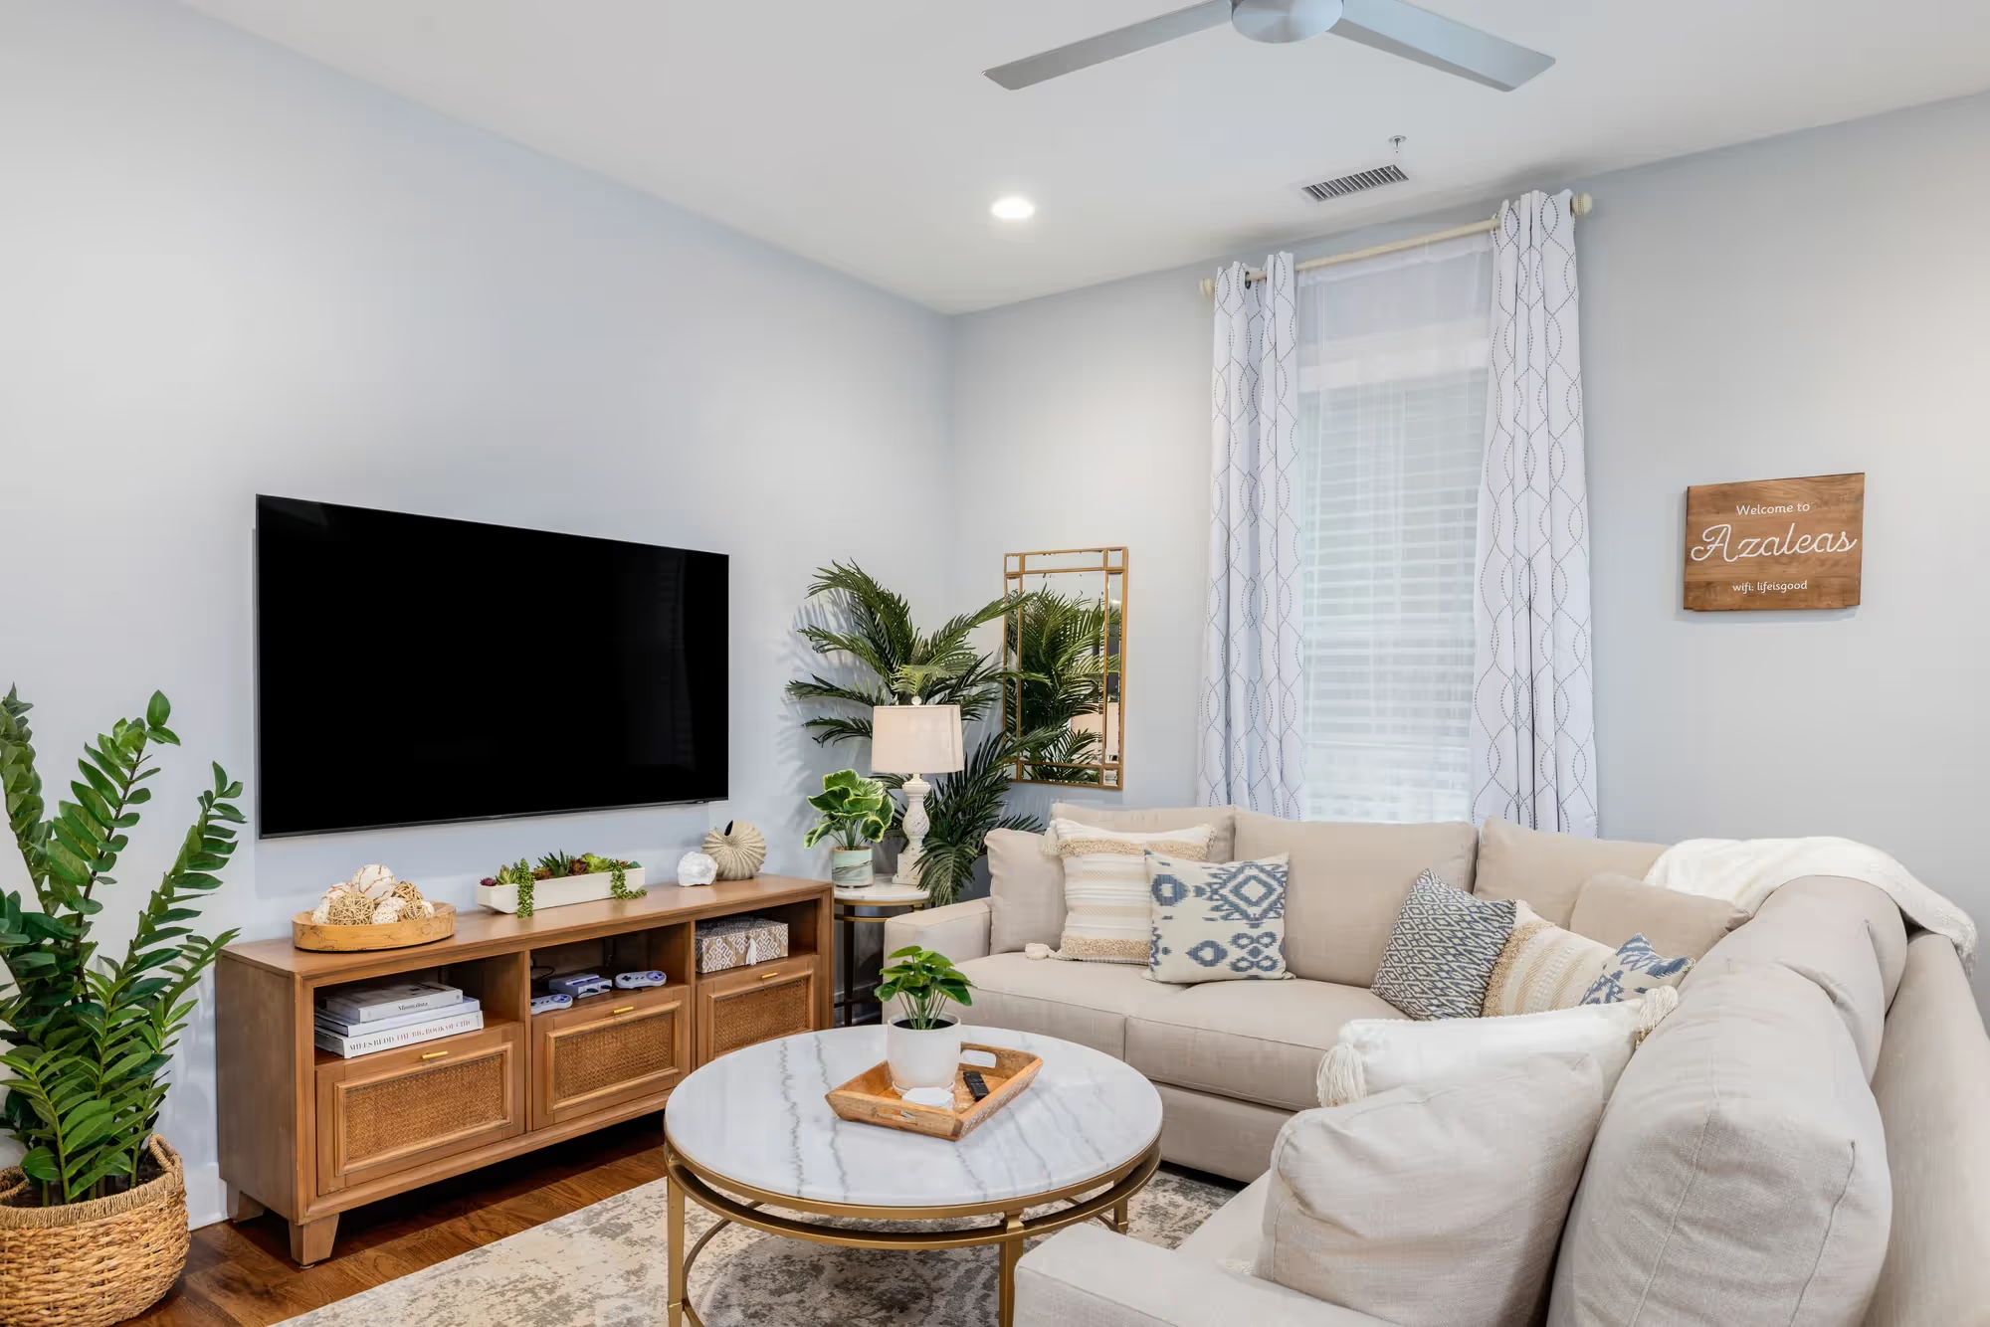
Best Luxury Stays in Charleston SC
Treat yourself to the best luxury stays in Charleston SC, where sophisticated design, top amenities & exceptional service create an unforgettable experience.

Slide 3
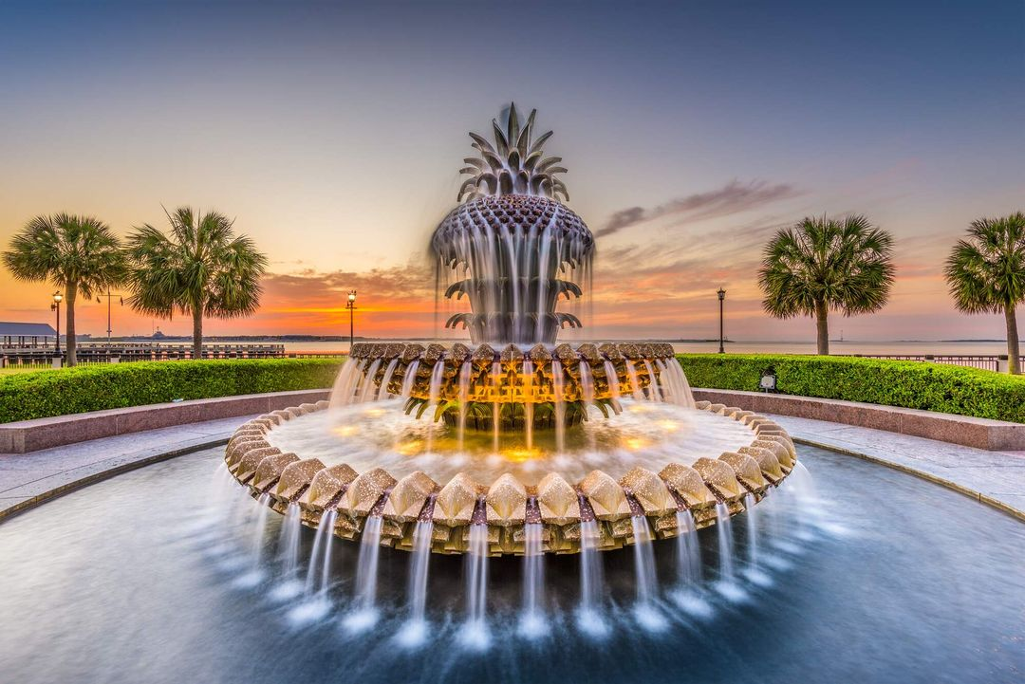
Charleston SC Rentals With Pool
Dive into relaxation with Charleston SC rentals with pool, featuring luxurious spaces, private pools & all the services you need for a fun & carefree getaway.

Slide 4

Contact Us
Lowcountry Getaway offers top-rated vacation homes in Charleston, SC, with 1,000+ reviews. Our properties include Azaleas, Palms, Rosé Getaway, and Wave Watcher, each with unique amenities.
182 Saint Philip St, Charleston, SC, United States
+1 843-309-3060
https://www.lowcountrygetaway.com/

