Slide 1


Quora Web Solution
Website Design and
Development
Company
Web Design & Web Development
Company in Bangalore, India
www.quorawebsolution.com
+91 9986 056 909
info@quorawebsolutions.com
24A, 1st Main Rd, Chandra Reddy
Layout, Koramangala 4th Block,
Koramangala, Bengaluru,
Karnataka 560034

Slide 2
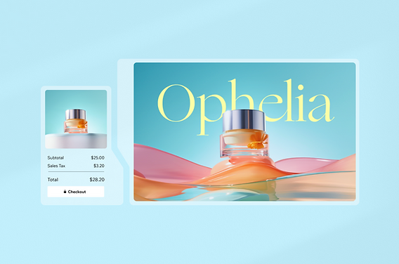
## Maximize Your Online Impact: Finding a Website Design & Development Company That Delivers
www.quorawebsolution.com

Slide 3
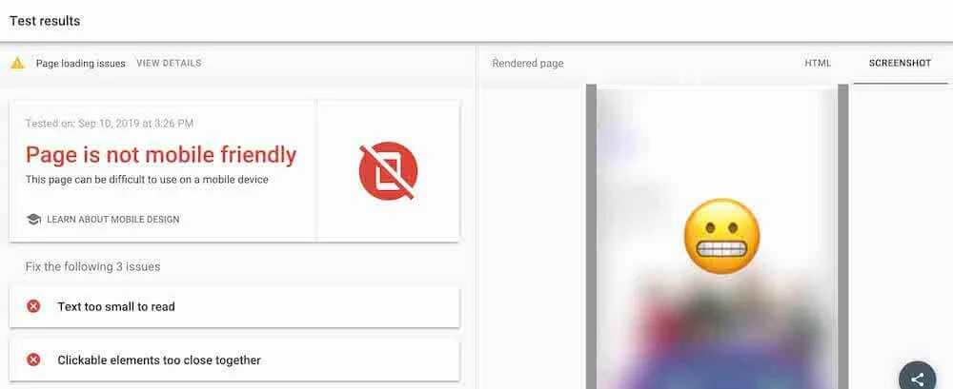
A robust online presence is indispensable for businesses thriving in today's digital landscape.
www.quorawebsolution.com

Slide 4
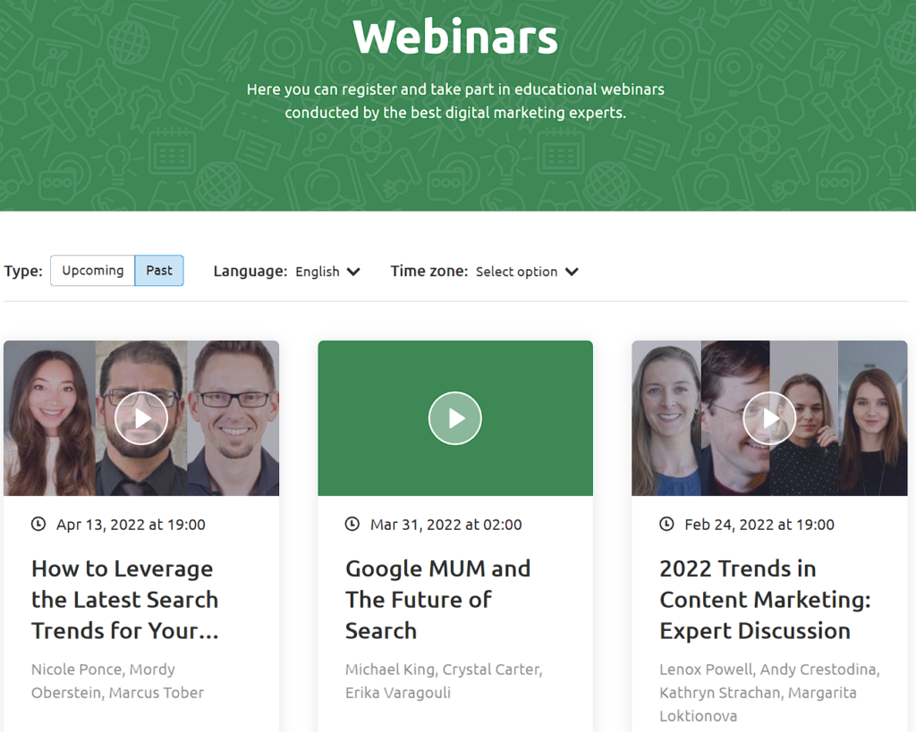
A company's website frequently serves as the initial point of contact for prospective clients, shaping their first perception of the brand.
www.quorawebsolution.com

Slide 5
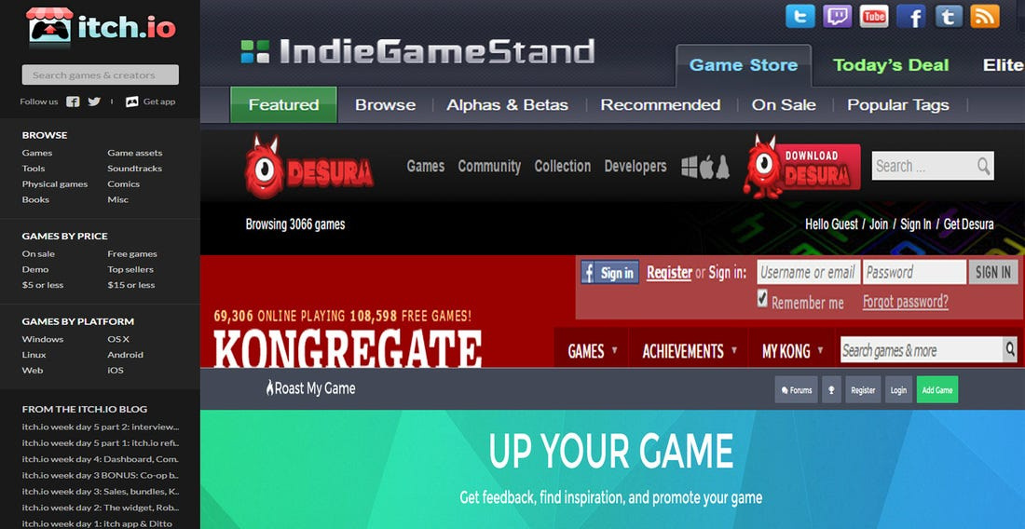
A poorly designed or outdated website can deter visitors, damage your credibility, and ultimately hinder your business growth.
www.quorawebsolution.com

Slide 6
That's where the right website design and development company comes in. Choosing the right partner can be a game-changer, transforming your online presence into a powerful tool for lead generation, customer engagement, and business success.
**Key Factors to Consider When Selecting a Website Design & Development Company:**
1. **Experience and Expertise:**
Prioritize companies with demonstrated experience within your specific industry. Understanding your business nuances allows them to create a website that resonates with your target audience.
www.quorawebsolution.com

Slide 7
* **Technical Proficiency:** Ensure they possess strong technical skills in web development technologies like HTML, CSS, JavaScript, and popular content management systems (CMS) like WordPress, Drupal, or Shopify.
* **Portfolio Review:** Analyze their past projects. Do their design aesthetics resonate with your preferred visual style? Do the websites they've created for other businesses in your industry appear successful and user-friendly?
2. **Communication and Collaboration:**
Investigate their project management methodologies. Do they use tools for effective communication, timelines, and progress tracking?
* **Client Communication:** Choose a company that prioritizes clear and consistent communication.
www.quorawebsolution.com

Slide 8
They should be readily available to answer your questions, provide regular updates, and actively involve you in the decision-making process.
* **Collaboration:** Look for a company that fosters a collaborative environment and values your input.
3. **Design and User Experience (UX):**
* **Design Aesthetics:** Does their design style align with your brand identity and target audience? Find a company that excels at creating websites that are both visually appealing and user-friendly.
* **User Experience (UX):** A well-designed website is not just visually appealing but also user-friendly. Ensure the company focuses on creating a seamless and intuitive user experience, making it easy for visitors to navigate and find the information they need.
www.quorawebsolution.com

Slide 9
* **Mobile Responsiveness:** In today's mobile-first world, a responsive website is crucial. Ensure the company creates websites that adapt seamlessly to different screen sizes (desktops, tablets, and smartphones).
4. **Services Offered:**
* **Comprehensive Services:** Consider companies that offer a comprehensive range of services beyond just design and development. These may include:
Consider companies that offer Search Engine Optimization (SEO) services to enhance your website's search engine rankings.
* **Content Marketing:** To create engaging and informative website content.
www.quorawebsolution.com

Slide 10
* **Digital Marketing:** To drive traffic to your website through various online channels.
* **E-commerce Solutions:** If you're an online retailer, choose a company with expertise in e-commerce platforms.
* **Maintenance and Support:** Ongoing support for website maintenance, updates, and security.
5. **Budget and Pricing:**
* **Transparent Pricing:** Discuss pricing models upfront. Are they transparent about their pricing structure and any potential hidden costs?
www.quorawebsolution.com

Slide 11
* **Value for Money:** While price is a factor, prioritize value for money. Consider the company's experience, expertise, and the quality of services offered.
**Finding the Right Partner:**
* **Online Research:** Start your search online. Look for reviews, testimonials, and case studies of potential companies.
* **Request Quotes:** Request quotes from several companies to compare pricing and services.
www.quorawebsolution.com

Slide 12
* **Schedule Consultations:** Schedule consultations with shortlisted companies to discuss your project requirements and get a better understanding of their approach.
* **Trust Your Gut:** Ultimately, choose a company you feel comfortable working with and trust to deliver exceptional results.
By carefully considering these factors and conducting thorough research, you can find a website design and development company that aligns with your business goals and helps you maximize your online impact. Remember, your website is a crucial asset for your business success, so investing in the right partner is an investment in your future.
www.quorawebsolution.com

Slide 13
## Boost Your ROI: Selecting a Website Design & Development Company That Drives Results
In today's hyper-competitive digital landscape, a well-designed and effectively developed website is no longer just a digital brochure; it's a crucial revenue driver. Your website is your 24/7 online salesperson, interacting with potential customers, building brand credibility, and ultimately driving conversions.
Choosing the right website design and development company is pivotal in maximizing your return on investment (ROI). This article will guide you through the selection process, focusing on key factors that ensure your website not only looks good but also delivers tangible business results.
**1. Define Clear Objectives and KPIs:**
www.quorawebsolution.com

Slide 14
* **Start with the end in mind:** Before embarking on your website development journey, clearly define your business objectives.
Is increasing online sales a primary objective?
* Generate more leads?
* Enhance brand awareness?
* Improve customer engagement?
* **Set measurable Key Performance Indicators (KPIs):** These will help you track your website's success.
* Examples include website traffic, conversion rates, bounce rates, time spent on site, and lead generation forms.
**2. Prioritize User Experience (UX) and User Interface (UI) design.
www.quorawebsolution.com

Slide 15
* **User-centric design:** A website that is difficult to navigate or visually unappealing will quickly drive visitors away.
* **Focus on usability:** Ensure the website is easy to use, with clear calls to action, intuitive navigation, and fast loading speeds.
* **Mobile optimization:** In today's mobile-first world, a responsive website that adapts seamlessly to different screen sizes is non-negotiable.
**3. Emphasize Search Engine Optimization (SEO):**
* **Choose a company with SEO expertise:** Ensure the company understands the importance of on-page and off-page SEO techniques.
www.quorawebsolution.com

Slide 16
* **Keyword research:** Work with the company to identify relevant keywords that your target audience is searching for.
* **Technical SEO:** Ensure the website is technically sound, with clean code, fast loading speeds, and a mobile-friendly design to improve search engine rankings.
**4. Leverage Data and Analytics:**
* **Data-driven decision making:** Choose a company that utilizes website analytics tools (like Google Analytics) to track website performance and identify areas for improvement.
* **A/B testing:** Experiment with different website elements (e.g., call-to-action buttons, page layouts) to optimize conversion rates.
www.quorawebsolution.com

Slide 17
* **Regular reporting:** Request regular reports on website performance to track progress and make data-driven adjustments.
**5. Focus on Content Marketing:**
* **High-quality content:** Invest in creating valuable, informative, and engaging content that resonates with your target audience.
* **Content strategy:** Develop a content strategy that aligns with your business goals and attracts organic traffic.
Distribute your content effectively across various channels, including social media, email marketing, and guest blogging.
www.quorawebsolution.com

Slide 18
**6. Build Long-Term Relationships:**
* **Choose a company that offers ongoing support:** Select a partner that provides ongoing maintenance, updates, and support to ensure your website remains secure and functional.
* **Open communication:** Maintain open and transparent communication with your chosen company throughout the entire project lifecycle.
**7. Don't Forget About Security:**
www.quorawebsolution.com

Slide 19
* **Data security:** Ensure the company implements robust security measures to protect your website and customer data from cyber threats.
Implement regular security audits to proactively identify and mitigate potential vulnerabilities.
By carefully considering these factors and selecting a website design and development company that aligns with your business goals, you can create a website that not only enhances your online presence but also drives significant ROI. Remember, your website is an investment, and choosing the right partner will ensure a successful return on that investment.
www.quorawebsolution.com

Slide 20
Quora Web Solution: Quora Web Solution is a trusted website development company based in Bangalore, India, offering a wide array of services to not only domestic but global clientele. Be it Website Design and Development, SEO services, Digital Marketing, Branding, App Development, Ecommerce Solution, and Logo Creation . Quora Web Solution has the best website developers offering top quality services and that is the reason why we are well known as one of the best Website Development Companies in Bangalore, India.
Visit Us - www.quorawebsolution.com
Call Us - +91 9986 056 909
Mail Us - info@quorawebsolutions.com
www.quorawebsolution.com

Slide 21

WORDPRESS DEVELOPMENT
ECOMMERCE DEVELOPMENT
PHP DEVELOPMENT
CMS DEVELOPMENT
DRUPAL DEVELOPMENT
WEBSITE SERVICES
WEBPORTAL DEVELOPMENT
MAGENTO DEVELOPMENT
WEBSITE DEVELOPMENT
JOOMLA DEVELOPMENT
SMALL BUSINESS DEVELOPMENT
CHEAP WEBSITE DEVELOPMENT
STATIC WEBSITE DEVELOPMENT
DYNAMIC WEBSITE DEVELOPMENT
WEBSITE DESIGN COMPANY
TOUR AND TRAVEL WEBSITE DEVELOPMENT
Services

