Slide 1
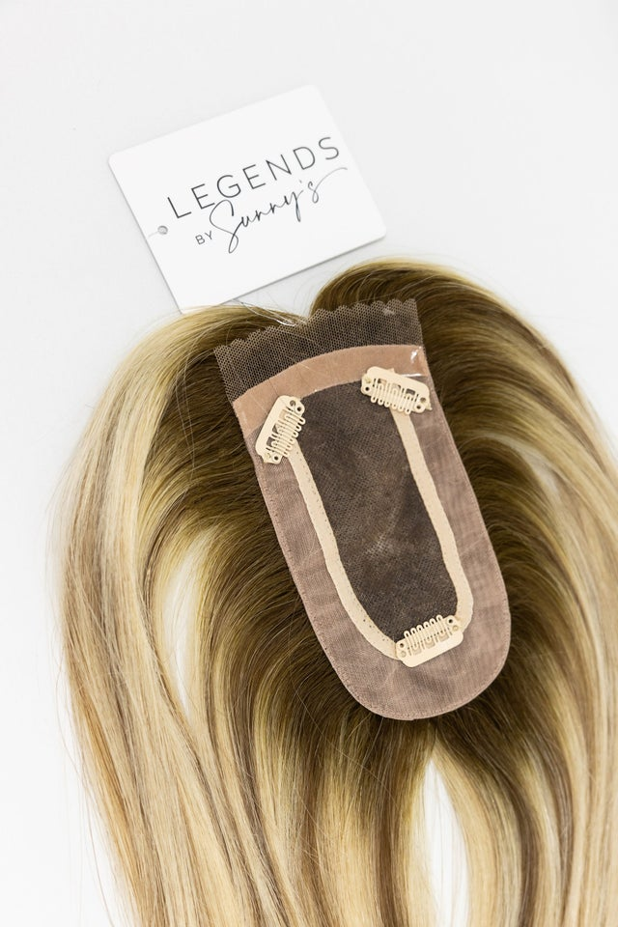
01
Toppers Hair Extensions
Enhance your style with toppers hair extensions, designed to add volume and a natural look, perfect for all hair types and easy to blend seamlessly into style.

Slide 2
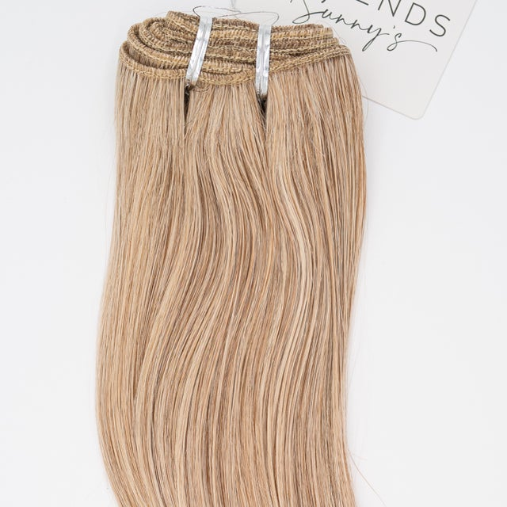
02
Genius Weft Hair Extensions
Discover our genius weft hair extensions that add volume, length, and a natural shine, all with an easy-to-apply method for a flawless and effortless style.

Slide 3
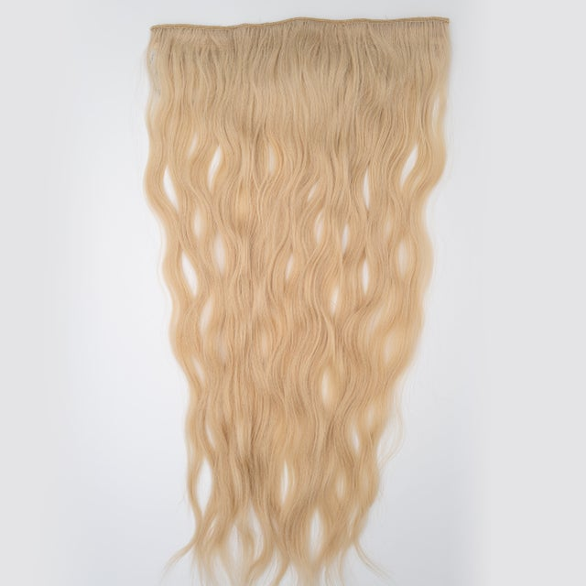
03
Short Hair Extensions
Upgrade your style with short hair extensions, which are designed to add volume & length, giving your shorter hair a fuller, more glamorous look in an instant.

Slide 4

Contact us
Legend's by Sunny's provide exemplary human hair extensions and wigs, extraordinary customer service, and an extremely knowledgeable staff. Change Your Hair, Change Your Life with us!
Address: 2035 S Alma School Rd, Mesa, AZ, 85210 United States
Website: https://www.legendsbysunnys.com/

