Slide 1
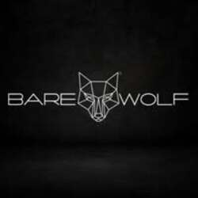
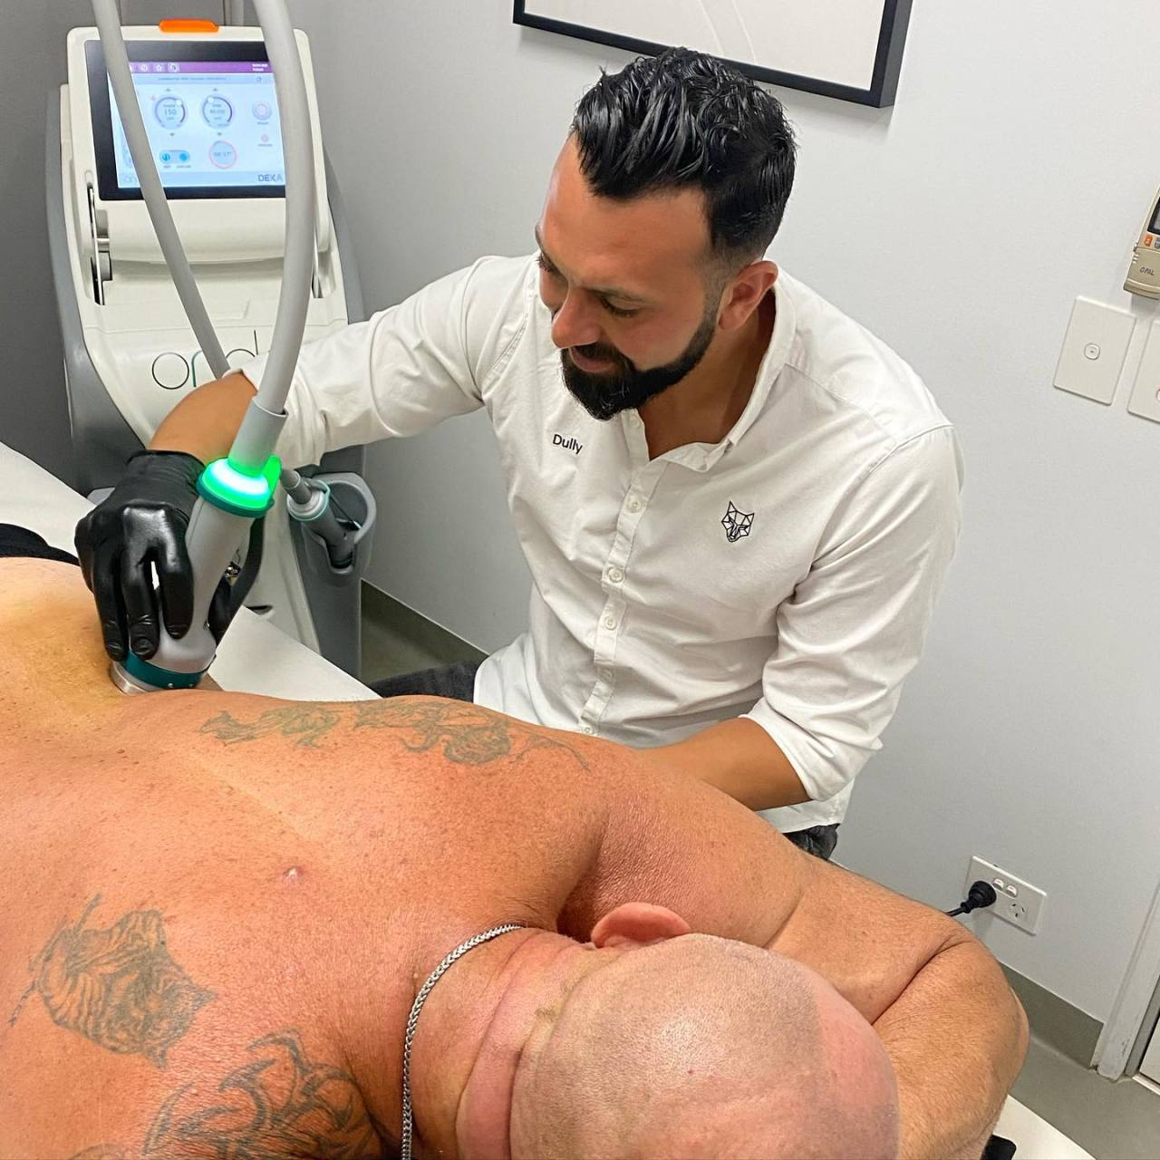
Simple Guide To Choosing The Right Laser
Technology For Male Hair Removal in Sydney

Slide 2
Every skin tone reacts differently to light energy, and every hair type absorbs heat in its own way. At Bare Wolf Sydney CBD, focus on matching the right technology to your skin, not forcing one solution on everyone. Here, we guide you on how to make wise decisions that will serve your skin well.
Understanding Laser Technologies and Skin Types
The laser systems focus on the hair pigment, while also protecting the surrounding skin. Skin tone, the colour and thickness of your hair, and your individual body reaction all factor in when your body responds to the laser systems. We always start with a consultation so we can understand how your skin reacts before we choose any setting or device.
We now use advanced machines that involve the use of more than one laser wavelength. This also enables us to customise as we react to how your skin responds to our treatment.
Types of Laser: Diode, Nd:YAG, and Alexandrite Explained
Each kind of laser has its own use, and by knowing the difference, you will feel confident.
Diode lasers are suitable for most skin types and hair.
Nd:YAG lasers protect the darker skin by reaching the deeper layer.
Alexandrite lasers work faster for people with lighter skin and dark hair.

Slide 3
At Barewolf, we use technology that works best with your skin. This approach supports clients looking for Male Hair Removal Sydney who feel safe and comfortable, while still being effective.
Why Multi-Wavelength Systems Matter
Single-technology machines limit results. Multi-wavelength systems allow us to personalise treatments across different areas of your body. We adjust energy levels, pulse speed, and cooling based on your skin's response.
This flexibility often extends to clients seeking Men's Beard Laser Sydney treatments. Facial skin is the most sensitive of all, and combined laser systems might be the best option for reducing irritation while obtaining the same results.
Cooling Systems Safeguard Against Discomfort
Cooling systems are a key part of skin protection during Male Hair Removal Sydney. Advanced contact and air cooling systems prevent overheating on the skin’s surface and are quite comfortable during treatment. At our clinic, we value the importance of cooling systems in preventing redness, burns, and any form of skin pigmentation.

Slide 4
Deciding on a Clinic where You Come First
Technology should be used by qualified practitioners only. We train thoroughly, know skin science, and then use techniques depending on your hair growth pattern. We don’t rush through treatment.
The men who go for Men’s Beard Laser Sydney are provided with the necessary information and help. At Barewolf, we provide complete support in the process of skin care between your treatments.
Conclusion
The best results of laser hair removal are when expertise, technology, and trust are combined. Comfort, safety, and visible results are the spotlights of our clinic. Many of our clients return to Men's Beard Laser Sydney, as they can notice the enhancement with each treatment and are confident in our approach.

Slide 5
For More Details Contact Us :
Name: Barewolf
Address: 128 Castlereagh St, Sydney NSW 2000, Australia
Telephone: 61450385395
Email id: info@barewolf.com.au
Website: https://maps.app.goo.gl/kaqLf9n5Yei5rKDn7

