Slide 1
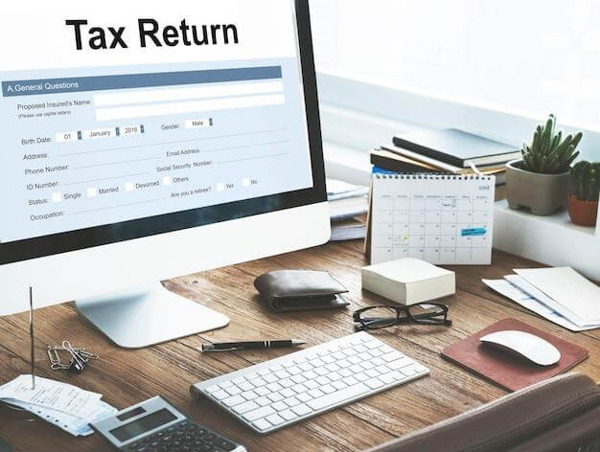
S Corporation Income Tax Return
Unlock the secrets to filing your S corporation income tax return with ease, reducing errors & avoiding penalties while staying compliant with California rules.

Slide 2

S Corporation Income Tax Return California
Get easy-to-understand tips to file your S corporation income tax return in California while ensuring all income and analyses are reported accurately & timely.

Slide 3

S Corporation Tax Return
Discover how to manage your S corporation tax return with ease by understanding forms, limits, & rules that keep your business compliant & financially secure.

Slide 4

CONTACT US
About: Business Taxes and More is your go-to destination for small business accounting & tax services that help lower your tax audit risks.
Address: 4455 Rockland Place Unit 10 La Canada Flintridge, CA 91011, USA
Website:- https://businesstaxesandmore.com/

