Slide 1




LEGAL SERVICES
4 Ways to Implement Technology into
Speech Therapy
WWW.CBSTHERAPY.COM

Slide 2
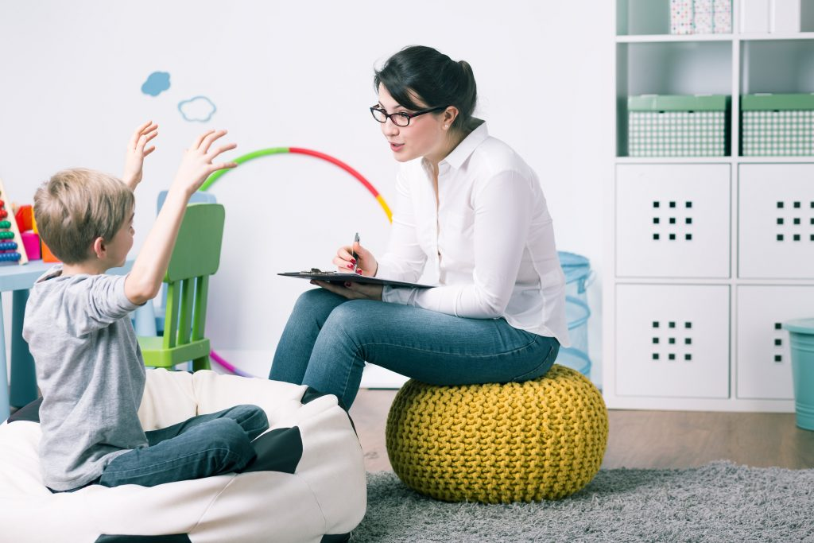

Introduction
Many SLPs had to turn their practices upside down this past year, with a majority of students learning from home instead of in person. One silver lining from this pandemic was discovering how beneficial technology can be to teaching speech therapy. Even with students back in the classroom, there are so many resources that can’t be left behind.
Technology isn’t a thing that was magnified during Covid and will dissipate. Online resources and live or asynchronous virtual classes are here to stay. They are convenient, accessible, and efficient. Use technology in your classroom in order to optimize your speech therapy practices.

Slide 3


Technology Ideas to Implement into Speech Therapy
Now is the time to embrace technology and implement it into your lessons with virtual and in-classroom students. Every child will be thrilled with the variety and familiarity. Take a look at some of following ideas:

Slide 4

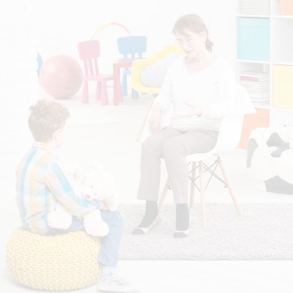

  4 Technology Ideas
01
Parent Involvement
02
Videos
03
No-Print Activities
04
Game

Slide 5
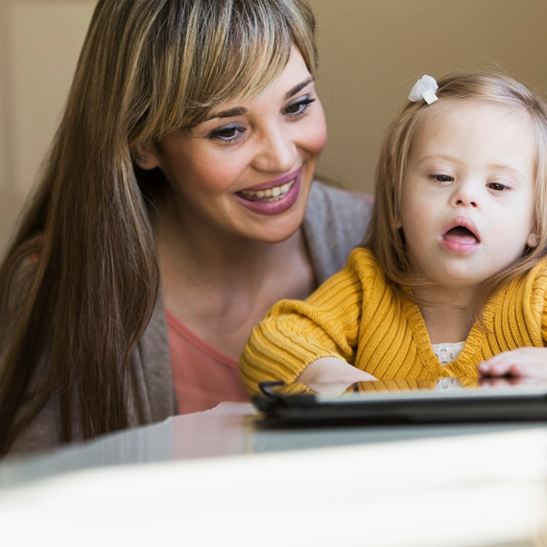

1. Parent Involvement
Sending videos between speech therapy lessons or teaching online will reach parents more than the occasional meeting at the school. Parents can see you in action and model how an SLP asks questions and encourages the students.

Slide 6





2. Videos
Use commercials, movie clips, and learning videos to teach your students. You can use the videos to work on the students’ vocabulary, articulation, recalling of details, and pointing out inferences. There are so many questions to get their brains thinking after showing a short video clip.

Slide 7
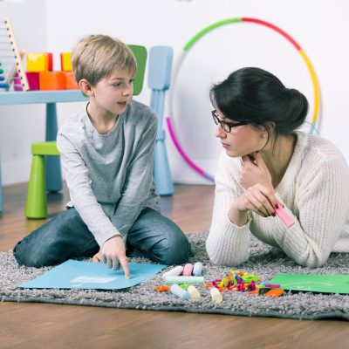

3. No-Print Activities
Many resources are available online that use interactive worksheets that require no printing. Few families have printers in their homes, so it is unrealistic to require printing in your lessons. Provide easy fill-in activities that will sharpen the student’s typing skills as well.
www.cbstherapy.com

Slide 8

There are endless games online that can be accessed for your speech therapy lessons. Choose an online matching game including works with s-blends, articulation games, or more. You can make speech therapy fun and collaborative with online activities. Children love the playful elements of these games and can learn and develop at the same time.
4. Game
It doesn’t matter whether you are teaching your students virtually or are able to meet face to face, switch things up with technology. You can personalize each lesson to their preferences. And most importantly, make the student look forward to speech therapy.

Slide 9

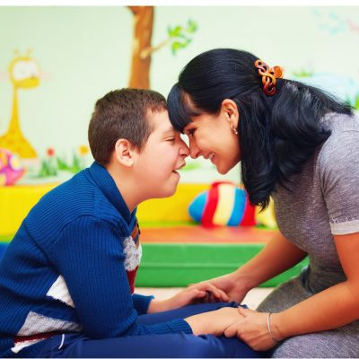
Finding the Balance with Technology
Technology can be a great support in SLP, but there is a balance to ensure the child isn’t in front of a screen too much. Research shows that too much screen time for younger children can potentially play a role in speech and language delays.
Don’t let technology or apps disrupt daily routines. Instead, use them as a supplement to enhance communication. With the right integration, technology encourages an interactive learning environment, supporting the needs of the child and their family.
CBS THERAPY

Slide 10

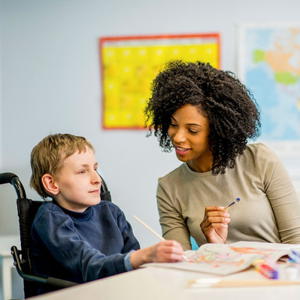





Contact Us
Website
www.cbstherapy.com
Phone Number
+1 401-952-4160
Location
845 North Main Street, Providence, Rhode Island 02904

