Slide 1

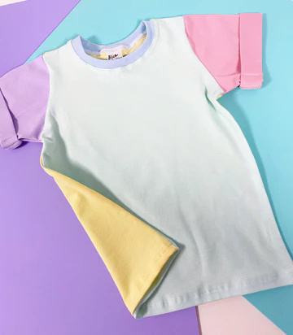
Raglan Sleeve Tee
Discover comfort and playful design with our raglan sleeve tee, made from soft fabrics, perfect for active days, layering, or casual everyday wear for kids.

Slide 2

Raglan Tops
Explore colourful and comfy raglan tops designed for all-day play, with bold prints, soft material, and styles that keep kids looking cool and feeling great.

Slide 3
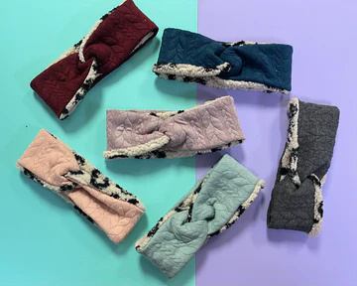
Handmade Hair Accessories
Choose our unique and stylish handmade hair accessories that bring charm to any outfit, from bows to clips, each crafted with care and full of fun character.

Slide 4

About Us:
At Alice + Harry LTD, we design fun, comfy clothes for all ages. From twirly skirts to cozy tees, our handmade styles bring joy, colour, and comfort, crafted with love right here in West Yorkshire.
Address: Alice & Harry LTD, 2A Cross Hill
Hemsworth, WF9 4LQ , UK
Website: https://aliceandharry.co.uk

