Slide 1
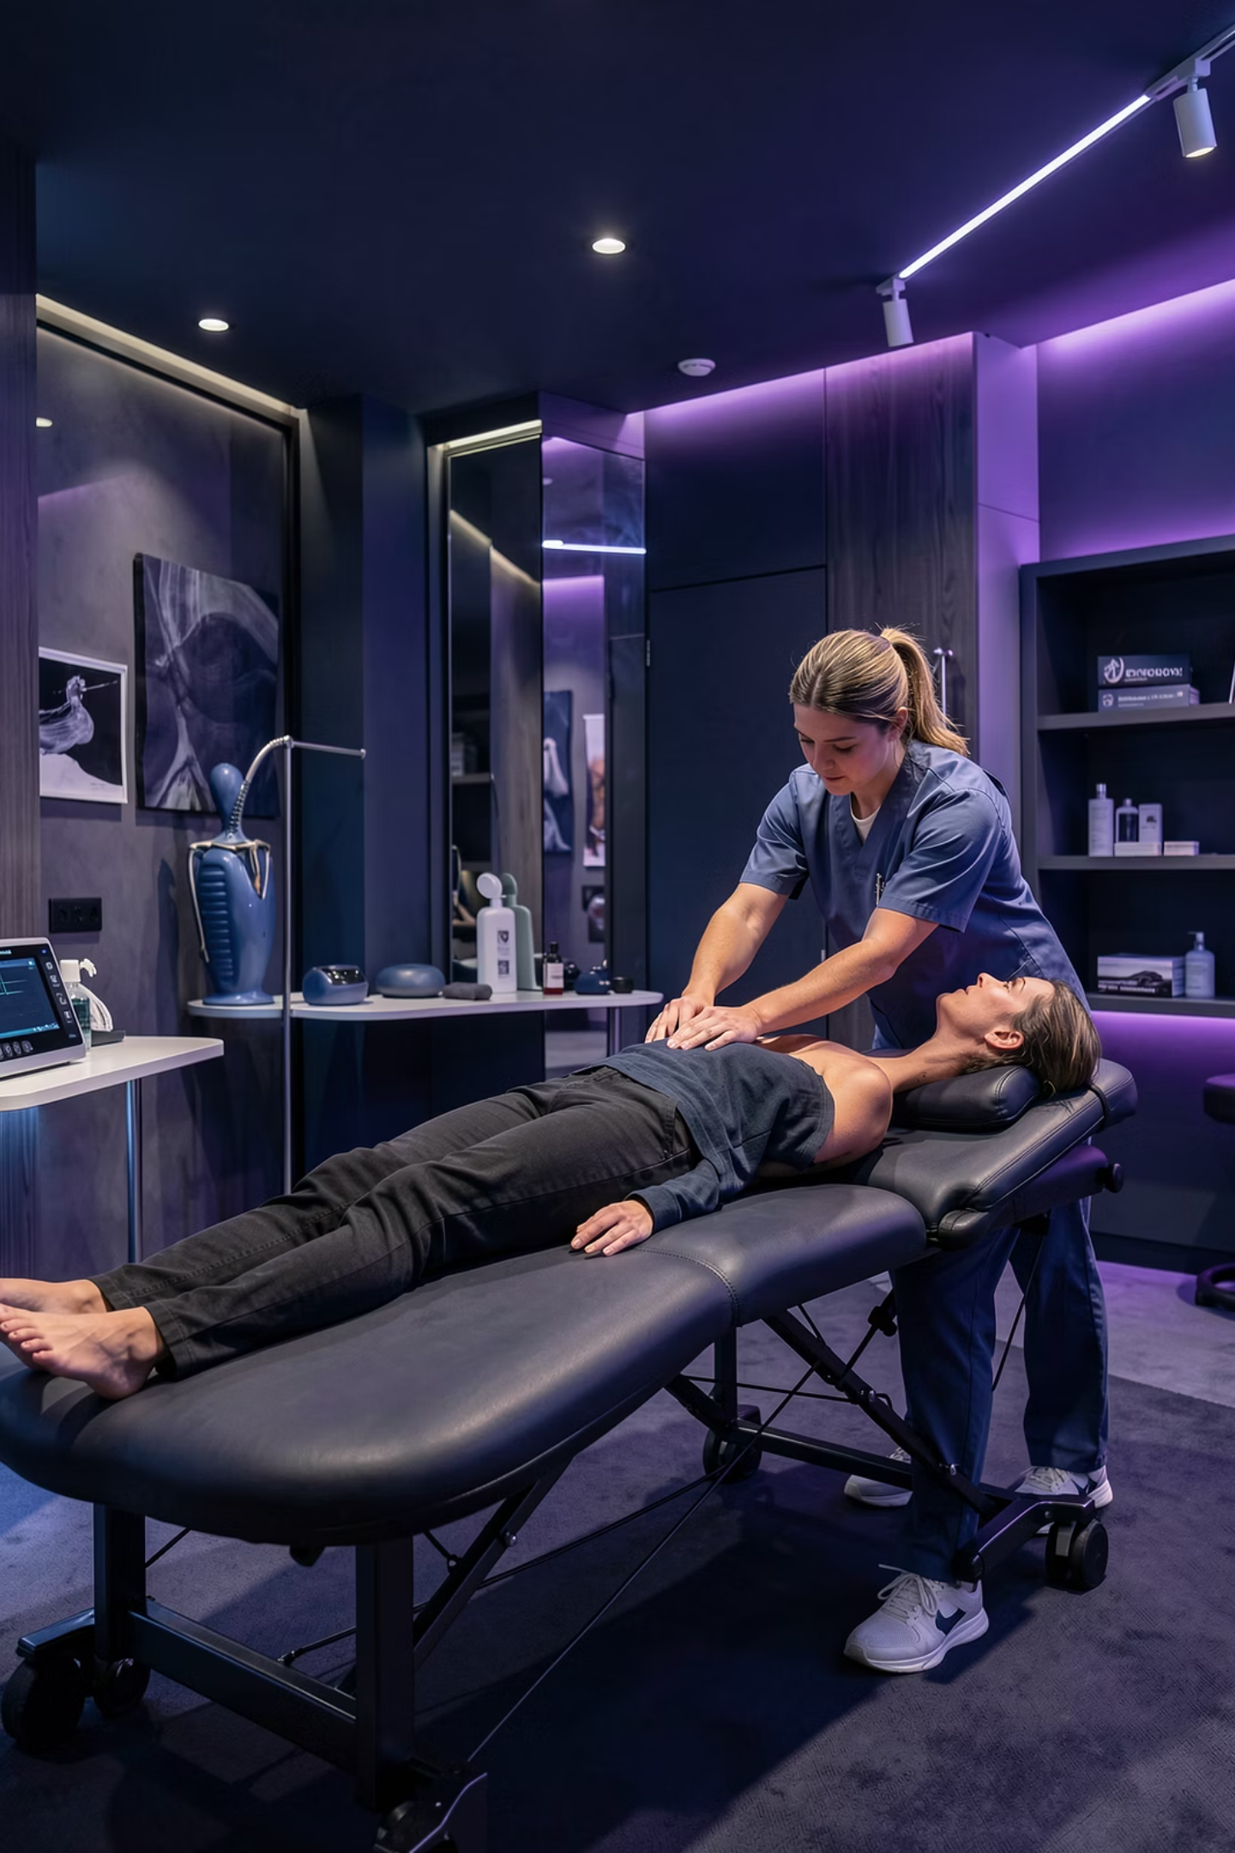
Musculoskeletal Physiotherapist Edinburgh for Expert Injury Care
Comprehensive injury assessment and structured rehabilitation for active recovery and lasting pain reliefIf you are looking for a highly experienced Musculoskeletal Physiotherapist Edinburgh residents can trust, Stuart Mailer Physio provides detailed assessment and structured rehabilitation for a wide range of injuries and pain conditions. Musculoskeletal physiotherapy focuses on problems affecting muscles, joints, ligaments, tendons, and nerves, helping individuals recover movement, reduce discomfort, and return to normal activity safely.

Slide 2
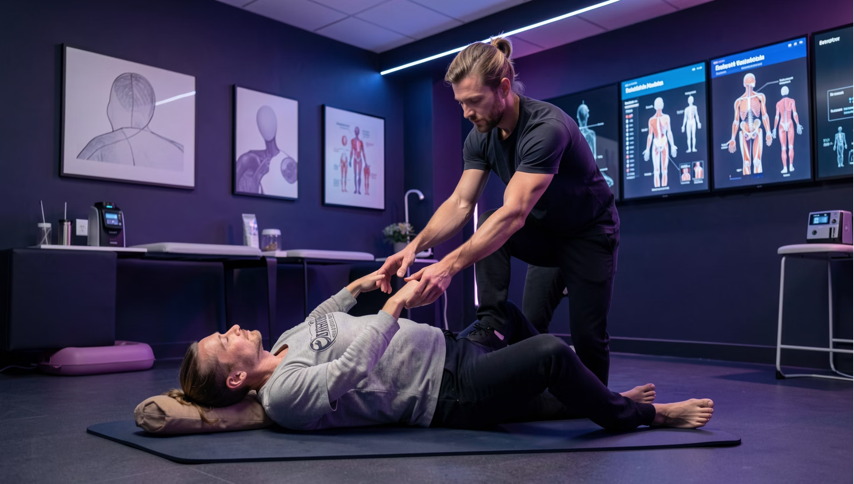

Pain Limiting Your Life?
Musculoskeletal physiotherapy addresses conditions affecting muscles, joints, ligaments, tendons, and nerves. Whether you're managing acute pain, chronic discomfort, or recovering from injury, expert treatment helps restore movement, reduce discomfort, and return to normal activity safely.
From persistent back pain to sports injuries, workplace strain to arthritis, targeted rehabilitation provides clarity and direction for your recovery journey.

Slide 3

Comprehensive Assessment Is Key
Effective treatment begins with understanding your complete condition. A thorough consultation includes detailed injury history, movement analysis, strength testing, and functional assessment.
Accurate Diagnosis
Targeted Treatment
Functional Analysis
Identify underlying causes of back pain, neck pain, shoulder injuries, knee problems, tendon irritation, and joint stiffness
Focus on the source, not just symptoms, for lasting results and prevention of recurrence
Assess movement patterns, strength deficits, and daily activity challenges unique to your lifestyle

Slide 4
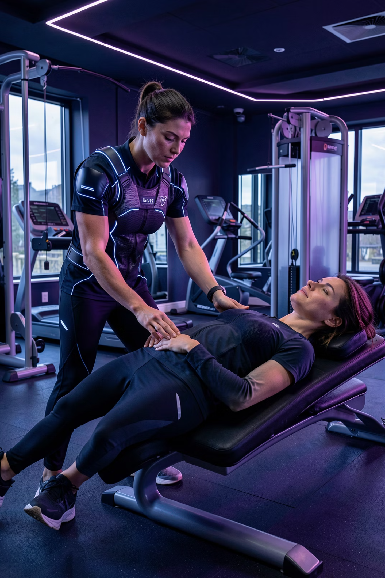
Personalized Rehabilitation Plans
01
Detailed Evaluation
Injury history, movement analysis, and functional testing to understand your unique situation
02
Tailored Program
Hands-on manual therapy, joint mobilization, soft tissue work, and progressive exercises aligned with your goals
03
Strength and Mobility
Integrated programs to restore function, prevent recurrence, and build resilience
04
Self-Management Skills
Education on load management, posture, and recovery strategies you can apply daily

Slide 5
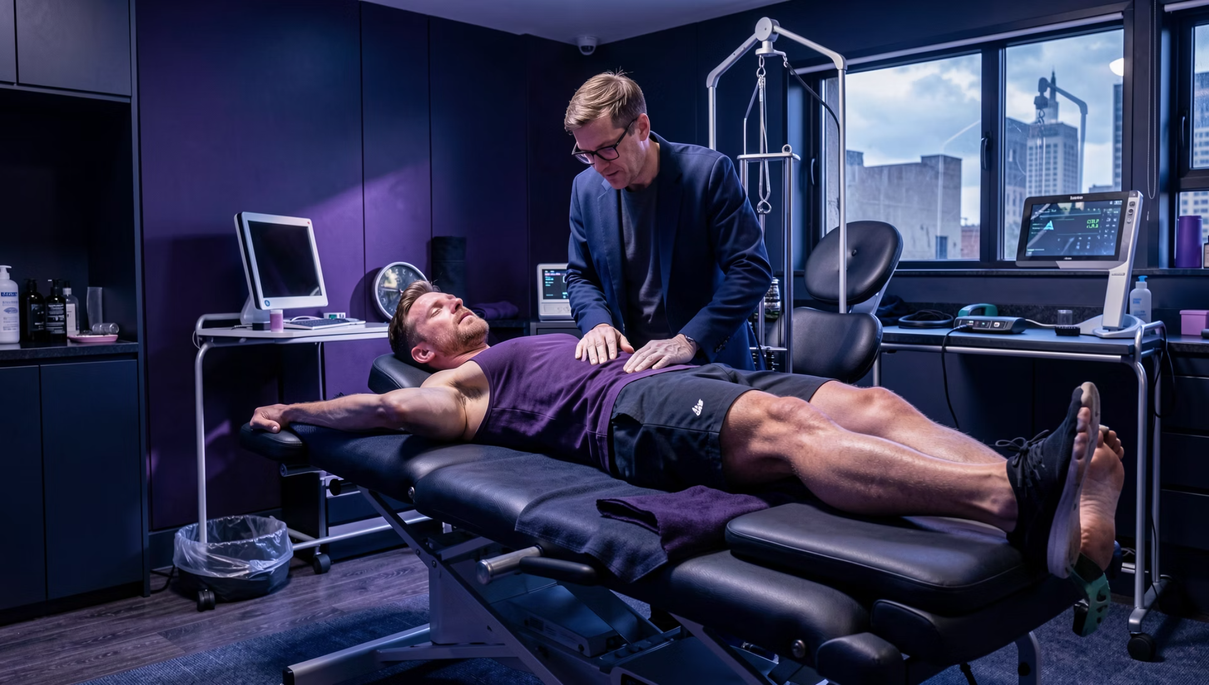
Supporting Active Lifestyles & Performance
For Active Individuals
Runners managing tendon pain
Gym enthusiasts recovering from strains
Athletes building resilience
Office workers with posture-related discomfort
Gradual loading strategies and sport-specific exercises ensure safe adaptation and renewed confidence in movement.

Slide 6
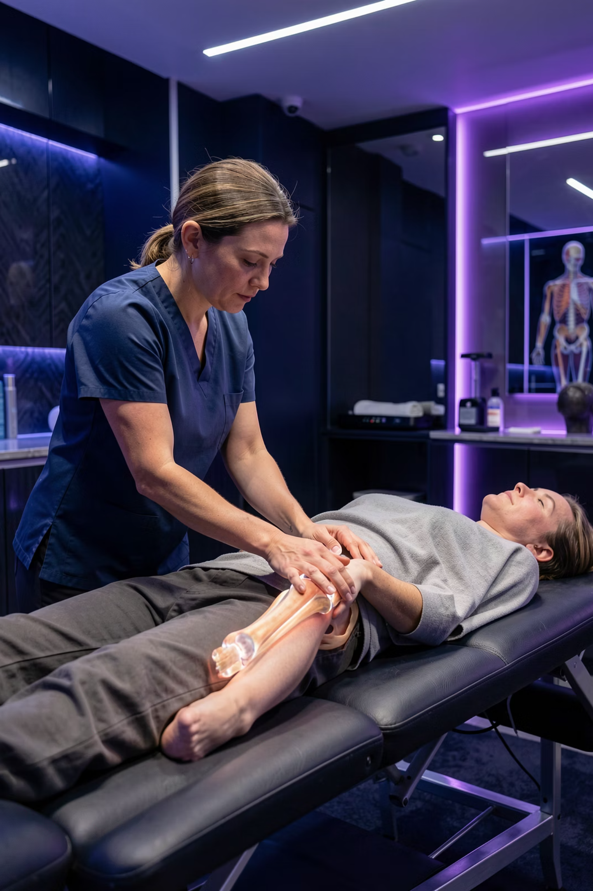
Acute & Chronic Condition Treatment
Acute Injuries
Recent sprains, muscle tears, and joint flare-ups benefit from early intervention to control pain and swelling while maintaining mobility through targeted treatment.
Chronic Conditions
Persistent back pain, osteoarthritis, and recurrent instability receive structured progression with regular reassessment as strength and tolerance improve over time.

Slide 7
Evidence-Based Care You Can Trust
One-to-One Attention
Clinical Expertise
Measurable Outcomes
Individual appointments allow focused care and tailored progression for your specific needs
Evidence-based practice combining experience with current research for optimal recovery
Clear goals, expert guidance, and structured rehabilitation for restored strength and mobility
Call Us
Email
Visit
0131 563 9449
Info@stuartmailerphysio.com
16 William Street
Edinburgh, EH3 7NH
United Kingdom
+44 7488 881344
Ready to restore your musculoskeletal health? Professional physiotherapy provides the clarity and direction you need for lasting recovery.

