Slide 1








Biggest Airport in the US: Discover America's Largest Aviation Hub
Focus: Denver International Airport (DEN) | Presenter Name | 2024
contact- +1-888-212-0809

Slide 2
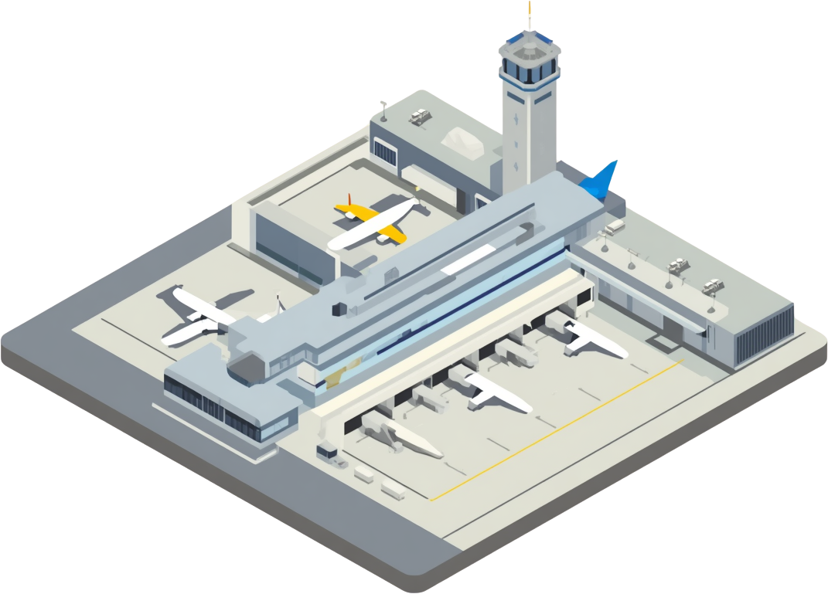

The Biggest Airport in the US
• Total land area: 33,531 acres (52.4 sq mi)
• Opened in February 1995
• Serves over 69 million passengers annually
• Largest airport in North America
• 2nd largest airport worldwide by land area
• Located 25 miles northeast of Denver, CO
Denver International Airport

Slide 3
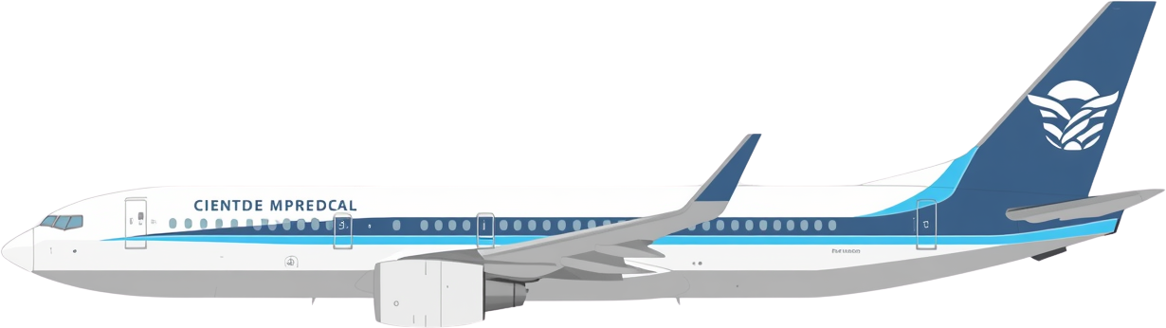




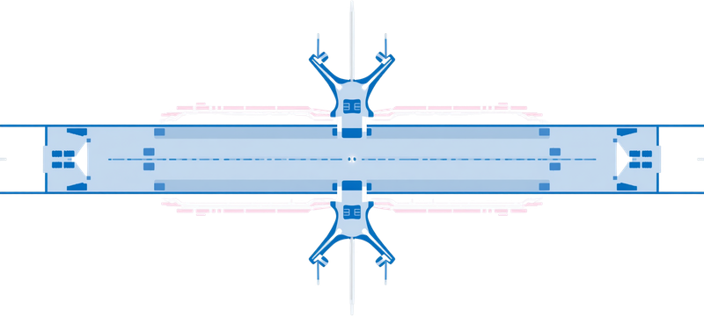

Biggest Airport in the US vs. Busiest Airport
DEN – Biggest by Size
ATL – Busiest by Traffic
Denver International Airport (DEN)
• Land area: 33,531 acres (52.4 sq mi)
• Largest airport in North America
• 2nd largest airport worldwide by area
• Opened: 1995
• Serves 69M+ passengers annually
• Metric: SIZE — DEN holds the record for the biggest airport in the US by total land area
Hartsfield-Jackson Atlanta (ATL)
• Annual passengers: 100M+
• Busiest airport in the US by traffic
• Busiest airport in the world by volume
• Consistently #1 for number of flights
• Smaller footprint than DEN
• Metric: TRAFFIC — ATL leads in passenger volume, not land size

Slide 4




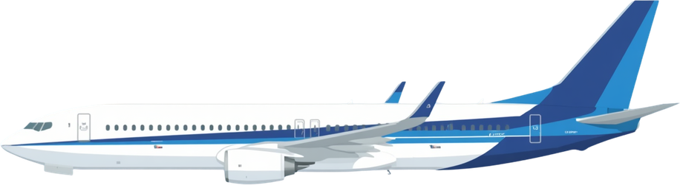
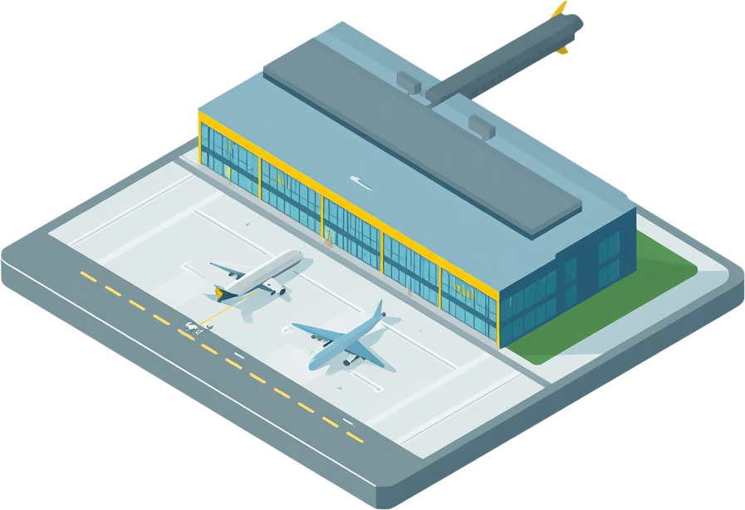
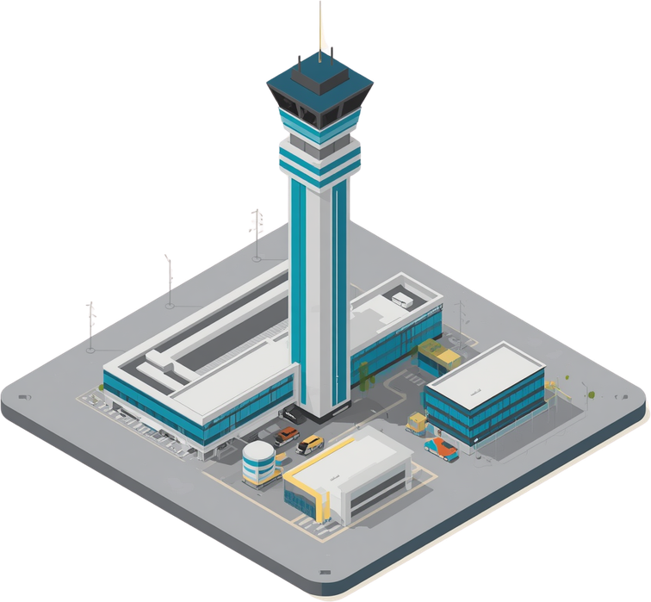

Comparing Major US Airports
• Denver Intl (DEN)
Land: 33,531 acres
Passengers: 69M/yr
Flights: ~600K/yr
• Hartsfield-Jackson (ATL)
Land: 4,700 acres
Passengers: 100M+/yr
Flights: ~900K/yr
• Dallas/Fort Worth (DFW)
Land: 17,207 acres
Passengers: 73M/yr
Flights: ~700K/yr
• Los Angeles Intl (LAX)
Land: 3,500 acres
Passengers: 88M/yr
Flights: ~600K/yr
• Chicago O'Hare (ORD)
Land: 7,627 acres
Passengers: 83M/yr
Flights: ~900K/yr
Key Insight: DEN leads in land area while ATL dominates in passenger volume and flight operations.

Slide 5



6 runways covering 39,045 feet total length, designed to handle simultaneous operations in all weather. Modern terminals feature state-of-the-art amenities for millions of travelers. DEN's iconic tent-shaped roof is an architectural landmark. Extensive cargo and maintenance facilities support round-the-clock aviation operations.
INFRASTRUCTURE

Slide 6








Economic Impact
• Supports over 30,000 jobs directly and indirectly across the Denver metro area
• Contributes over $33 billion annually to Colorado's economy
• One of the largest economic engines in the Rocky Mountain region
• Generates significant tax revenue supporting local infrastructure and public services
• Key hub for domestic and international connectivity linking over 200 destinations worldwide
• Boosts tourism and business travel, attracting millions of visitors to Colorado annually
• Supports local businesses, hotels, and hospitality sectors
• Drives growth in cargo, logistics, and freight industries across the region

Slide 7
Runway Extensions & Upgrades (by 2028)
New runway construction and upgrades to increase capacity and reduce delays.
Terminal Expansions
Expanded gates and passenger facilities to accommodate growing traffic beyond 80M annually.
Sustainability Initiatives
Green energy, solar installations, and eco-friendly infrastructure enhancements.
Airline Partnerships
Collaborations to add new domestic and international destinations from DEN.
FUTURE EXPANSION

Slide 8
Summary
Denver International Airport (DEN) holds the title of the largest airport in the US and North America by land area, spanning an impressive 33,531 acres (52.4 square miles). Opened in 1995, DEN continues to grow, serving over 69 million passengers annually with world-class infrastructure, six runways, and a uniquely iconic tent-shaped terminal roof.
DEN plays a critical role in the US aviation network and economy, supporting over 30,000 jobs and contributing billions to Colorado's economy each year. With ongoing expansion plans, sustainability initiatives, and increasing international connectivity, Denver International Airport is set to strengthen its position as America's premier aviation hub for decades to come.

Slide 9
Thank You
for Your Attention
Questions?
contact- +1-888-212-0809

