Slide 1





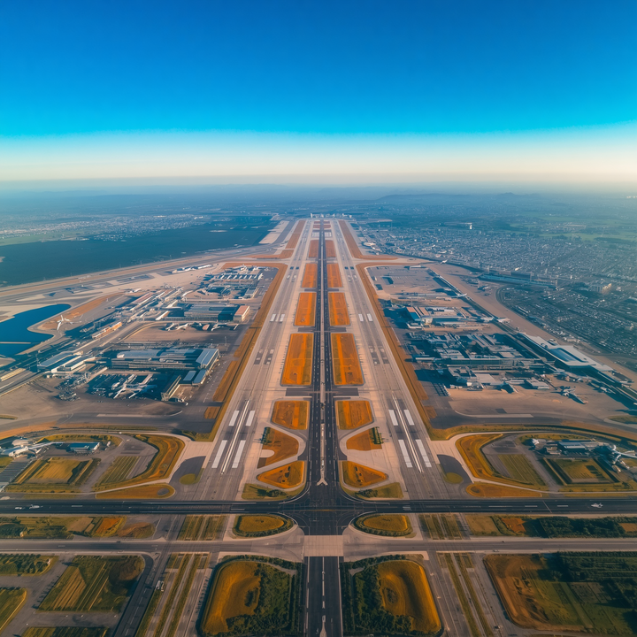

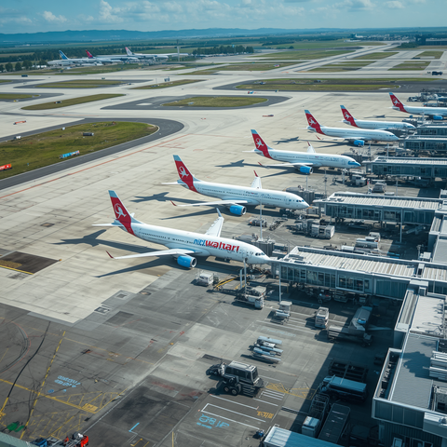
Airport Size & Infrastructure Presentation
TOP 5 LARGEST AIRPORTS IN THE UNITED STATES
Exploring the Biggest Airports in the US by Land Area
Presented By:
Daisy Parker
www.airflypolicy.com

Slide 2

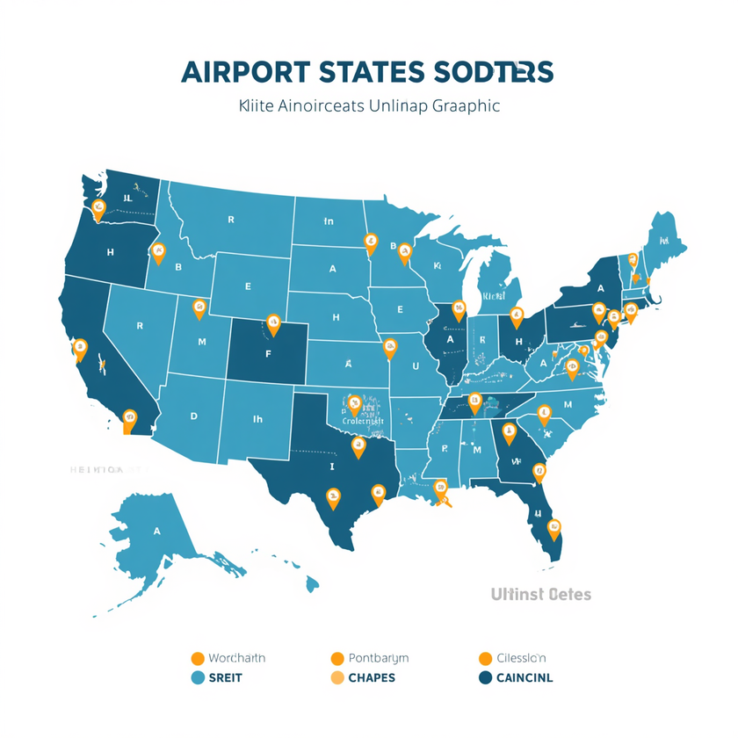

UNDERSTANDING THE BIGGEST AIRPORTS IN THE US
Airports are ranked by land area, highlighting the largest airport in the US. Size impacts operations, hub capacity, and the ability to serve millions of passengers — making the biggest airports in the US vital to national and global connectivity.
www.reallygreatsite.com

Slide 3
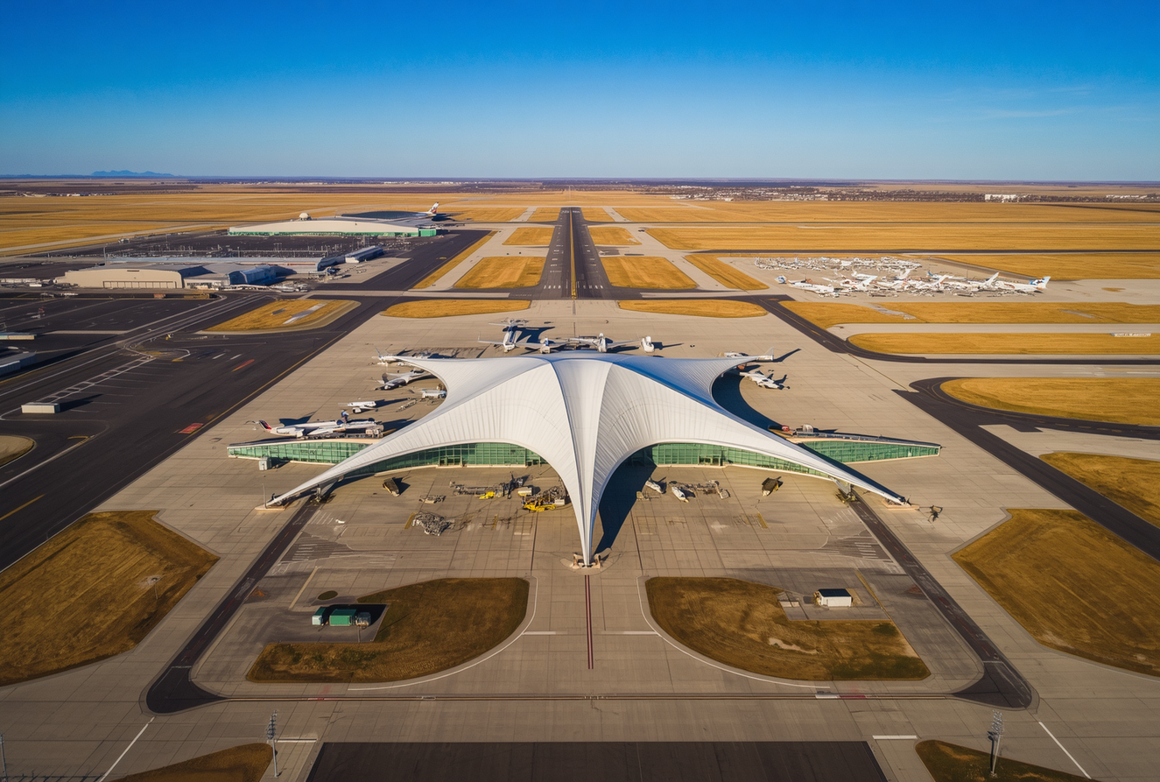

@reallygreatsite
Denver Int'l Airport (DEN)
Size: ~53 sq miles (33,531 acres) | Location: Colorado | Opened: 1995 | Hubs: United Airlines, Frontier Airlines — the largest airport in the US by land area.
DENVER
INTERNATIONAL
AIRPORT

Slide 4
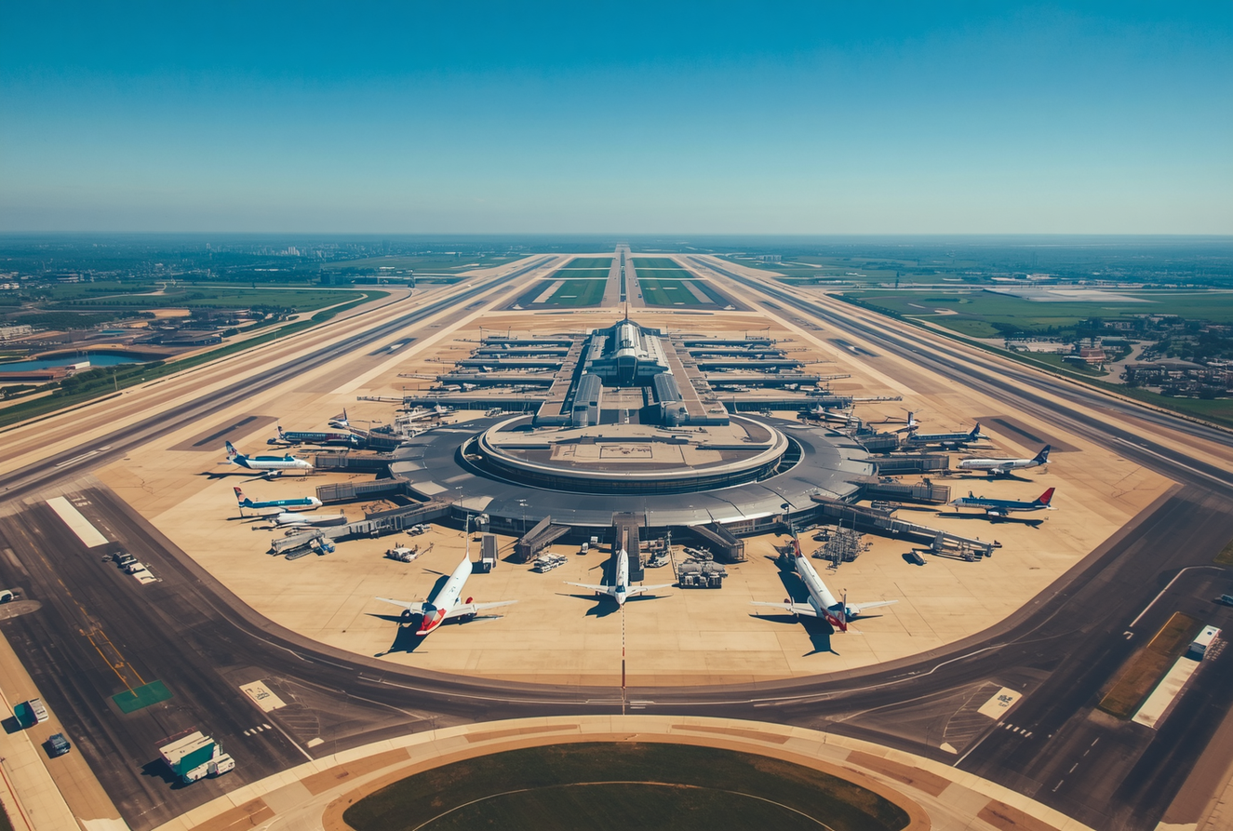

@reallygreatsite
Dallas/Fort Worth International Airport (DFW)
Size: ~27 sq miles (17,207 acres) | Location: Texas
Major hub for American Airlines. One of the busiest airports globally, serving over 70 million passengers annually.
DALLAS/
FORT WORTH

Slide 5
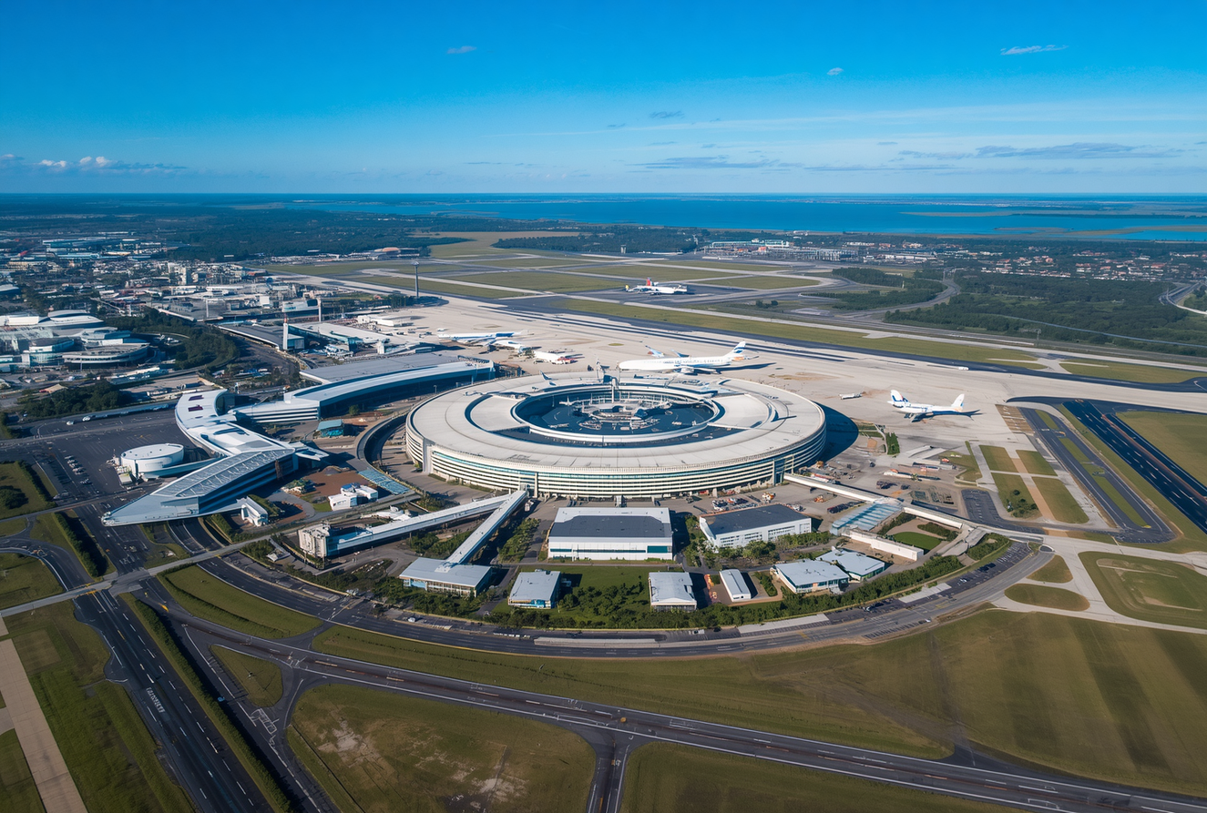

@reallygreatsite
MCO – Orlando, Florida
Spanning approximately 21 square miles (13,400 acres), MCO serves millions of visitors traveling to world-famous theme parks and attractions in Central Florida.
ORLANDO INTERNATIONAL
AIRPORT

Slide 6
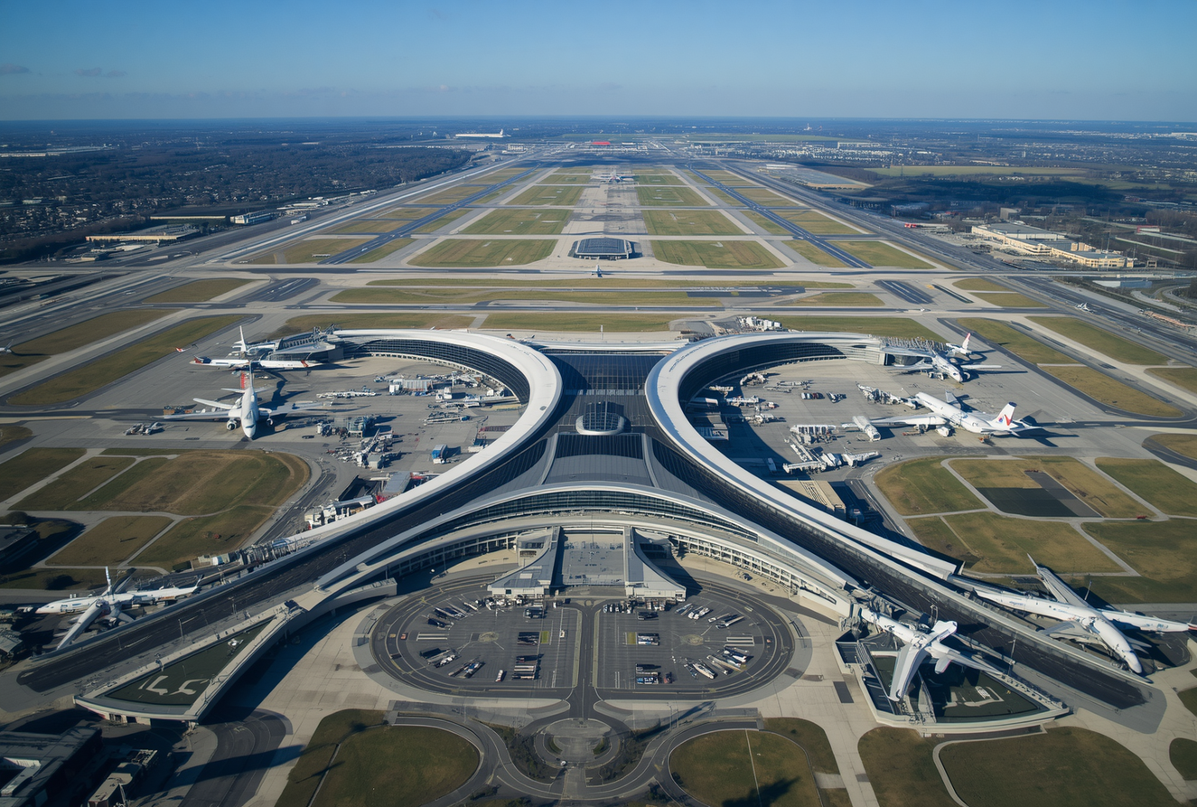

@reallygreatsite
Washington Dulles International Airport (IAD)
Size: ~20 square miles (13,000 acres) | Location: Virginia
Major international gateway serving the Washington D.C. metro area, connecting the capital region to destinations worldwide.
WASHINGTON
DULLES

Slide 7
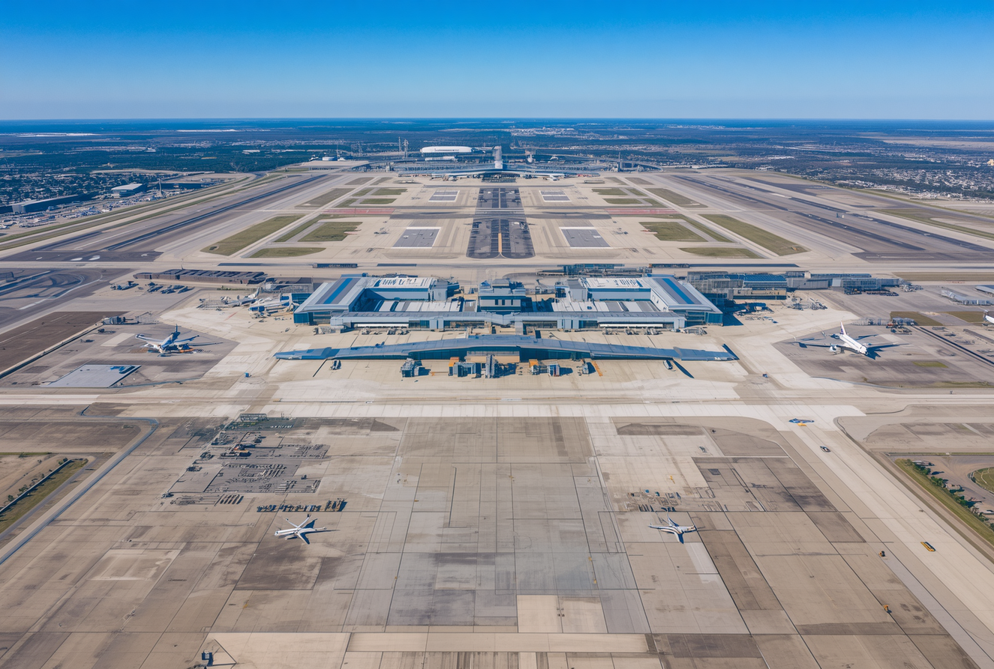

@reallygreatsite
George Bush Intercontinental Airport (IAH)
Size: ~17 sq miles (10,000 acres) | Location: Houston, Texas. Major hub for United Airlines and a key international gateway serving the southern United States.
GEORGE BUSH
INTERCONTINENTAL

Slide 8
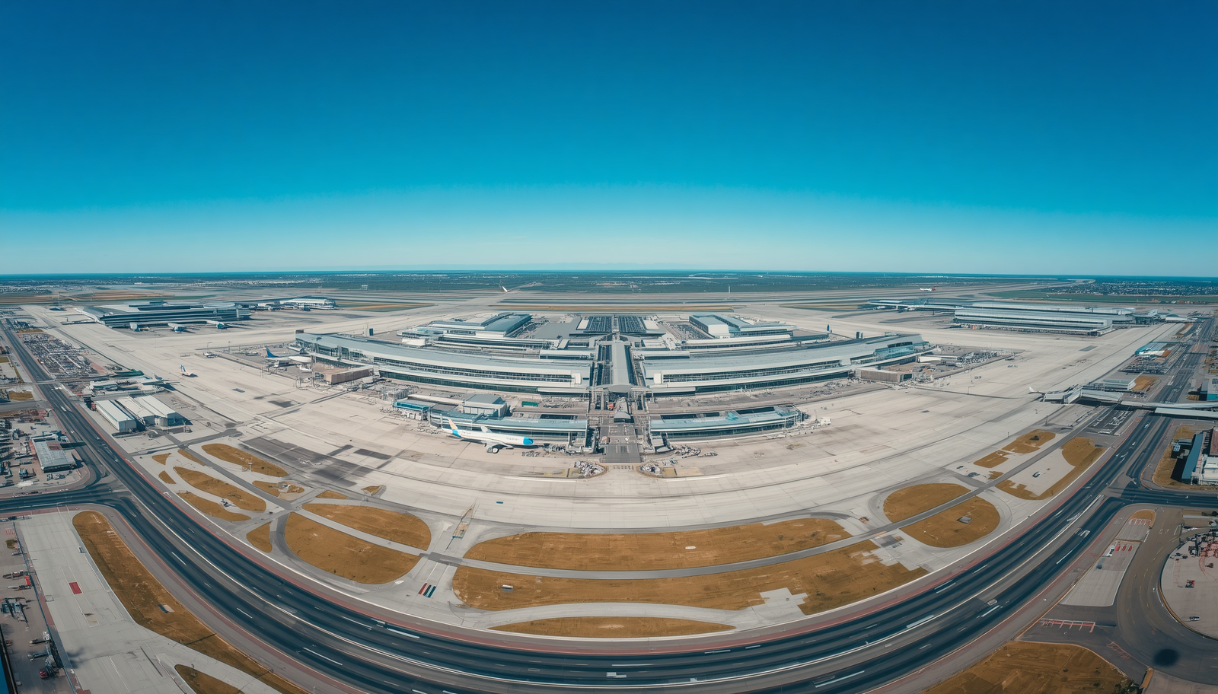


THANK YOU!
www.airflypolicy.com
+1-888-212-0809

